Slide 1





Creating Sustainable Funding for Higher Education
FERDINAND FUND
David Woodrow - President
10985 Pleasant Lake Rd. Manchester, MI 48158
(248)935-6973
theclfoundation@gmail.com
Notes:
The Community Link Foundation has developed a patented Purchasing Rewards Programs that brings together all parties involved in a purchasing transaction to also support philanthropy.

Slide 2







The Concept; Direct Purchasing Rewards Towards Children
Bank Reward
1%
Bank Reward
1%
Merchant Reward
1-3%
Online Retailer Reward
3%
Up to 4%
Tax deductible
Notes:
Whether purchasing directly through a local merchant, at a retail location, or online, a Community Link Rewards Card directs much needed funding to a nonprofit organization chosen by the card holder.

Slide 3
What is Community Link?
Many financial institutions and merchants spend 1-4% or more of every sale on marketing – as consumer rewards.
Community Link reaches out to communities to transform these marketing dollars into charitable contributions.
Participating charities are invited to market Community Link fundraising programs to supporting businesses and individual consumers.
We're a foundation that doesn't operate off of an endowment — we create endowments!

Slide 4
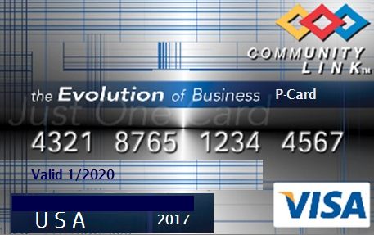
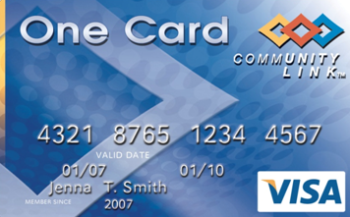
Three Sources of Revenue
Institutional Purchasing Card
Consumer Card
Ferdinand Loyalty Card for Education

Slide 5
Institutional Purchasing Cards through US Bank
Issued to supporting organizations offering;
1.5% Bank revenue sharing Committed to “Sustainable Higher Education” from consortium
1-4% optional vendor contributions

Slide 6
Community Link Consumer Card
Credit/debit cards offering;
1.5% Bank rewards
1-4% Vendor contributions

Slide 7
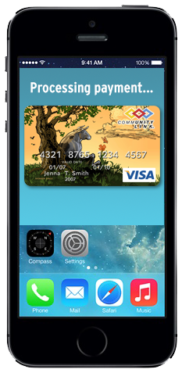
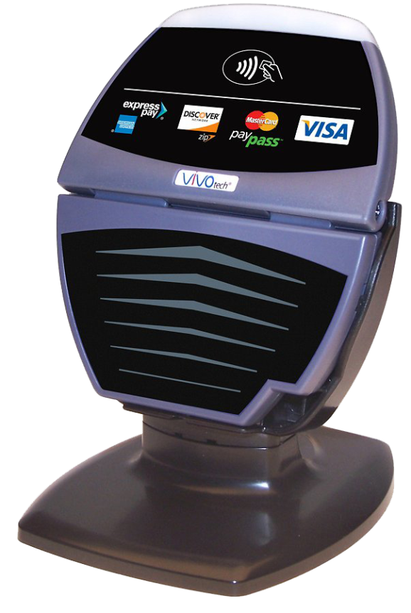
Ferdinand Fund Model; Bypassing the Banks
CLF to distribute dedicated processing hardware to local merchants providing;
1-4% guaranteed contributions off of every transaction
Optional “Every Penny Counts” dollar rounding
1-4% optional vendor contributions
Optional consumer match

Slide 8

Ferdinand 529 Merchant Rewards - Bypassing the Banks at Point of Sale
Loyalty card, not debit or credit card
Scale drives lower costs
Tax advantages (529)
Non tax advantaged
Equity returns
Glide path
http://communitylinkfoundation.org
8

Slide 9
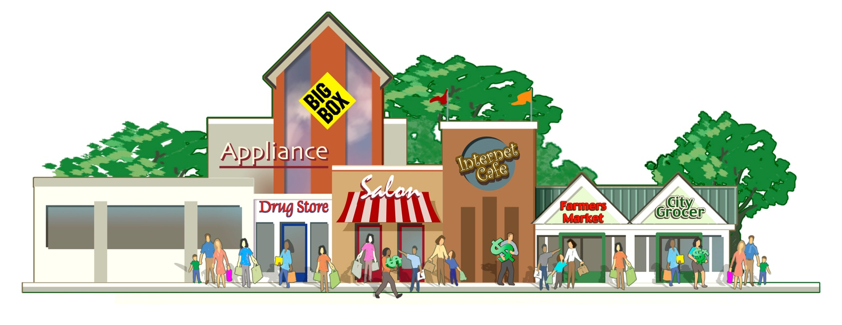
Merchant Benefits
Attract loyal new customers
Strengthen existing relationships
Streamline their giving programs
Tax-deductibility
New marketing channel and data resource
Enhanced reporting and reconciliation (reducing labor costs).
No need to extend credit.
Quicker payment (compare 2-3 days to 30 to 60 and sometimes 90)
Fewer collection issues and expenses.
Increased revenue and sales opportunities - more and more large businesses and government accounts REQUIRE their vendors to accept purchasing card payment.

Slide 10
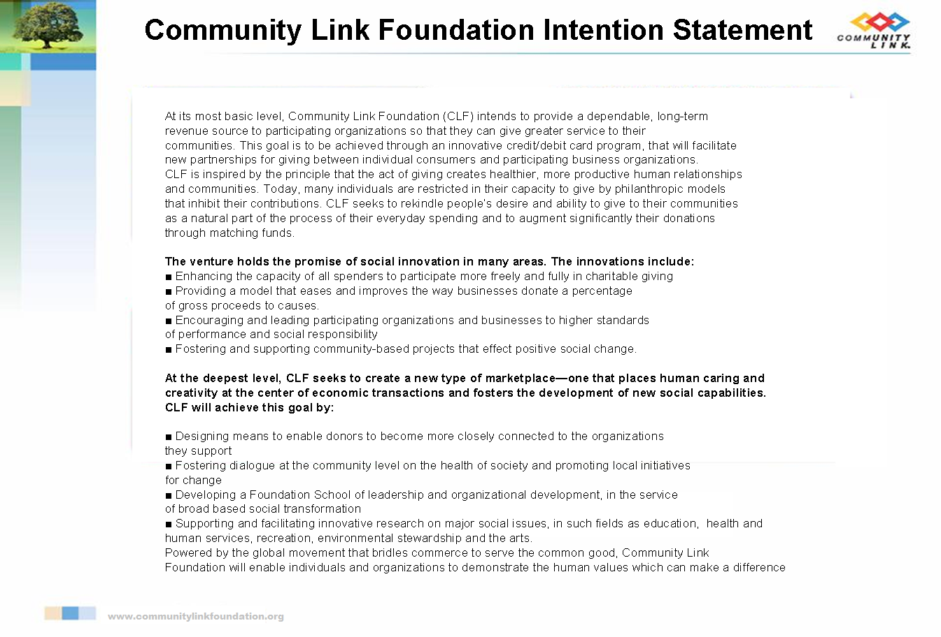

Slide 11



Taking Philanthropy
from the Last Dollar to the First

