Slide 1
http://www.free-powerpoint-templates-design.com
The Rumen

Slide 2
The rumen is the LARGEST of the four compartments of the stomach.
It is the FERMENTATION VAT where micro-organisms break down ingesta into nutrients that can be used by the animal
It occupies most of the LEFT half of the abdomen
It is divided into:
  DORSAL SAC- the uppermost part of the rumen
  VENTRAL SAC- the lower part of the rumen
    The cranial end of the ventral sac is called the RUMINAL RECESS
The dorsal and ventral sacs are separated by a depression called the LONGITUDINAL GROOVE (located on both the left and right side)
  Other grooves include:
    CRANIAL
    CAUDAL
    ACCESSORY
    CORONARY (located on both the left and right side)
The CRANIAL SAC is located between the RUMINORETICULAR FOLD and the CRANIAL GROOVE

Slide 3
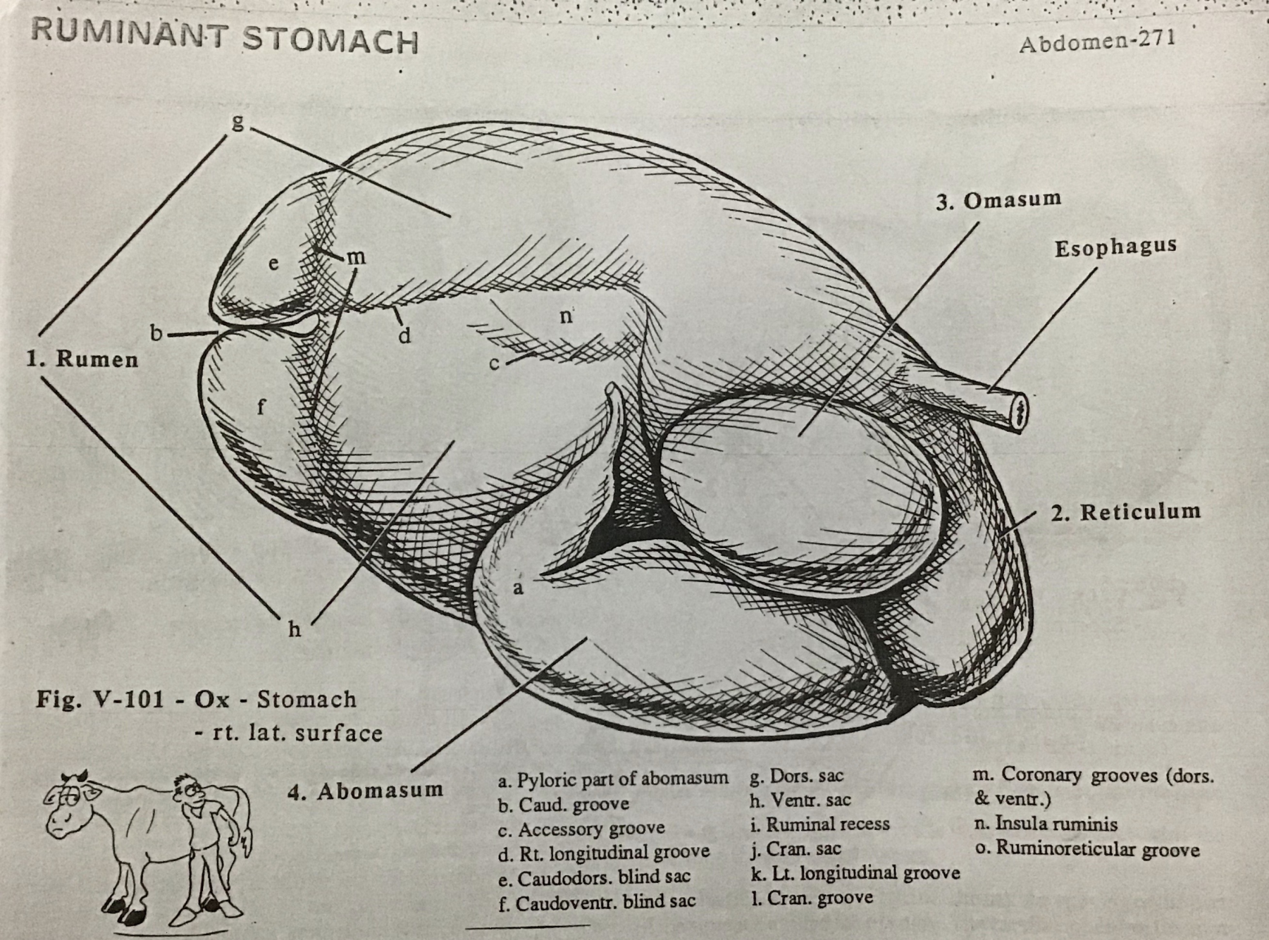
Right Lateral View

Slide 4
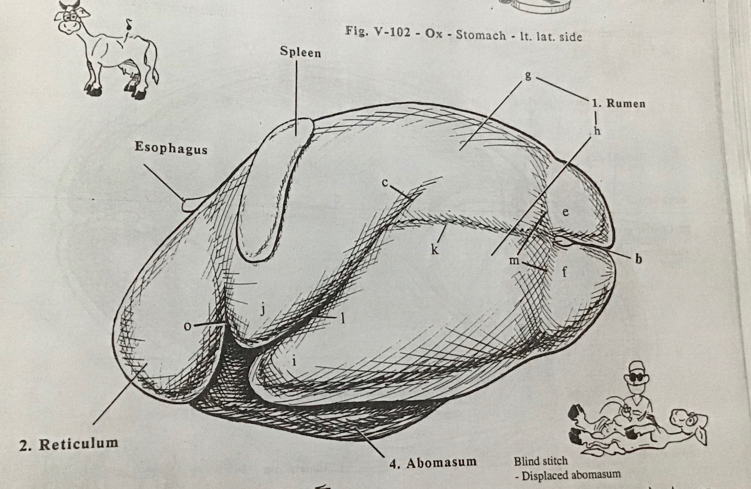
Left Lateral View

Slide 5
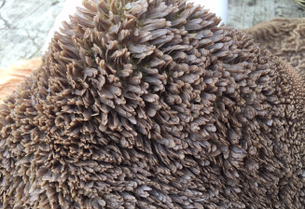
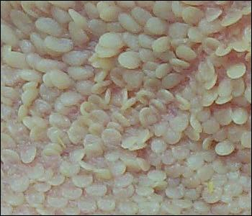
The PILLARS are the internal representation of the GROOVES (see next slide)
The CARDIAC OPENING is the where the oesophagus enters into the rumen
The internal surface of the rumen contains many mucosal projections called papillae that vary in shape and size

Slide 6
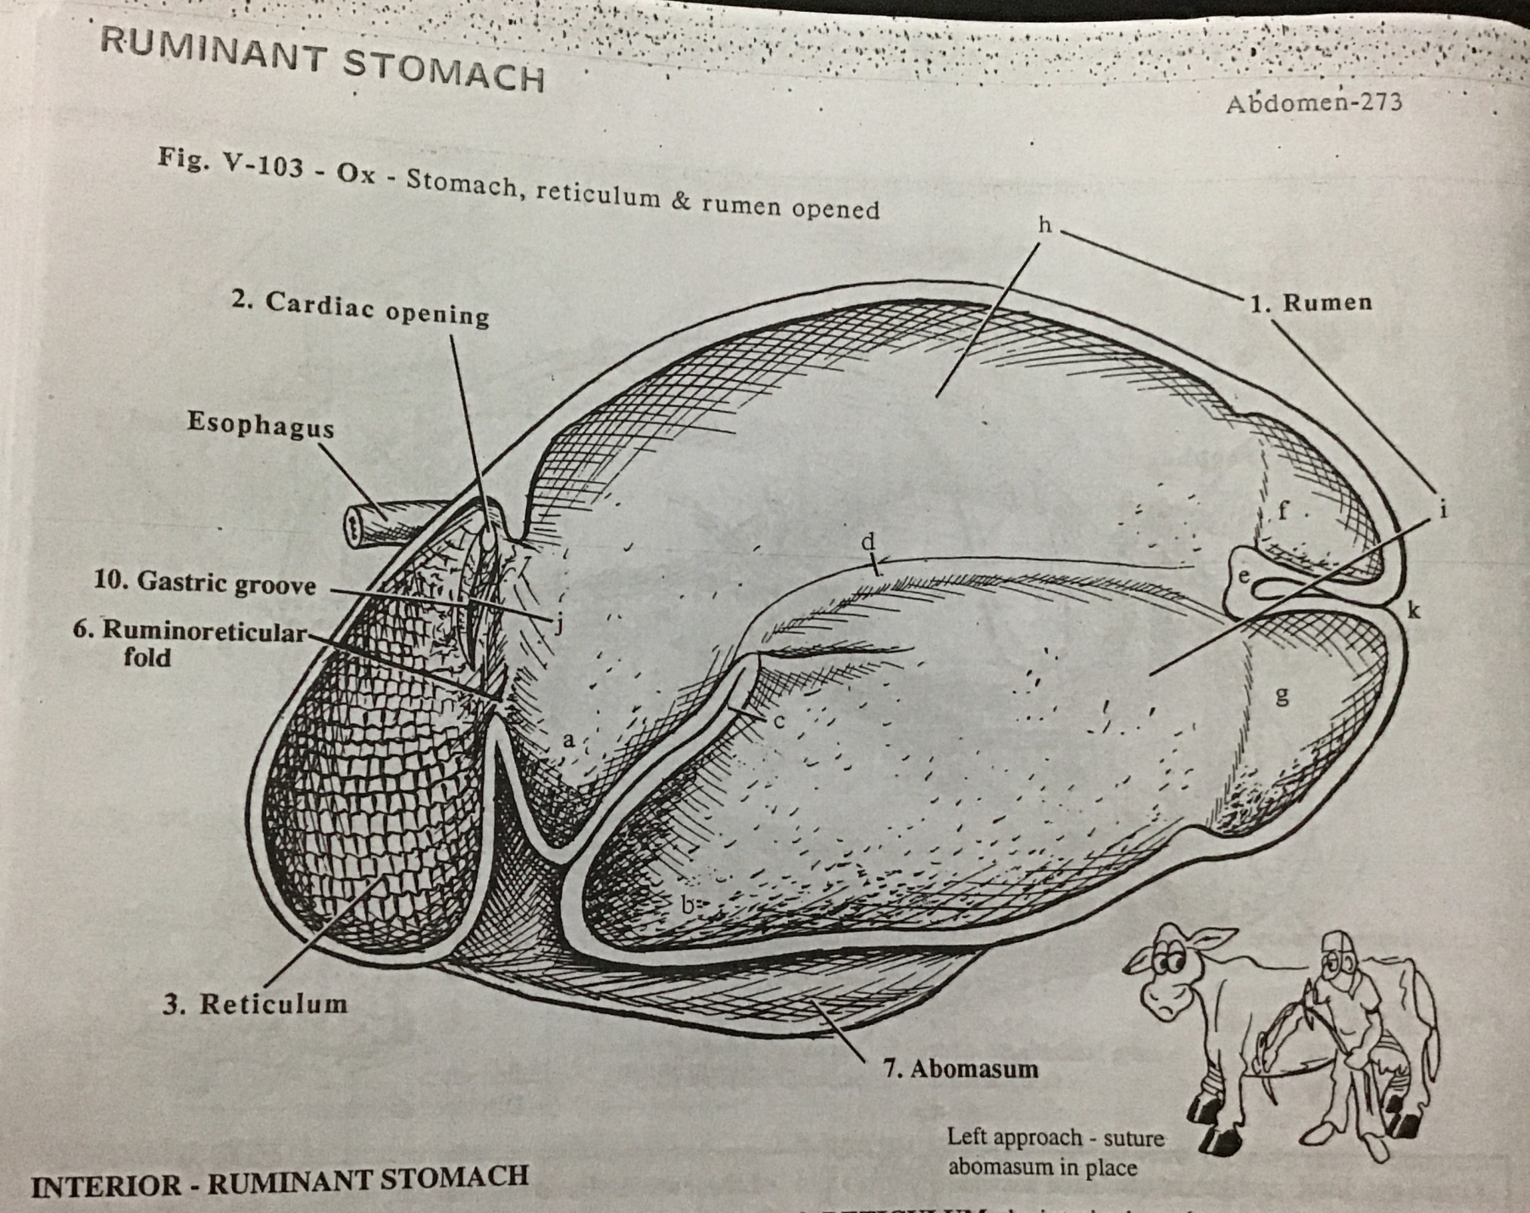
K
K
Cranial pillar
Right longitudinal pillar
Caudal pillar
Caudodorsal blind sac
Caudoventral blind sac
Dorsal sac
Ventral sac
k. Caudal groove

