Slide 1
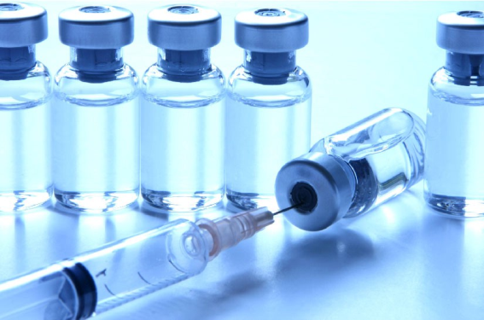
Drugs Used Pre-Op in Equine Castrations
With a sample calculation using an 18 month old Arabian colt weighing 366kg*
*average weight according to: https://starmilling.com/estimating-body-weight-of-growing-foals/

Slide 2
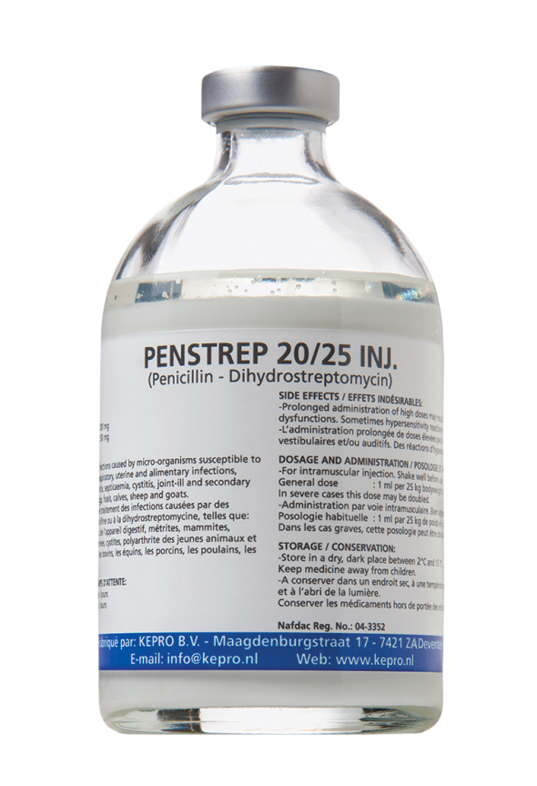
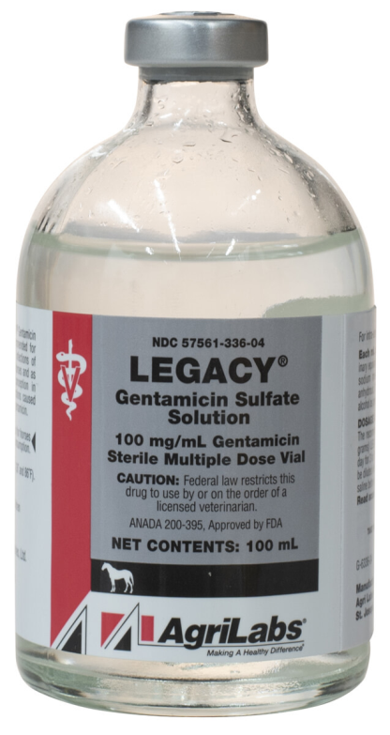
Antibiotics
Broad spectrum
  Eg Penstrep (1mL per 25 kg IM for 3-4 days)
  or Gentamicin ( 11-15 mg/kg IV)

Slide 3
Drug Volume Calculation
Penstrep @ 1mL per 25 kg
-> 14.64 mL
https://www.kepro.nl/products/penstrep-2025-inj-2/#:~:text=Penstrep%2020%2F25%20Inj.%20is,infections%20in%20cattle%2C%20horses%2C%20pigs
Gentamicin:
Volume (mL) = Dose (mg/kg) x Weight (kg) ÷Concentration (mg/mL)
= 11 x 366 ÷ 100
= 40.2 mL

Slide 4
Contraindications:
Penstrep:
Patients with hypersensitivity to penicillins, aminoglycosides and procaine
Patients impaired with renal function or disturbances to the auditory or vestibular organs.
Gentamicin:
Patients with hypersensitivity to aminoglycosides
Use with caution in patients with renal disease, neuromuscular dz
Should not be used in animals with Botulism

Slide 5
Adverse Effects
Penstrep:
With administration of high doses:
  -> renal dysfunction
  -> vestibular and/or auditory dysfunction
Gentamicin:
Nephro & Ototoxicity
Muscle irritation with IM injections
May cause colitis
Neuromuscular blockade
Facial oedema
Peripheral neuropathy

Slide 6
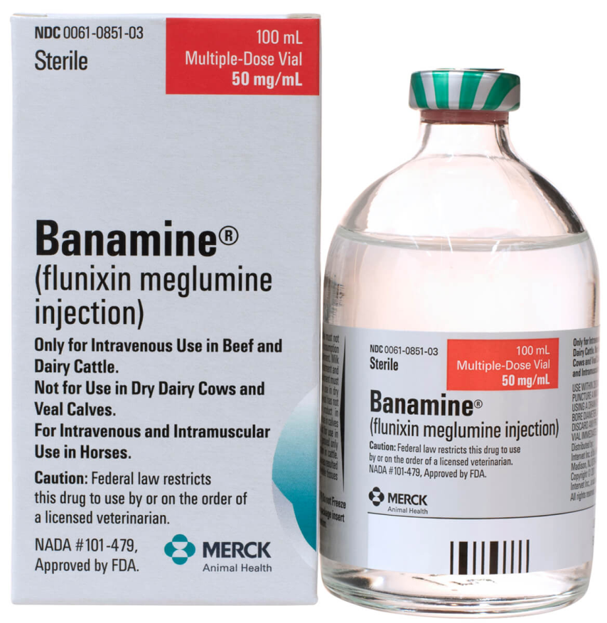
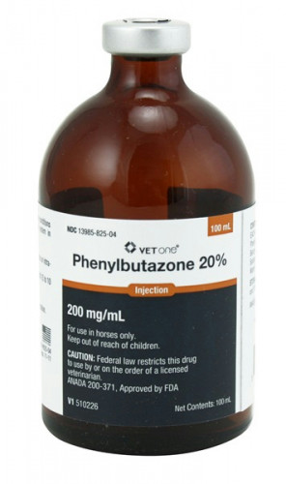
Analgesics
Flunixin Meglumine (1.1 mg/kg IV or IM once daily for 5 days)
Phenylbutazone (1-2 g per 454 kg IV)

Slide 7
Drug Volume Calculation
Flunixin Meglumine:
Volume (mL) = Dose (mg/kg) x Weight (kg) ÷ Concentration (mg/mL)
= 1.1 x 366 ÷ 50
= 8.05 mL

Slide 8
Contraindications:
Flunixin Meglumine
Contraindicated in patients with hypersensitivity to Flunixin
Use cautiously in patients with
  Renal, hepatic or haematologic disease
Not to be used in patients with equine gastric ulcer syndrome (EGUS)
Phenylbutazone:
Contraindicated in patients with:
  a history of or preexisting hematologic or bone marrow abnormalities
  preexisting GI ulcers
Avoid use in patients with EGUS
Use cautiously in patients with renal dz or CHF
Do not administer subcutaneously- caused necrosis and sloughing

Slide 9
Adverse Effects
Flunixin Meglumine:
Localized swelling, induration, stiffness, and sweating have been reported
Intra-arterial injection may cause CNS stimulation, ataxia, hyperventilation and weakness
High doses for prolonged periods causes gastric ulcers, anorexia and depression
Rarely: anaphylaxis and clostridial myonecrosis (with IM route)
Phenylbutazone:
GI erosions and ulcers
Hypoalbuminaemia
Diarrhea
Anorexia
Renal effects
  Azotemia
  Renal papillary necrosis
Intra-carotid injections may cause CNS stimulation and seizures

Slide 10
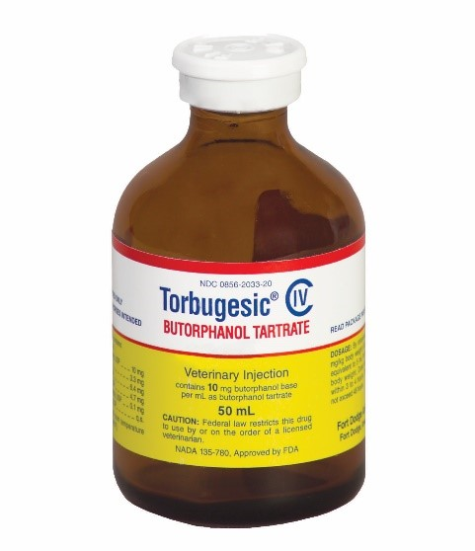
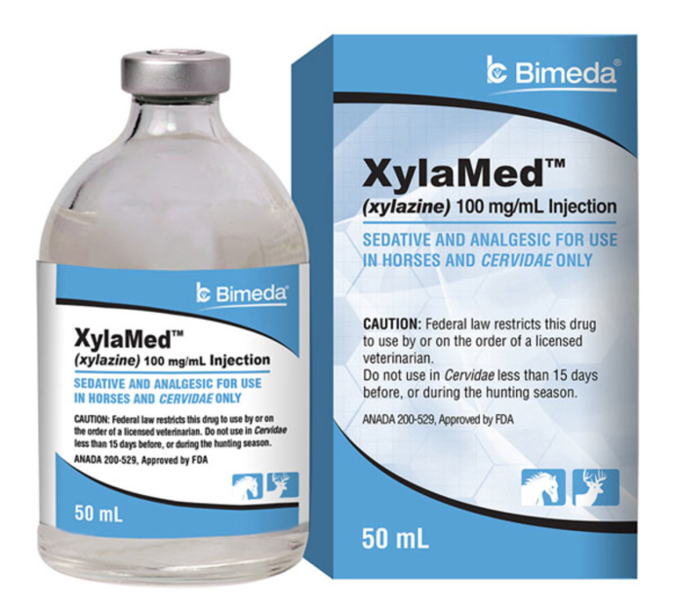
Sedation, Muscle Relaxation & Some Analgesia
Xylazine + Butorphanol
Doses for Field Sedation:
Xylazine (1mg/kg IV)
Butorphanol (0.01-0.04 mg/kg IV)
Doses for preanaesthetic sedation analgesia:
Xylazine: 0.1-0.5 mg/kg IV
Butorphanol: 0.01-0.04 mg/kg IV

Slide 11
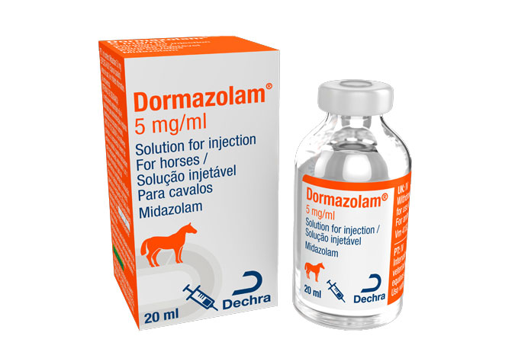
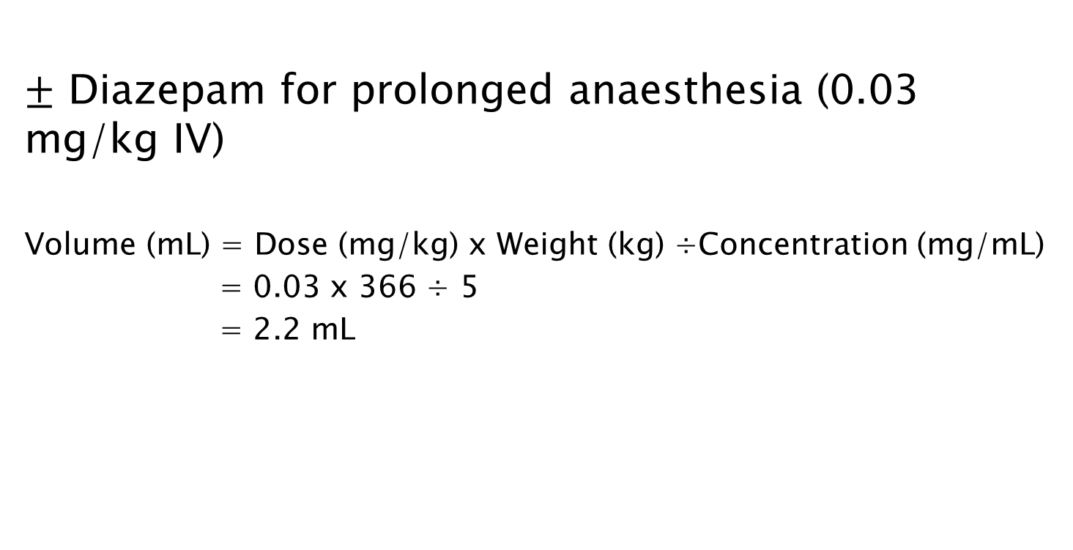
$±$ Diazepam for prolonged anaesthesia (0.03 mg/kg IV)
Volume (mL) = Dose (mg/kg) x Weight (kg) ÷Concentration (mg/mL)
= 0.03 x 366 ÷ 5
= 2.2 mL

Slide 12
Drug Volume Calculation
For Field Sedation:
Xylazine:
Volume (mL) = Dose (mg/kg) x Weight (kg) ÷Concentration (mg/mL)
= 1 x 366 ÷ 100
= 3.7 mL
Butorphanol:
Volume (mL) = Dose (mg/kg) x Weight (kg) ÷Concentration (mg/mL)
= 0.01 x 366 ÷ 100
= 0.73 mL
For Preanaesthetic Sedation Analgesia :
Xylazine:
Volume (mL) = Dose (mg/kg) x Weight (kg) ÷Concentration (mg/mL)
= 0.1 x 366 ÷ 10
= 0.37 mL
Butorphanol:
Volume (mL) = Dose (mg/kg) x Weight (kg) ÷Concentration (mg/mL)
= 0.01 x 366 ÷ 10
= 0.73 mL

Slide 13
Contraindications:
Xylazine:
when administered with butorphanol increases risk for development of hypotension and ileus
intra-arterial injection may cause severe seizures and collapses
use with caution in patients that have previous intestinal impaction and patients with laminitis
Butorphanol use contraindicated in:
Hypersensitive patients
Patients with:
  -> hypothyroidism
  -> severe renal insufficiency
  -> Addison's dz
  ->debilitations
Diazepam:
Hypersensitivity to Benzodiazepines
Significant liver dz

Slide 14
Adverse Effects
Xylazine:
muscle tremors
bradycardia with partial A-V block
reduced respiration rate
movement in response to sharp auditory stimuli
sweating
transient hypertension
decreased mucociliary clearance rates
Butorphanol:
Transient
  -> ataxia and sedation
  -> CNS excitement
  -> Salivation
  -> Hyperthermia
  -> Decreased GI motility
Diazepam:
Sedation, weakness & ataxia
Muscle fasciculations
Rapid administration can cause hypotension

Slide 15
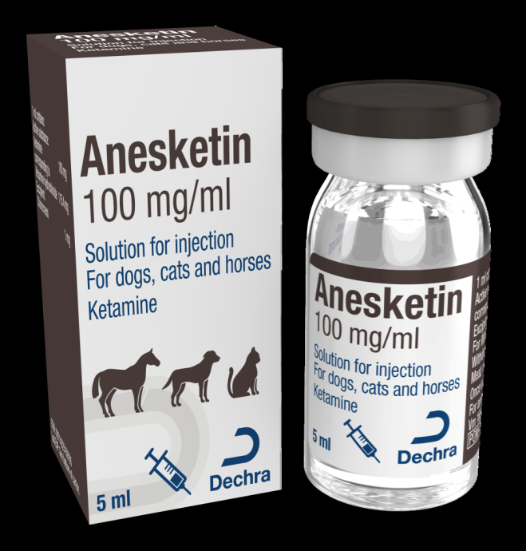
General Anaesthesia in the Field
Ketamine (2 mg/kg IV)**
** Considerations for Ketamine

Slide 16
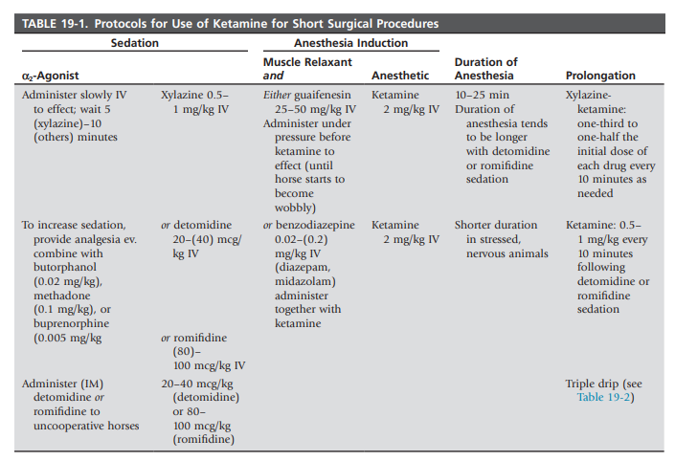
** Considerations for Ketamine & Doses

Slide 17
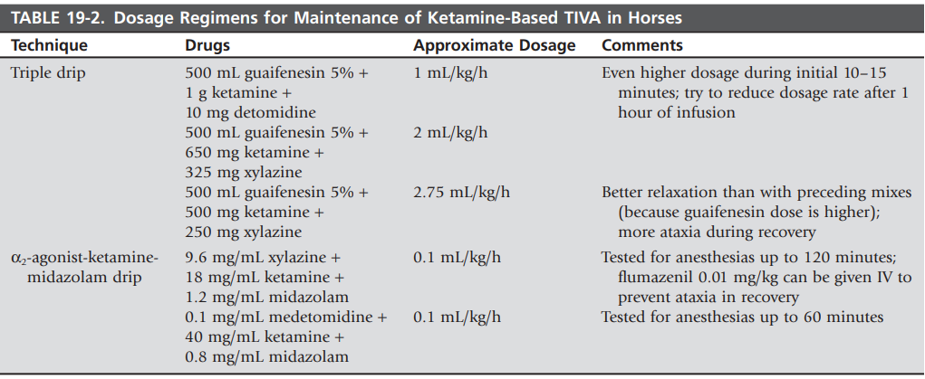
** Considerations for Ketamine & Doses

Slide 18
Contraindications
Should not be used in patients with
  Hypersensitivity to Ketamine
  Hepatic or renal insufficiency
  Elevated pressure
  Head trauma
  Increased ocular pressure
  Open globe injuries
  Pre-existing seizure disorders
Controversial or warning against use in patients with
  Malignant hyperthermia
  Hypertension
  Heart failure
  Arterial anyeurisms

Slide 19
Adverse Effects
Hypertension
Hypersalivation
Respiratory depression or dyspnoea
Hyperthermia
Emesis
Vocalization
Seizures or spastic jerking movements
Muscular tremors
Hypertonicity
Opisthotonos
Cardiac arrest
Erratic & prolonged recovery
Pain after IM injection may occur

Slide 20
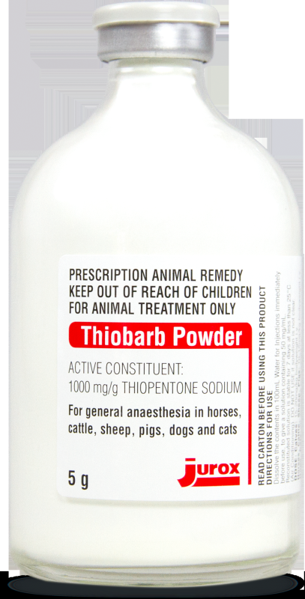
General Anaesthesia in the Field continued….
Thiopental sodium (can be used alone or with Ketamine [refer to 'Considerations for Ketamine']
With preanaesthetic tranquilization:
6–12 mg/kg IV
Without preanaesthetic tranquilization:
8.8–15.4mg/kg IV

Slide 21
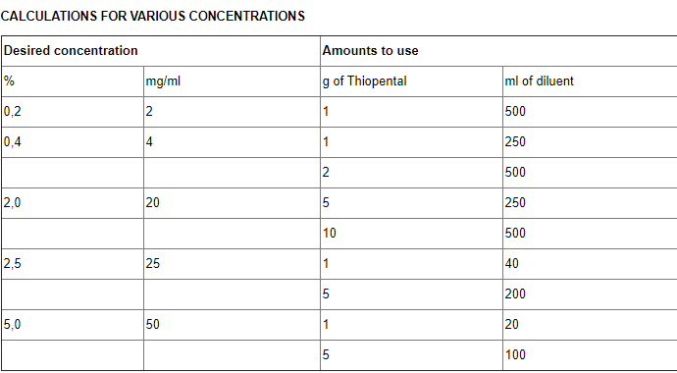
https://www.medicines.org.uk/emc/product/665/smpc#gref

Slide 22
Drug Volume Calculation
Using the 5% Thiopental sodium
With preanaesthetic tranquilization:
Volume (mL) = Dose (mg/kg) x Weight (kg) ÷Concentration (mg/mL)
= 6 x 366 ÷ 50
= 44 mL
Without preanaesthetic tranquilization:
Volume (mL) = Dose (mg/kg) x Weight (kg) ÷Concentration (mg/mL)
= 8.8 x 366 ÷ 50
= 64.4 mL

Slide 23
Contraindications:
Absolute Contraindications:
Absence of suitable veins for IV administration
Hypersensitivity to barbiturates
Status asthmaticus
Pre-exisiting leukopenia
Relative contraindications:
Severe cardiovascular disease
Pre-existing ventricular arrhythmias
Shock
Increased intra-cranial pressure
Myasthenia gravis
Asthma
Conditions such as hepatic disease, anaemia etc that can prolong hypnotic effects

Slide 24
Adverse Effects
Severe CNS toxicity with intra-carotid injections
When used alone, can exhibit signs of excitement and severe ataxia during the recovery period
Can develop transient leukopenia, hyperglycaemia, apnoea, moderate tachycardia and mild respiratory acidosis after administration
Rapid administration can cause hypoglycaemia

Slide 25
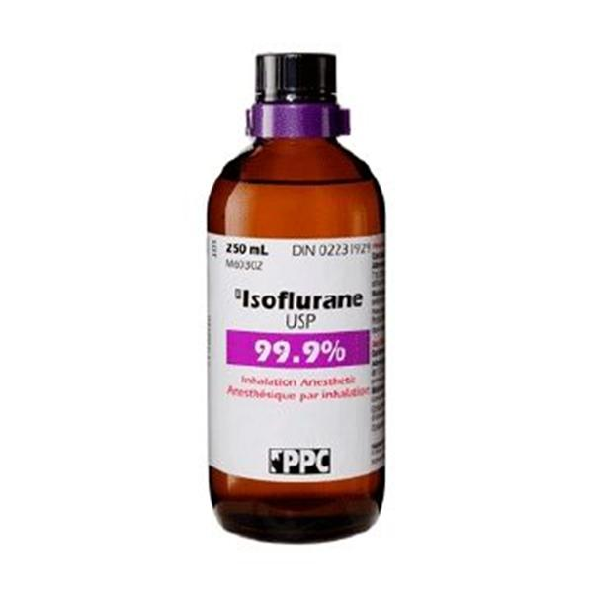
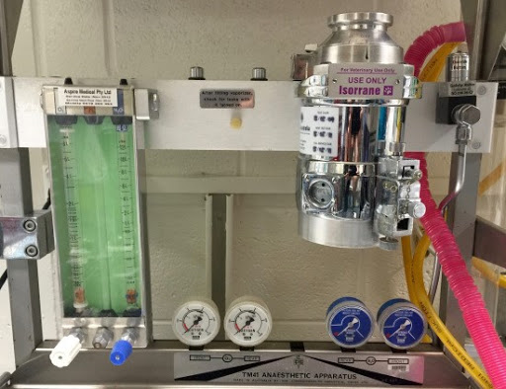
General Anaesthesia in the OR
Inhalant Isoflurane used in a gas anaesthetic machine

Slide 26
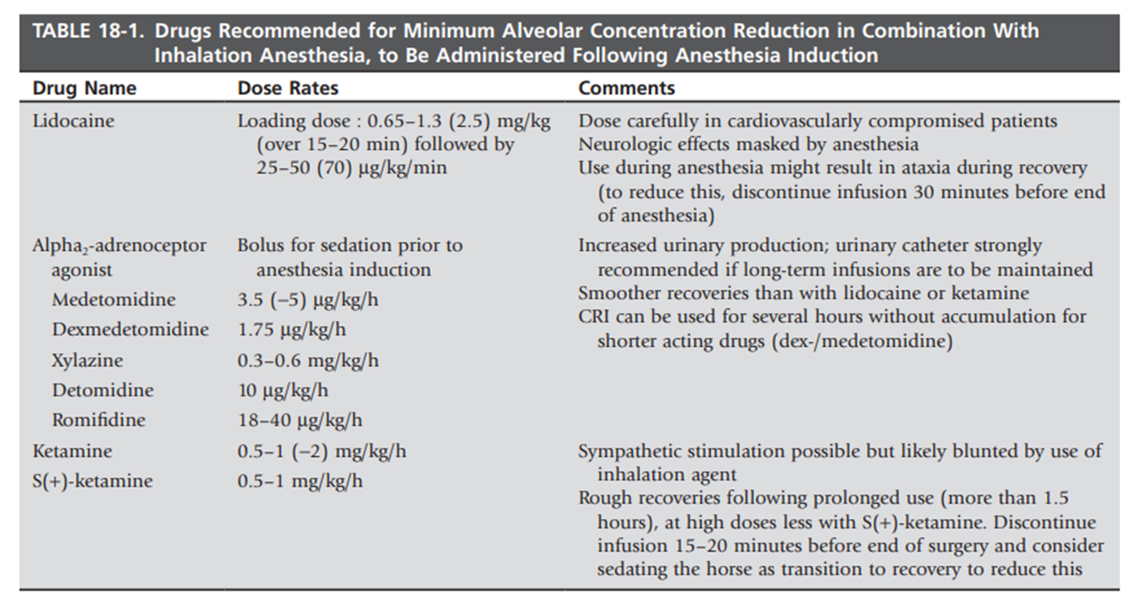

Slide 27
Contraindications:
Contraindicated in patients with a history of malignant hyperthermia
Should be used with caution in patients with increased CSF, head injury or myasthenia gravis
Due to the respiratory depressant effects, intermittent positive pressure and ventilation may be required to achieve anaesthesia

Slide 28
Adverse Effects
Dose dependant:
Hypotension secondary to vasodilation
Respiratory depression
GI effects (nausea, vomiting & ileus)
Arrhythmias (rare)

Slide 29
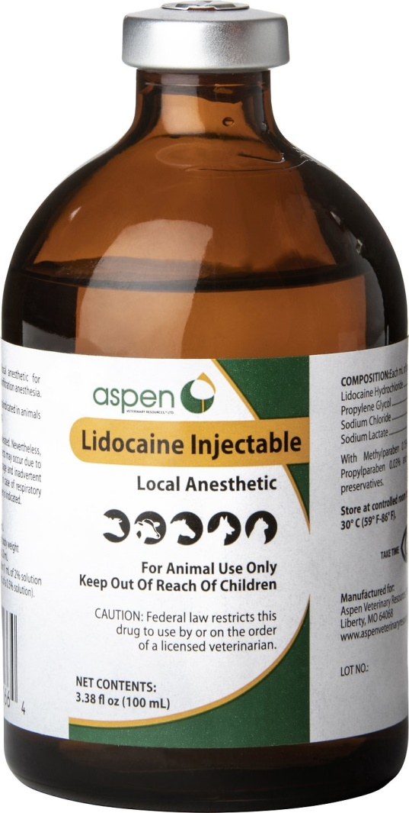
Local Anaesthesia
Lidocaine
15-30 mL in each spermatic cord
Or
25 mL into the parenchyma of each testicle

Slide 30
Contraindications:
Not to be used IV if products contains epinephrine
Contraindicated in patients with:
-> known hypersensitivity to amide-class local anaesthetics
-> severe degree SA, AV or intraventricular heart block
-> Adams-Stokes syndrome
Use with caution in patients with:
-> Liver diseases
-> CHF
-> Shock
-> Hypovolemia
-> Severe respiratory depression
-> Marked hypoxia

Slide 31
Adverse Effects
Dose related but usually mild:
CNS signs (drowsiness, depression, ataxia, muscle tremors etc.)
Cardiac effects (at high plasma concentrations)
Increase ventricular rates in patients with atrial fibrillation
Hypotension when given IV bolus too rapidly

Slide 32
References:
Plumb D. Plumb's veterinary drug handbook|Veterinary drug handbook. 7th ed. Stockholm, Wis.: Blackwell; 2011.
Auer J. Equine surgery. 5th ed. St. Louis: Elsevier; 2019.
Turner A, McIlwraith C, Hull B. Techniques in large animal surgery. 4th ed. Philadelphia (Pa.): Lippincott Williams & Wilkins; 2013.

