Slide 1

Physical restraint and handling of horses
For castrations

Slide 2
You will need:
An experienced handler
A Halter & Lead
A Twitch (may be necessary for extra restraint in standing procedures)
  Can be used together with ear hold/twitch (but be careful to not damage the auricular cartilages) or skin twitch
Some Rope (of adequate thickness) to hold off the legs

Slide 3
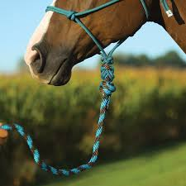
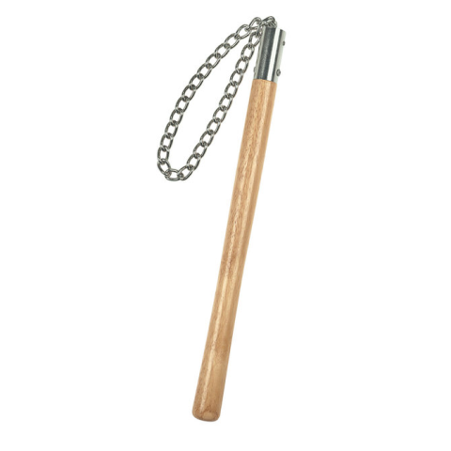
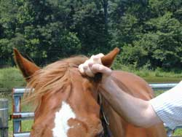
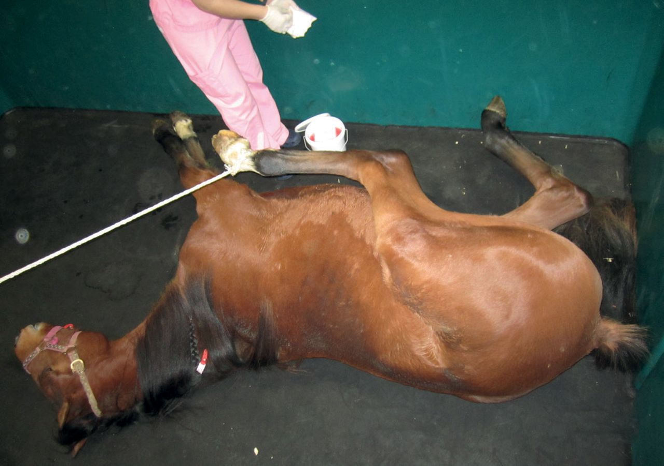
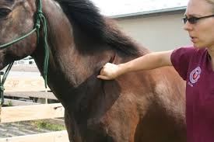

Slide 4
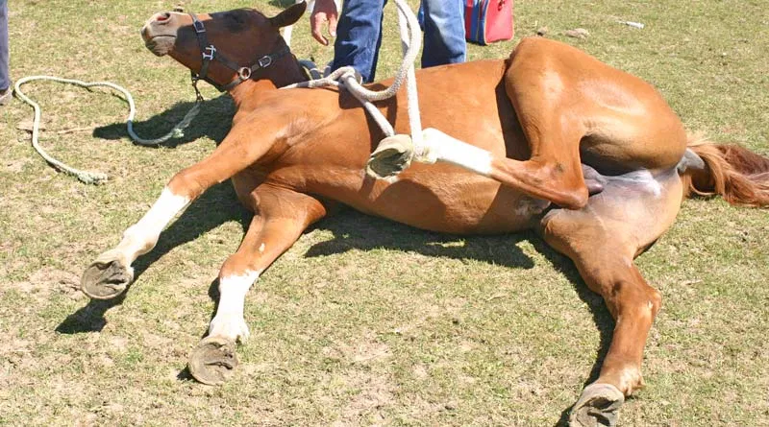
Considerations for field/stable castrations:
Advise the client to handle the horse as much as possible prior to the procedure
→ This would facilitate quicker and easier induction
Ensure that the ground is flat (and clean)
→ This helps with recovery and prevents injury to the horse while getting up

Slide 5
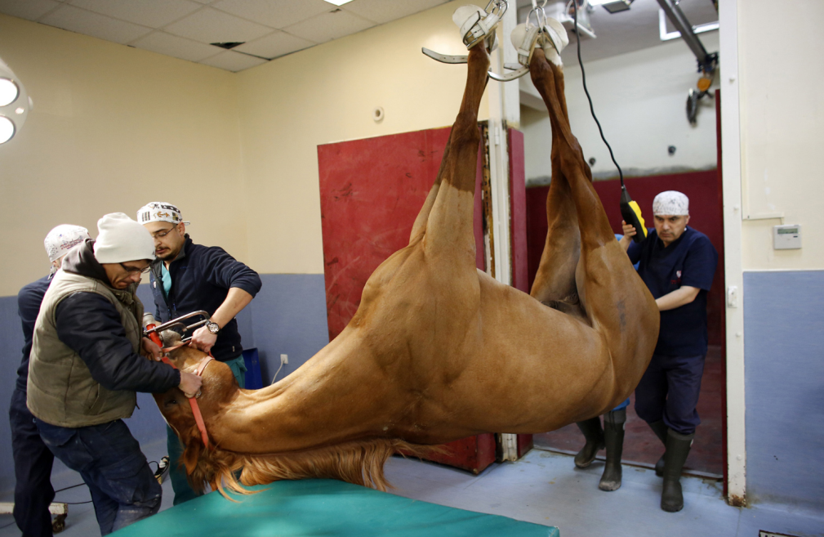
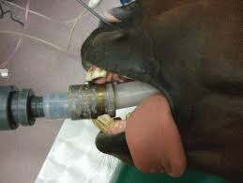
Considerations for castrations in the OR:
Check for adequate sedation
Careful hoisting and placing of horse on the operating table
Careful and correct placement of ET tube
Proper positioning/angling of the head
Etc…

Slide 6

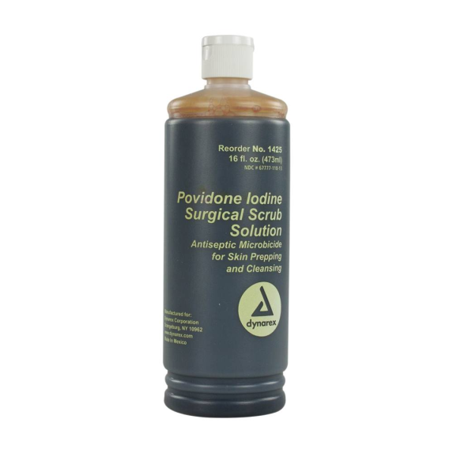
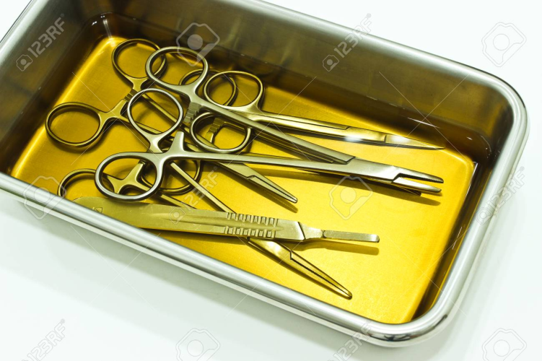
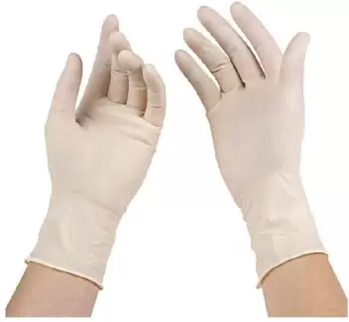
General pre-surgical considerations:
Would apply to field/stable castrations as it is understood in the OR:
Surgical scrubbing and preparation of the site with Hibiscrub & Iodine+Alcohol solution
Sterilization of all equipment for at least 10 minutes prior to the surgery
Wear sterile gloves- ALWAYS!

Slide 7

-end

