Slide 1
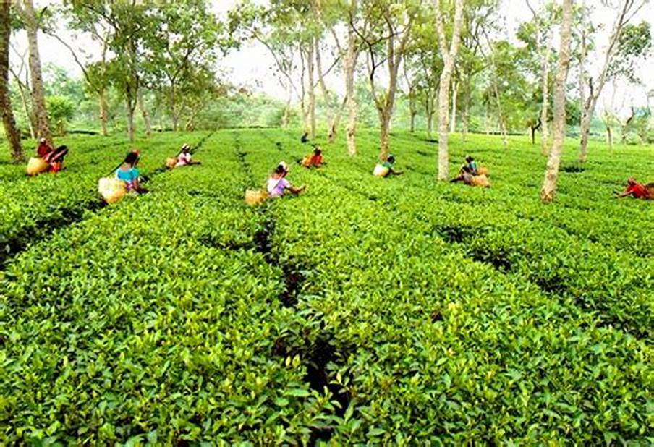
Assam Tea
Click arrow to progress
Next

Slide 2
What is Assam Tea?
Assam tea is a black tea named after the region of its production, Assam, in India
manufactured specifically from the plant Camellia sinensis var
mostly grown at or near sea level and is known for its body, briskness, malty flavour, and strong, bright colour. Assam teas, or blends containing Assam, are often sold as "breakfast" teas
Back
Next

Slide 3
Quiz Time Assam is named after a region in which country?
India
Singapore
China
USA
Back
Next

Slide 4
Well Done
Back
Next

Slide 5
Wrong. Try Again. Click here to go back to quiz
Back
Next

Slide 6
Congratulations!
You now know more about assam
For more info visit http://assamworld.com
Back
Back to start

