Slide 1
TYPES of Iphone in Apple shop (SG)
Iphone X(?)
Iphone 8(?)
Iphone 8
Iphone 8Plus
Iphone XS Max
Iphone XS
Iphone XR
WELCOME!
This is a module to teach you all about the different types of Iphone
This knowledge may help you decide which Model of Iphone to buy
Click a particular topic in the Navigation Map on the right to go to a particular topic.
Or use the navigation buttons at the bottom right to move between the pages or to return to this Home page.
Enjoy the module!

Slide 2
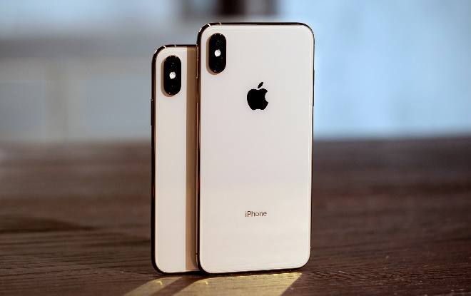
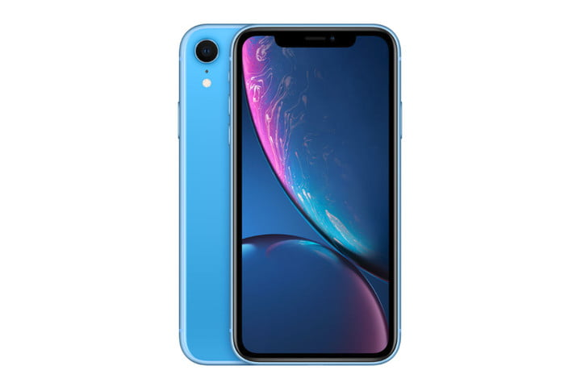
Iphone X(?) Model
There are 3 type of Iphone x(?) in apple shop available now with different colours available to select from.
This is the almost full screen phone and newest model
Iphone XS and XS Max
Iphone XR

Slide 3
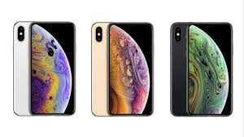
Iphone XS Model
Super Retina in two sizes — including the largest display ever on an iPhone. Even faster Face ID. The smartest, most powerful chip in a smartphone. And a breakthrough dual-camera system with Depth Control. iPhone XS is everything you love about iPhone. Taken to the extreme.
For more info Web-Link here.

Slide 4
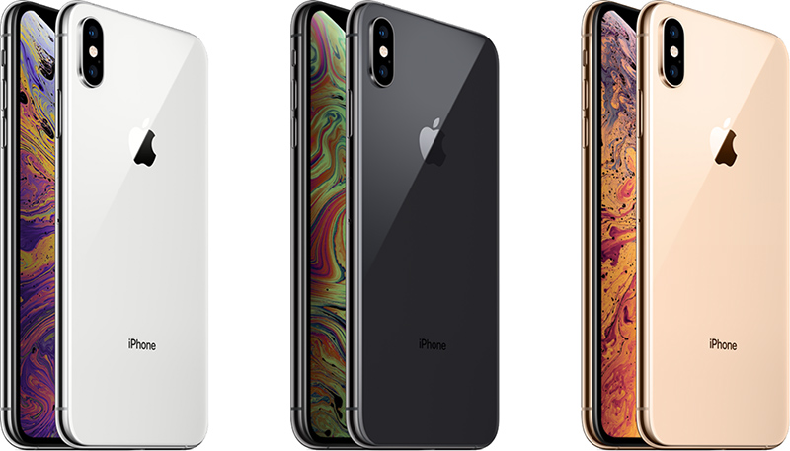
Iphone XS Max Model
Super Retina in two sizes — including the largest display ever on an iPhone. Even faster Face ID. The smartest, most powerful chip in a smartphone. And a breakthrough dual-camera system with Depth Control. iPhone XS is everything you love about iPhone. Taken to the extreme.
This is the almost full screen phone and newest model
For more info Web-Link here.

Slide 5
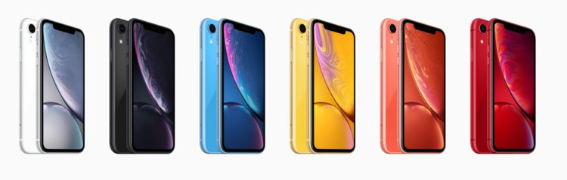
Iphone XR Model
Introducing Liquid Retina. The new display on iPhone XR is the most advanced LCD in the industry. An innovative backlight design allows the screen to stretch into the corners. So you see true-to-life colour from one beautiful edge to the other.
For more info Web-Link here.

Slide 6
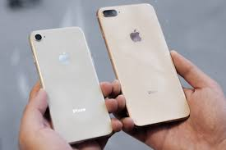
Iphone 8(?) Model
There are 2 type of Iphone8(?) in apple shop available now with different colour available to select from.
This is the almost full screen phone and newest model

Slide 7
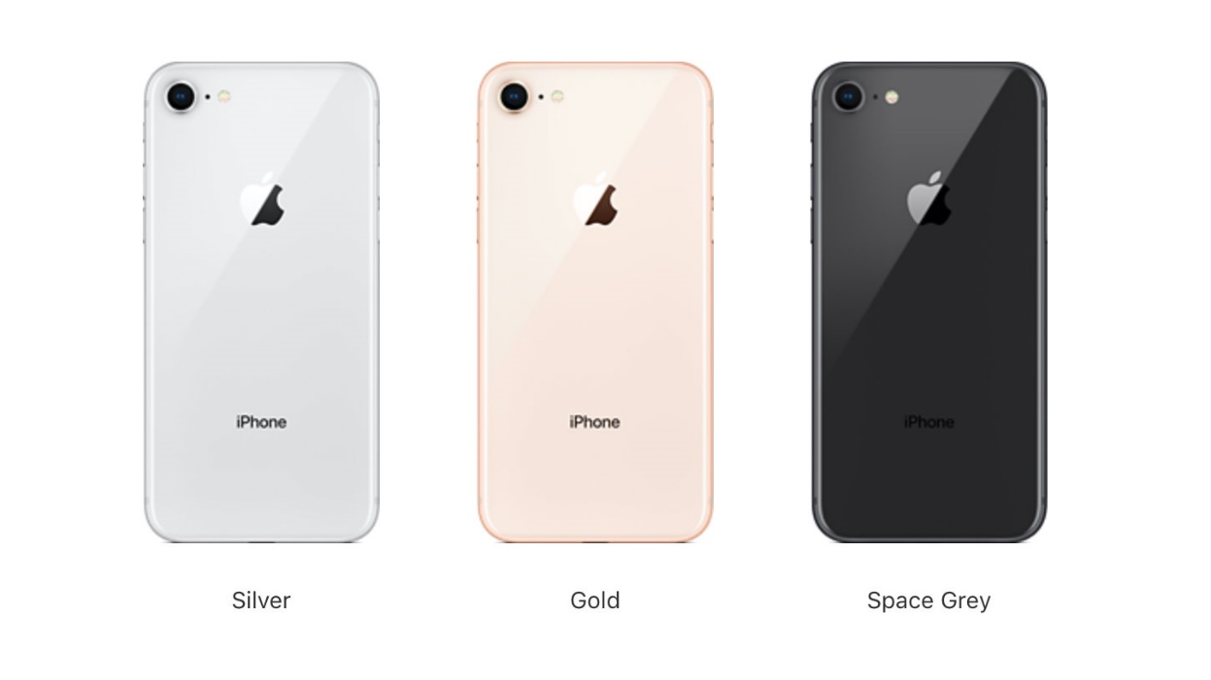
Iphone 8 Model
The original iPhone only came in aluminum and black, but now Apple offers iPhone 8 in silver, gold (a new, blushing copper gold), space gray, and PRODUCT(RED). If you're not sure which color is right for you, here's what you should consider
For more info Web-Link here.

Slide 8
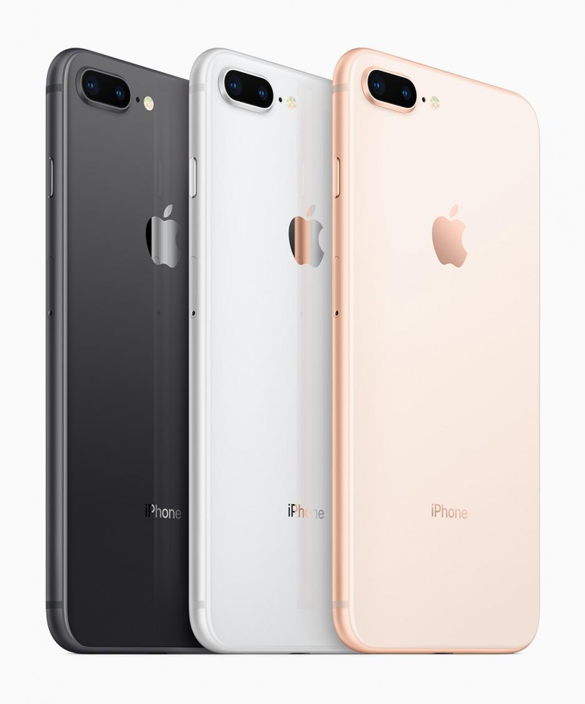
Iphone 8Plus Model
The original iPhone only came in aluminum and black, but now Apple offers iPhone 8plus in silver, gold (a new, blushing copper gold), space gray, and PRODUCT(RED). If you're not sure which color is right for you, here's what you should consider
For more info Web-Link here.

