Slide 1
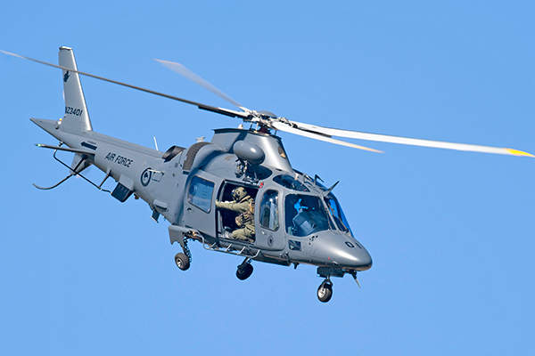
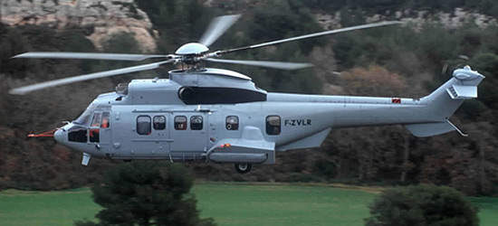
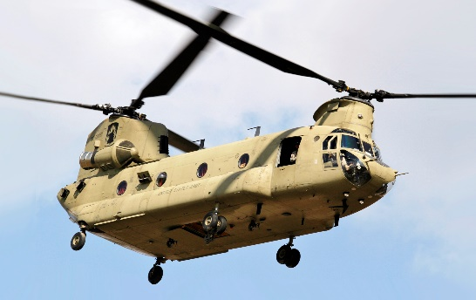
Transport Helicopter
1) Light transport Helicopters
2) Medium transport Helicopters
3) Large transport Helicopters

Slide 2

Links to sites and Videos
1) https://www.globalsecurity.org/military/world/russia/helicopter-classes.htm

Slide 3
The End

