Slide 1
Types of Ships
Military
Commercial
Patrol
Missile Armed
Oil
Cargo
WELCOME!
This is a module to teach you all about the different types of Naval Vessels.
This knowledge may help you decide which type of pet to get.
Click a particular topic in the Navigation Map on the right to go to a particular topic.
Or use the navigation buttons at the bottom right to move between the pages or to return to this Home page.
Enjoy the module!

Slide 2
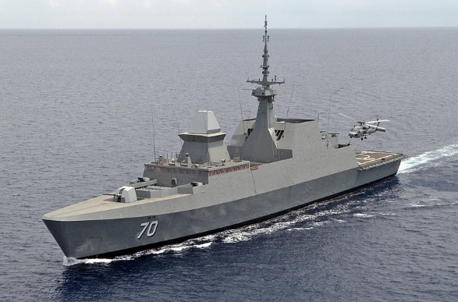
Military
A naval ship is a military ship (or sometimes boat, depending on classification) used by a navy. Naval ships are differentiated from civilian ships by construction and purpose. Generally, naval ships are damage resilient and armed with weapon systems, though armament on troop transports is light or non-existent.
Naval ships designed primarily for naval warfare are termed warships, as opposed to support (auxiliary ships) or shipyard operations.

Slide 3
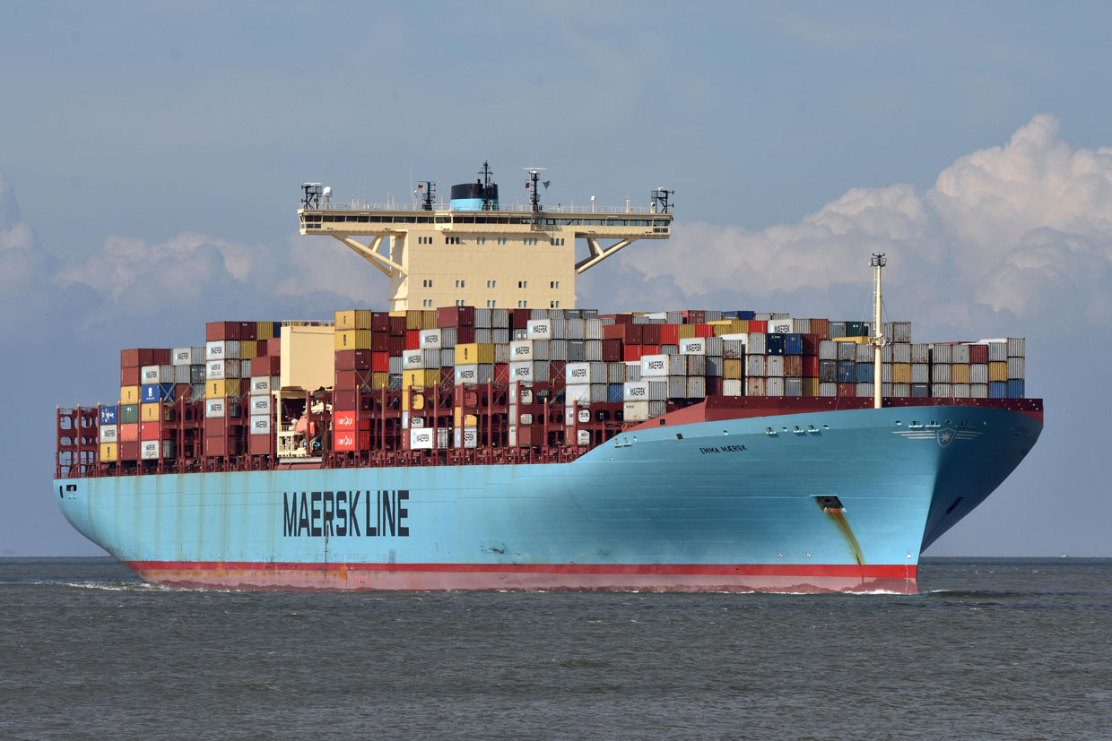
Commercial
A merchant vessel, trading vessel or merchantman is a boat or ship that transports cargo or carries passengers for hire. This excludes pleasure craft that do not carry passengers for hire; warships are also excluded.

