Slide 1
Getting a mobile phone
Which is most suitable for you?!

Slide 2
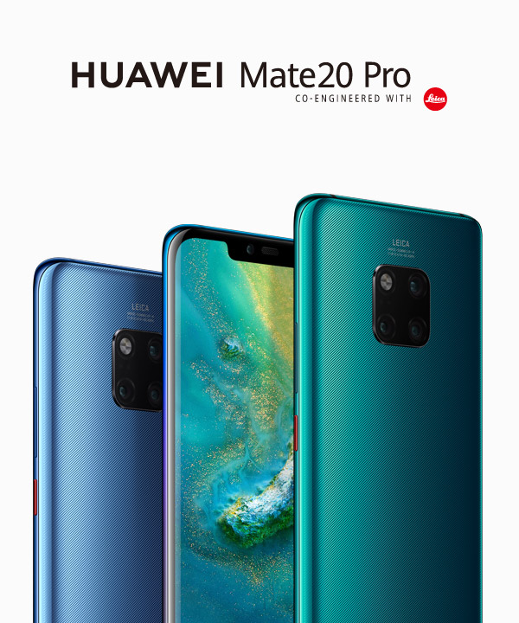
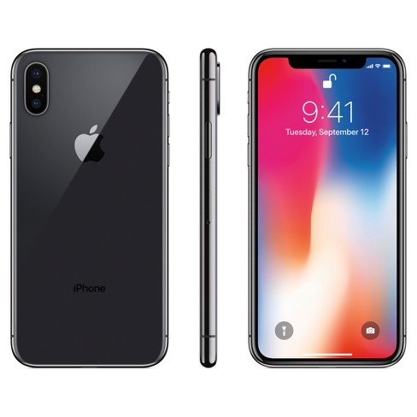
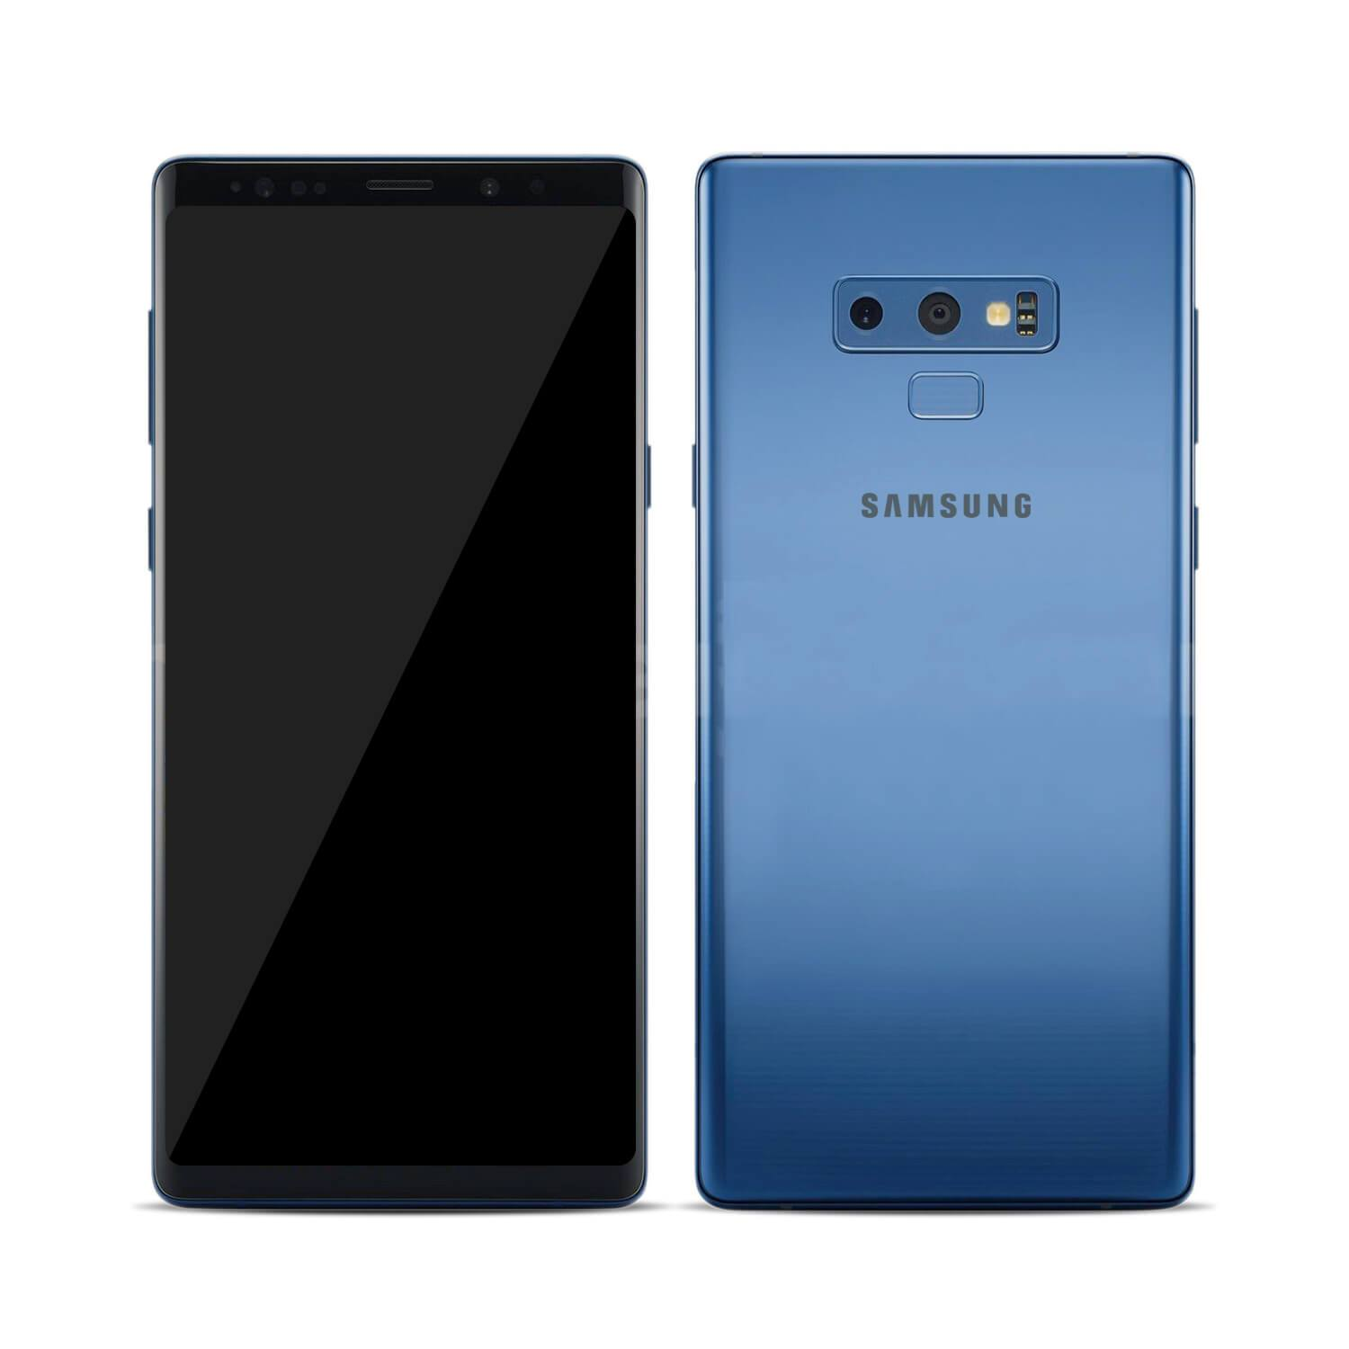
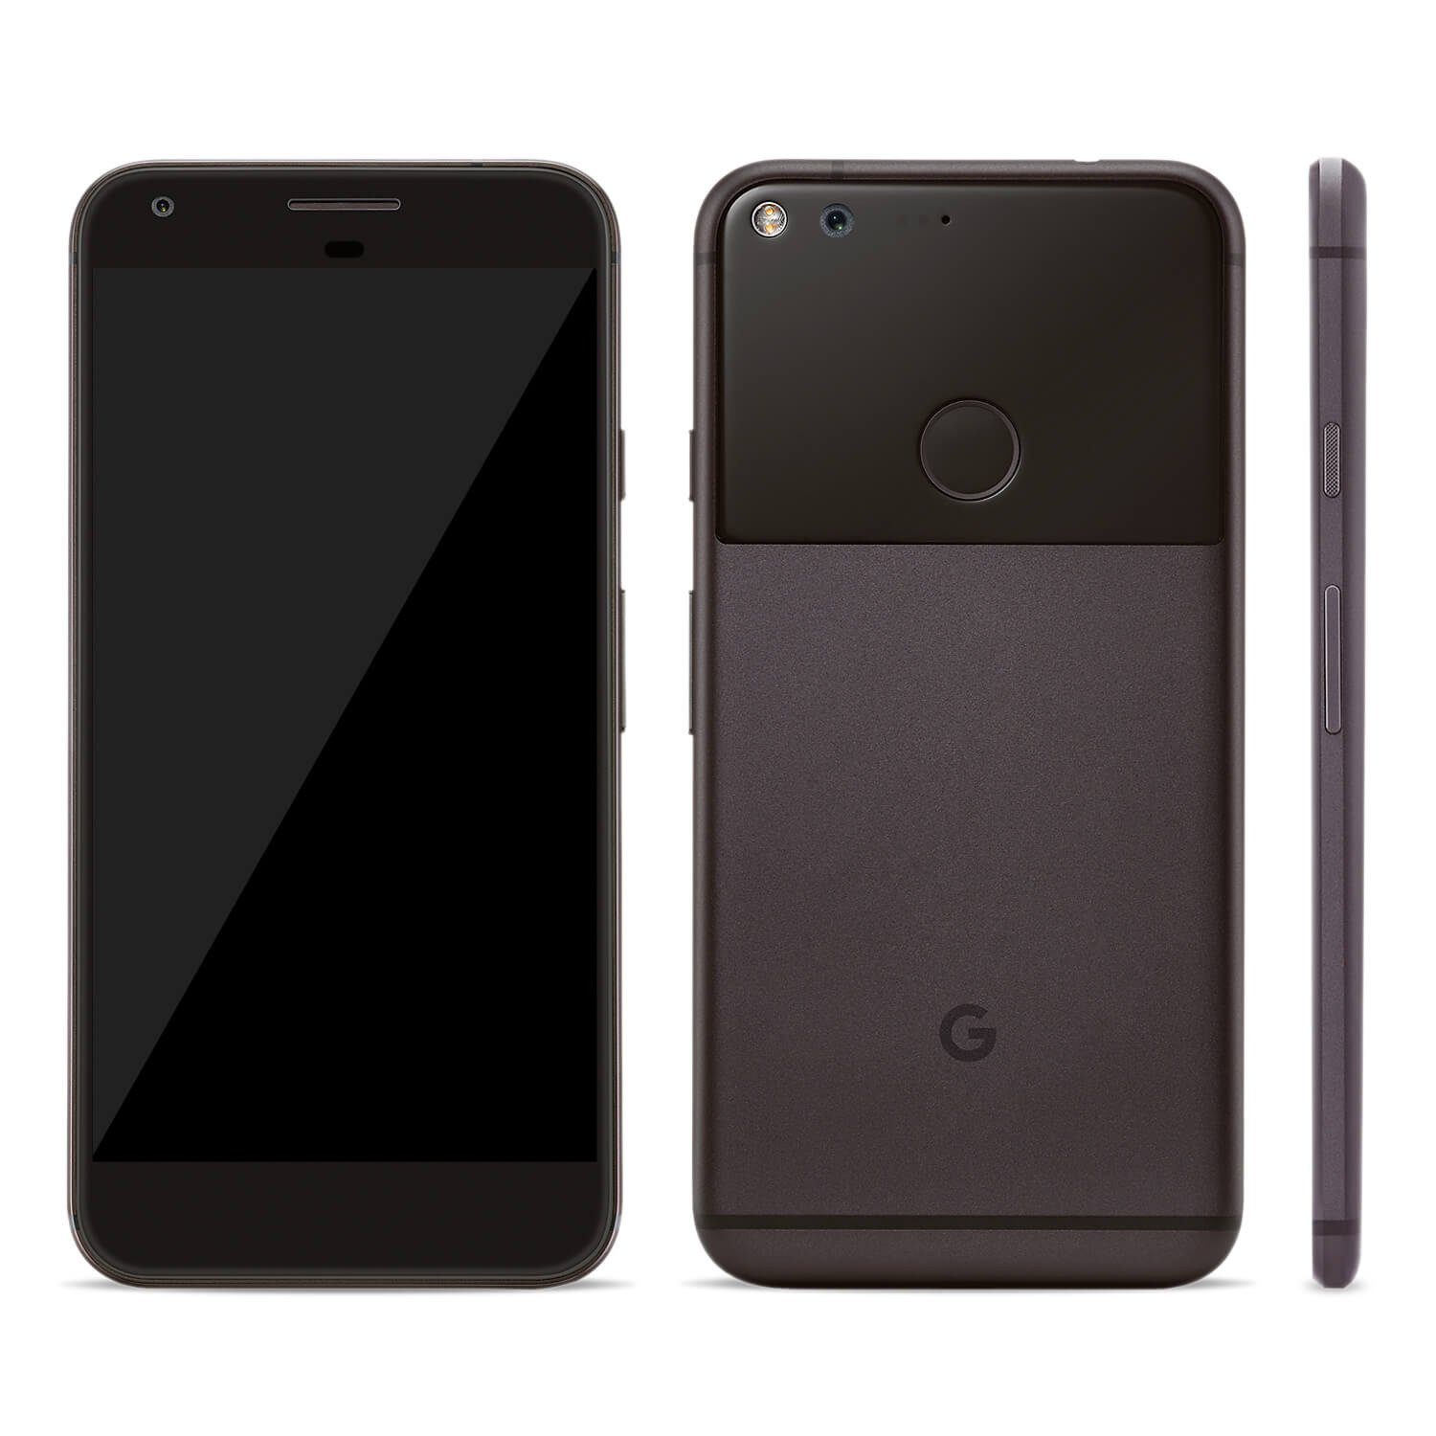
Battle of the four most popular brands in the market……
Which is the best for you?!

Slide 3
Comparison of the four mobile devices
Click onto ☺ for link to comparison

