Slide 1
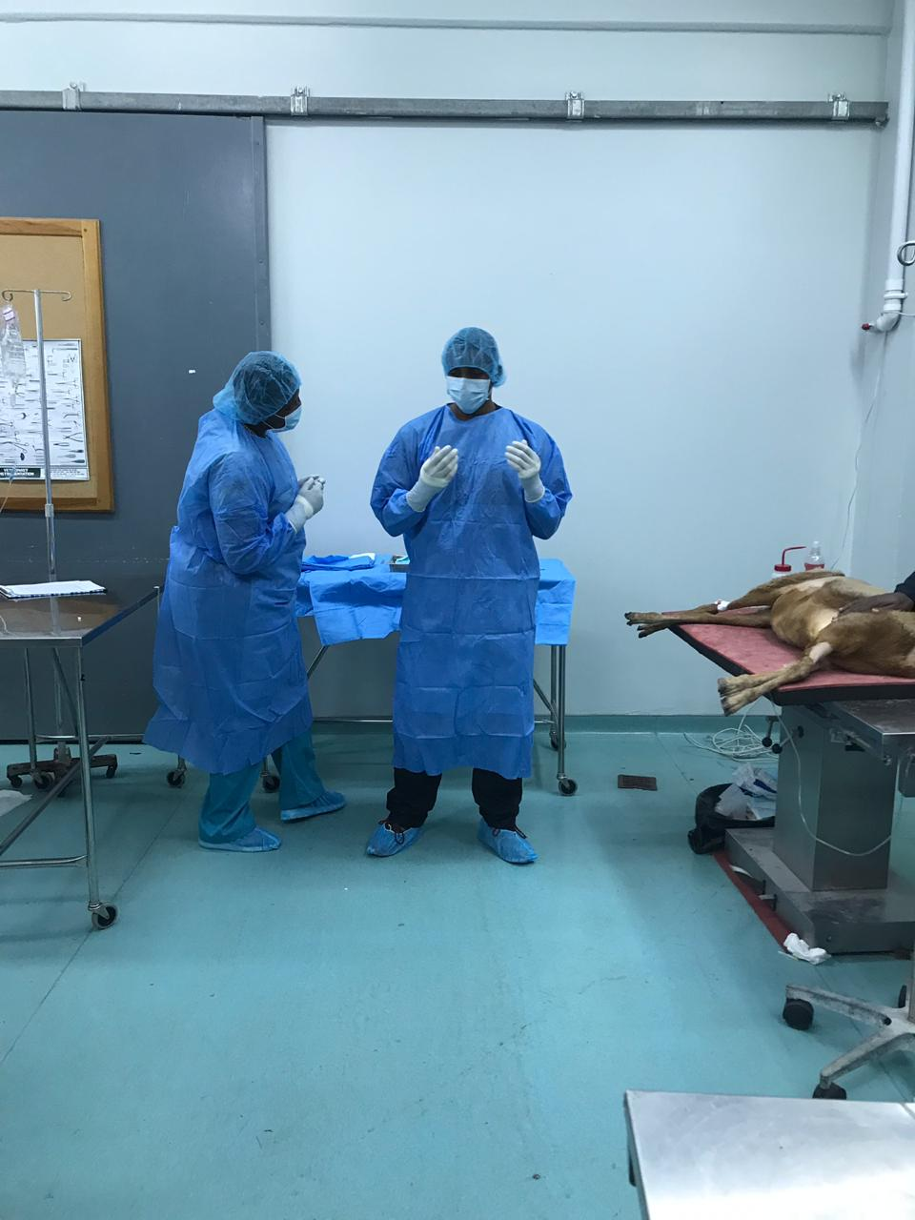
The Calm before the storm

Slide 2
Instruments Needed

Slide 3
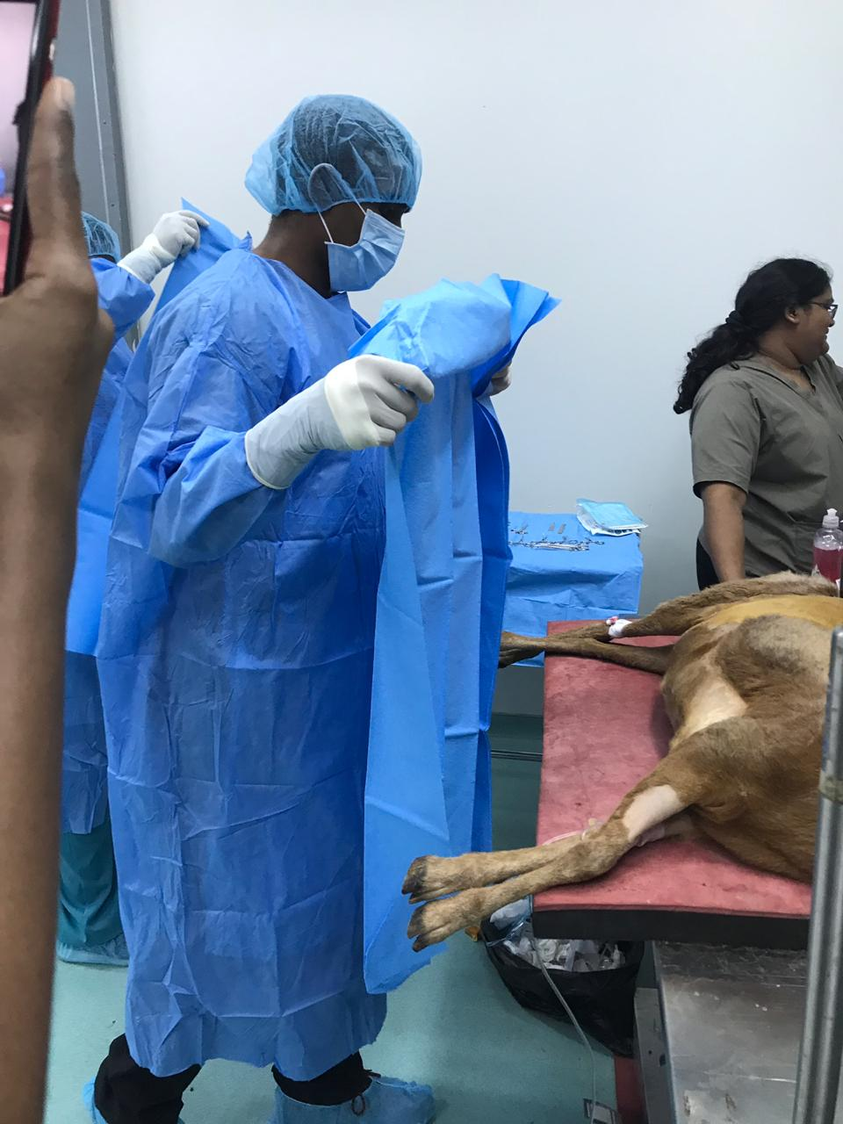
Draping Procedure

Slide 4
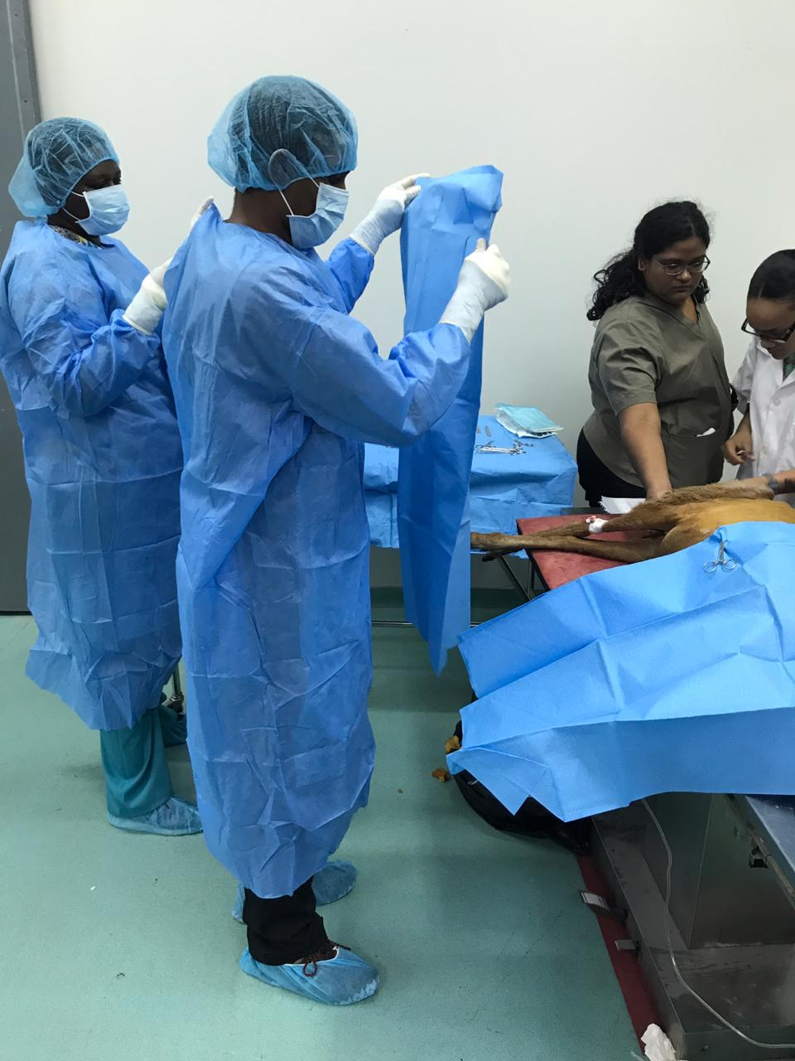
Draping Procedure continued

Slide 5
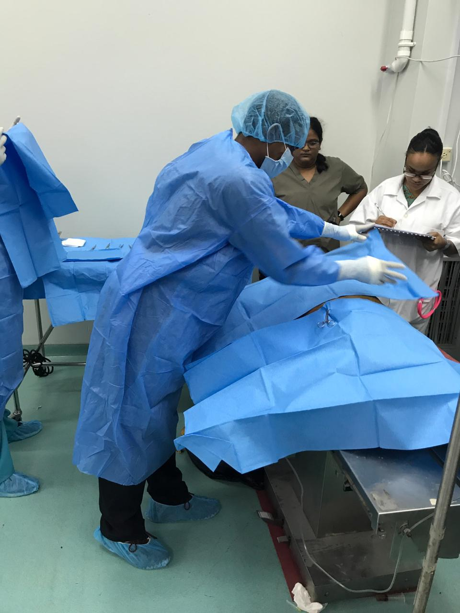
Draping Procedure completed

Slide 6
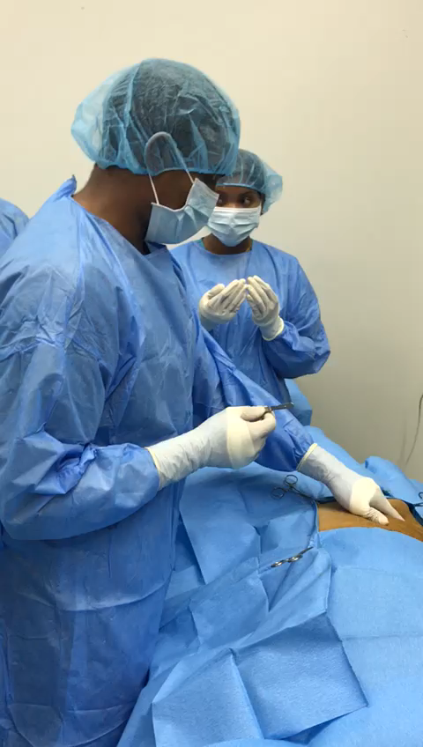
Ensuring proper incision site location

Slide 7
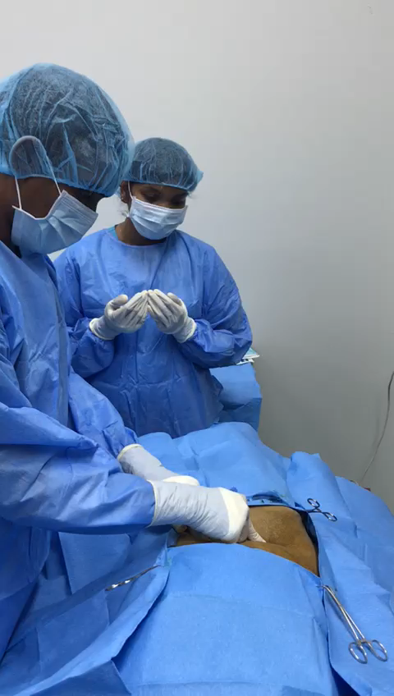
Incision

Slide 8
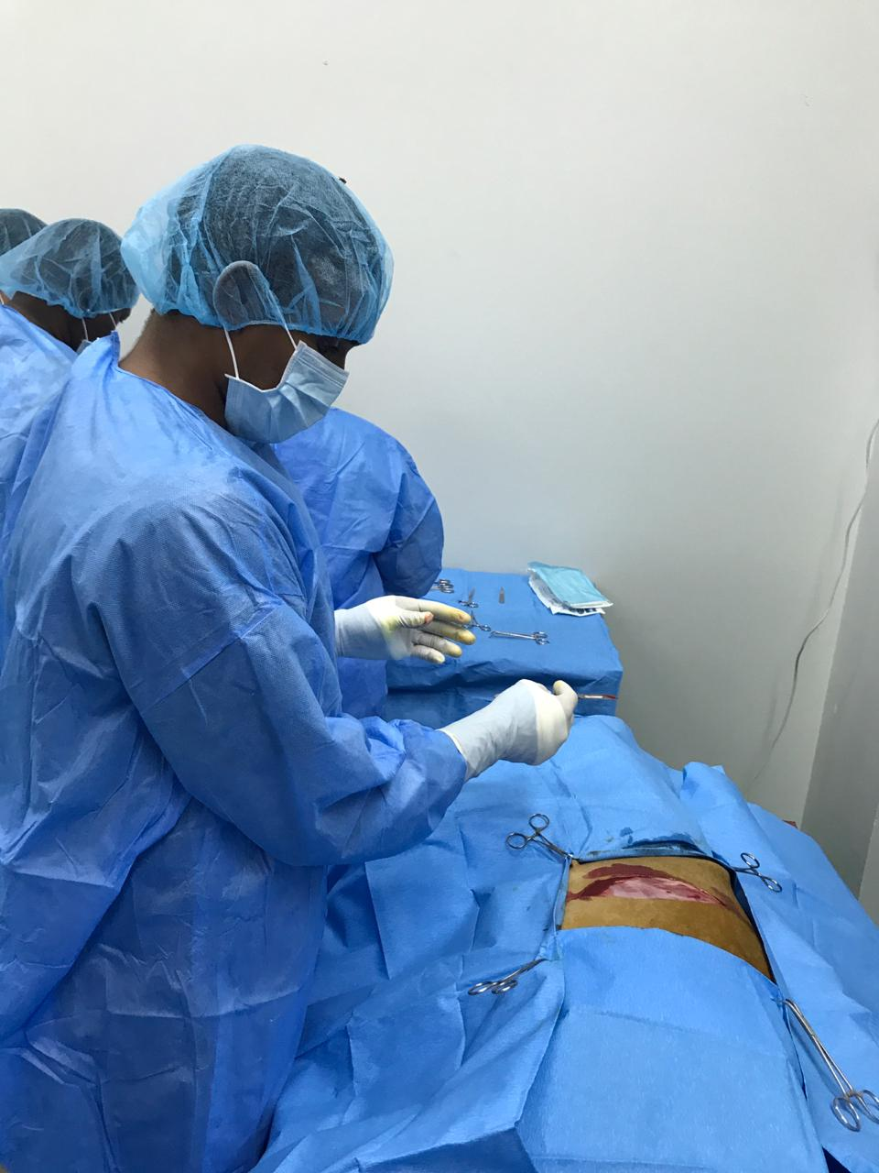

Slide 9
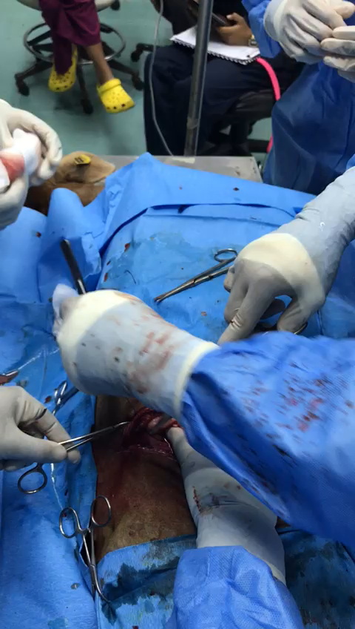
Ligating cutaneous vessel

Slide 10
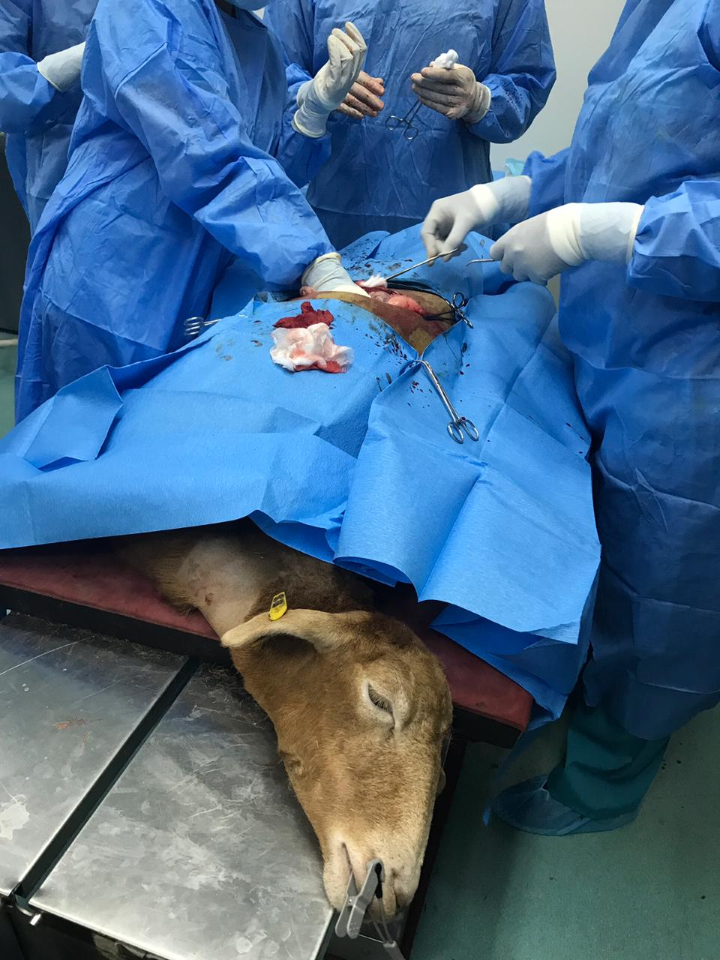
Palpation and Examination of GIT contents in situ

Slide 11
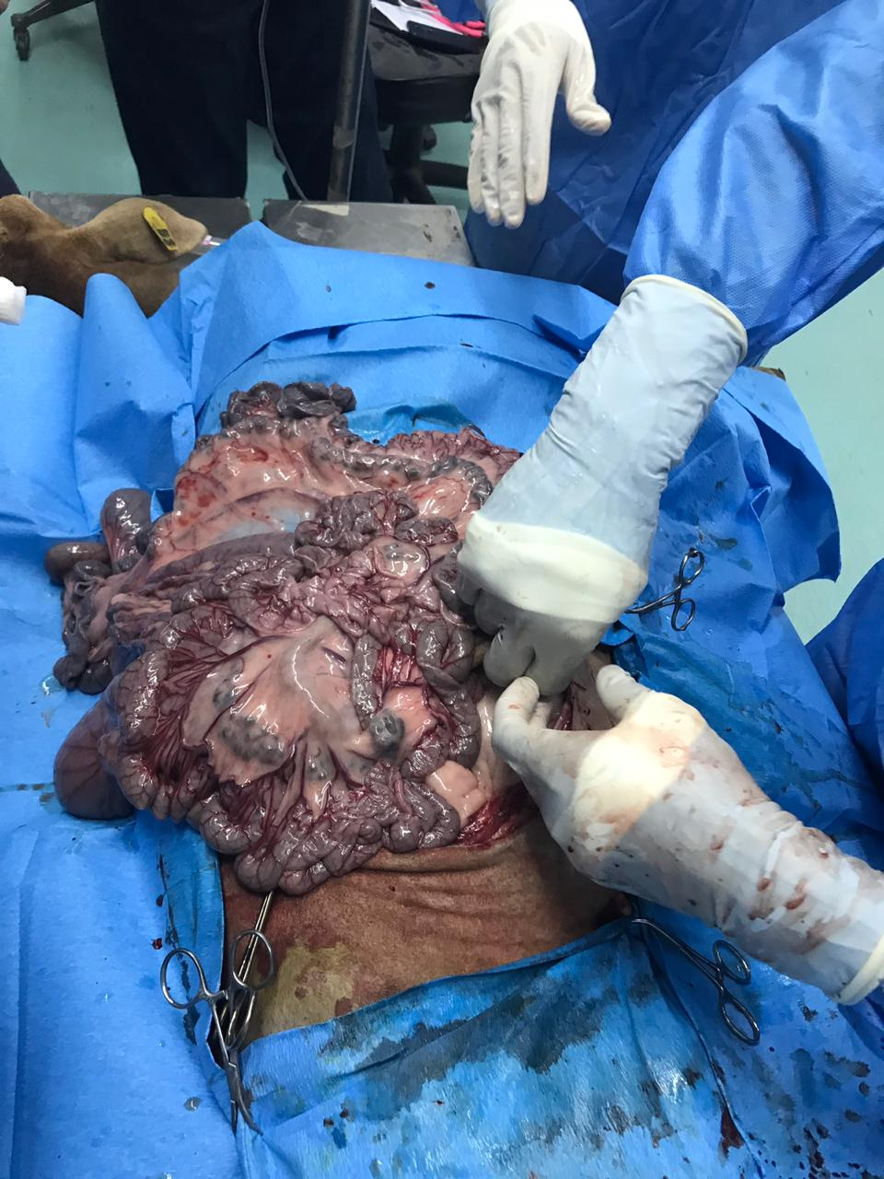
Exteriorization

Slide 12
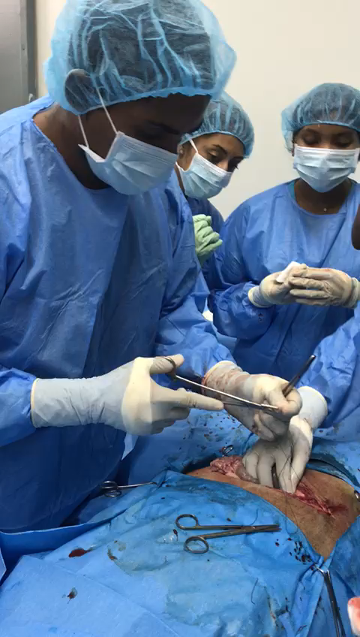
Closing Up

