Slide 1
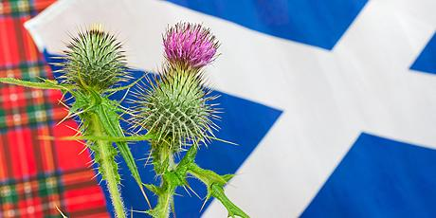
Scotland

Slide 2
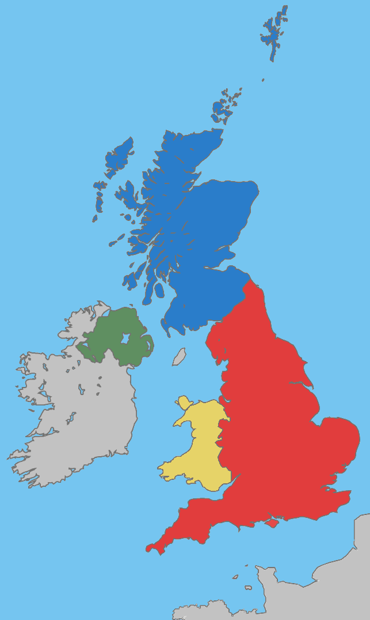
Scotland is in the United Kingdom

Slide 3
Scotland is in the United Kingdom
SCOTLAND

Slide 4
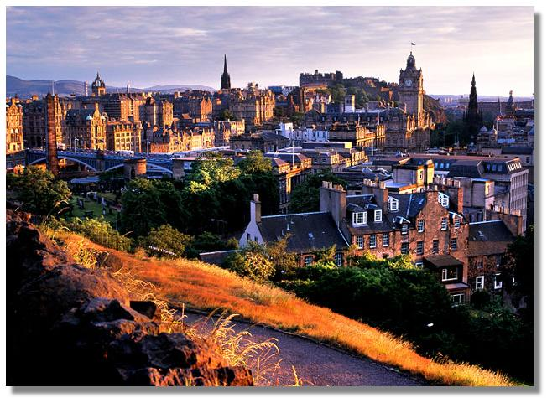
Edinburgh
Edinburgh is the capital city of Scotland.

Slide 5
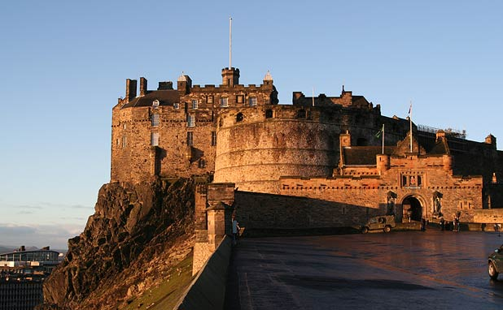
Edinburgh Castle
This is Edinburgh Castle. The castle sits above the city on Castle Rock and is over a thousand years old. The castle was built by King David and many other Scottish Kings lived here.

Slide 6
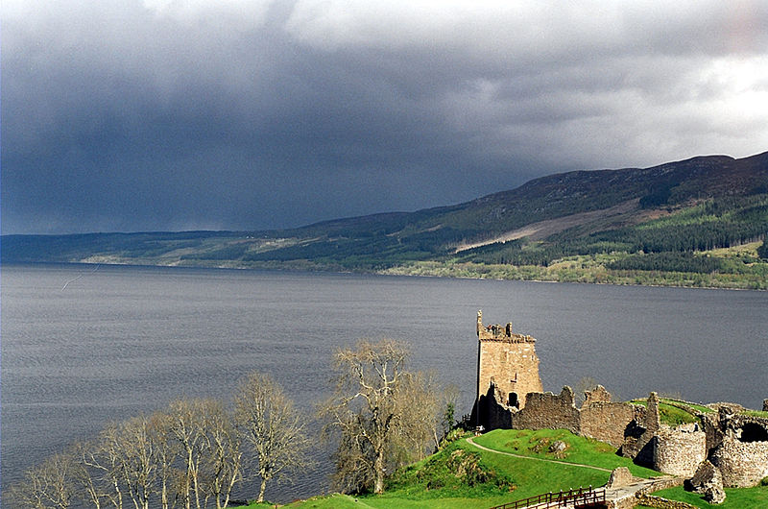
Loch Ness
Loch Ness is a large lake in the Scottish Highlands. It is famous because lots of people have said they have seen a monster there called the Loch Ness Monster.

Slide 7
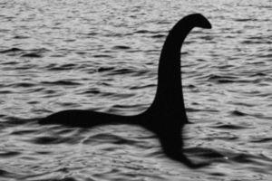

Slide 8
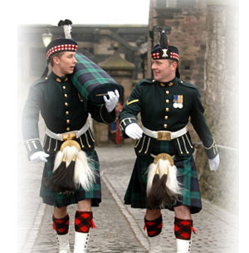
Kilts
A kilt is a traditional dress of men and boys in the Scottish Highlands. It is usually made from woollen cloth with a tartan pattern.

Slide 9
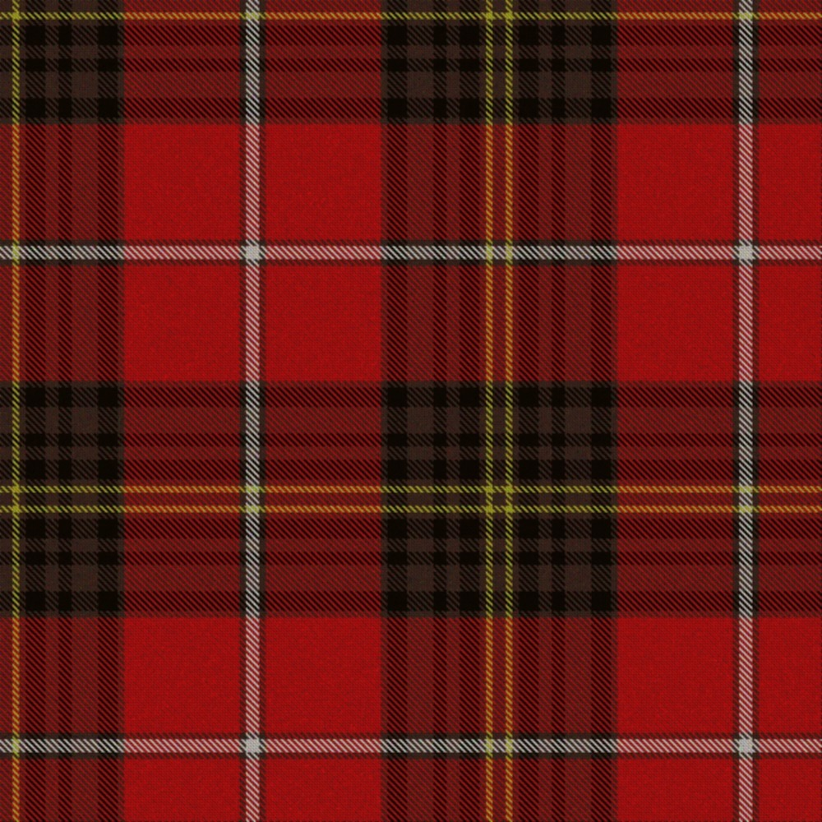
Tartan

Slide 10
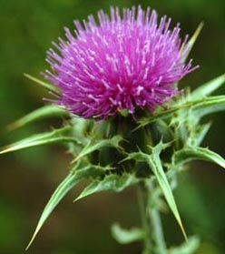
Thistle
The national flower of Scotland is the thistle, a prickly-leaved purple flower which was first used as a symbol of defence.

Slide 11
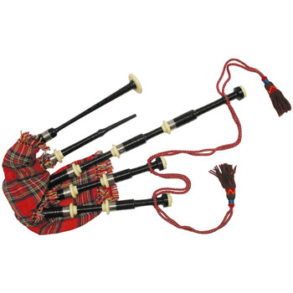
Bagpipes
Bagpipes are the national instrument of Scotland. Every year bagpipe players from all over the world come to Scotland to play in a big bagpipe competition called the World Pipe Band Championship.

Slide 12

Bagpipes at Edinburgh Castle

