Slide 1
Introduction of the Operating System
Welcome Everyone!
Today we will be learning the various operating systems that are on the internet today!
This knowledge will help you decide which operating system you will use in the future.
Click a particular topic in the Navigation Map on the right to go to a particular topic.
Or use the navigation buttons at the bottom right to move between the pages or to return to this Home page.
Enjoy the module!
Operating systemSlide 2
Windows
XP
Vista
Linux
Ubuntu
Fedora

Slide 2
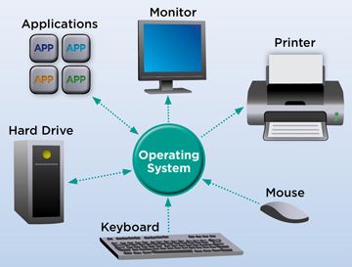
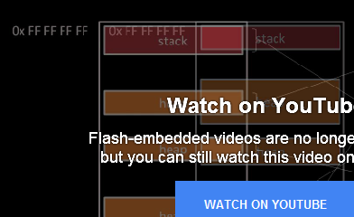
Operating System
What is an operating system?
From Wikipedia, an operating system is a system software that manages computer hardware and software resources and provides common services for computer programs. Click below to watch an introduction.
An illustration of an operating system.

Slide 3
Quiz time!
What is an operating system?
1.
A system software that manages computer hardware and software resources and provides common services for computer programs.
A program that keeps the computer running.
A piece of software.
2.
3.

Slide 4
You have gotten it wrong! Press the button below to try again!
Sorry!
Try again!

Slide 5
Congratulations!
You have gotten it right!

