Slide 1
WELCOME!
This is a module to teach you all about the different types of cars.
This knowledge may help you decide which type of cars to get.
Click a particular topic in the Navigation Map on the right to go to a particular topic.
Or use the navigation buttons at the bottom right to move between the pages or to return to this Home page.
Enjoy the module!
Car
Diesel
Petrol
Asia
Conti
Asia
Conti

Slide 2
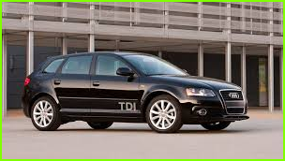
Buying a new car is a unique experience. Like it or not, a new car is likely to be one of the biggest purchases you’ll ever make. Many of us look forward to the process, but others may find it incredibly daunting, especially given the huge amount of choice that faces buyers today – even in just one manufacturer’s showroom.
Either way, Carbuyer is here to help. Here, we show you exactly what to expect, from initial choices like those between new or used, petrol or dieseland even a choice as simple as body style.
Our mission is to help you find your perfect car, while answering any questions you may have about the buying and ownership process.
You can view the range of cars from here.
Considerations between petrol and diesel car, read from here.

Slide 3
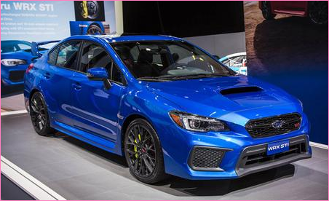
Petrol Cars
A petrol engine is an internal combustion engine with spark ignition, designed to run on petrol and similar volatile fuels.
In most petrol engines, the fuel and air are usually pre-mixed before compression (although some modern petrol engines now use cylinder-direct petrol injection). The pre-mixing was formerly done in a carburetor, but now it is done by electronically controlled fuel injection, except in small engines where the cost/complication of electronics does not justify the added engine efficiency. The process differs from a diesel engine in the method of mixing the fuel and air, and in using spark plugs to initiate the combustion process. In a diesel engine, only air is compressed (and therefore heated), and the fuel is injected into very hot air at the end of the compression stroke, and self-ignites
List of petrol car.

Slide 4
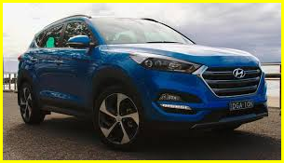
Diesel engines began to be used in automobiles in the 1930s. Mainly used for commercial applications early on, they did not gain popularity for passenger travel until their development in Europe in the 1960s.
Diesel cars continue to develop into highly desired, high performance while retaining power and performance. In terms of pollution, diesel engines generally produce less carbon dioxide than gasoline-based engines but produce more nitrous oxides
List of diesel cars.

