Slide 1
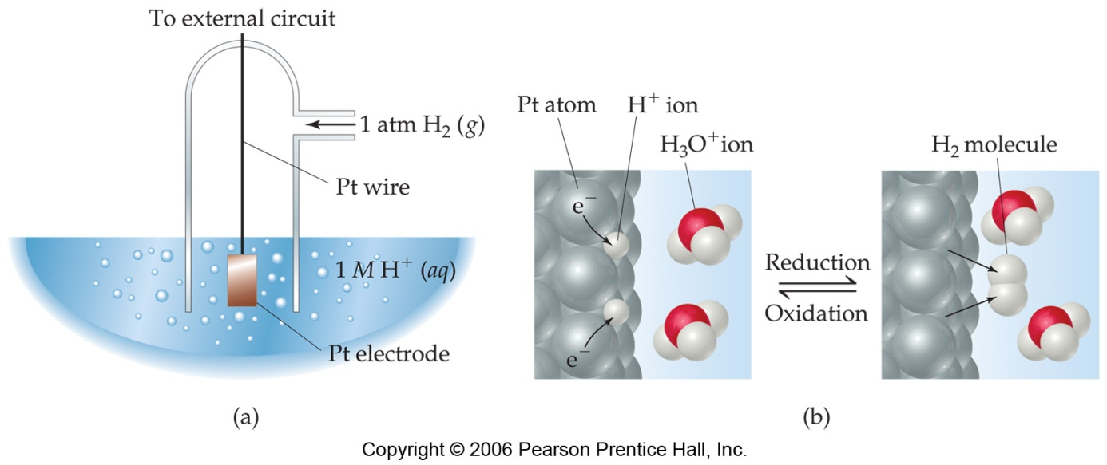
Standard Hydrogen Electrode
https://youtu.be/pORJQyP-2j8
Standard Reduction potential values are referenced to a standard hydrogen electrode (SHE).
The reduction potential for hydrogen is 0 V:
2 H⁺ (aq, 1M) + 2 e⁻ ⎯⎯→ H₂ (g, 1 atm)

Slide 2

Electrode with more +ve Eº_{red} value acts as cathode.
Thus, SHE can act as either cathode or anode when connected to other half-cells.
Eº_{red} for the half-cell = -ve
⇒ the half-cell electrode is anode and SHE is cathode.
Eº_{red} for the half-cell = +ve
⇒ the half-cell electrode is cathode and SHE is anode.
2H⁺(aq) + 2e⁻ H₂(g)
Eº = 0 V
^{SHE}
^{Zinc electrode}
Zn²⁺(aq) + 2e⁻ Zn(s)
Eº = - 0.76 V
^{copper electrode}
Cu²⁺(aq) + 2e⁻ Cu(s)
Eº = + 0.34 V

Slide 3
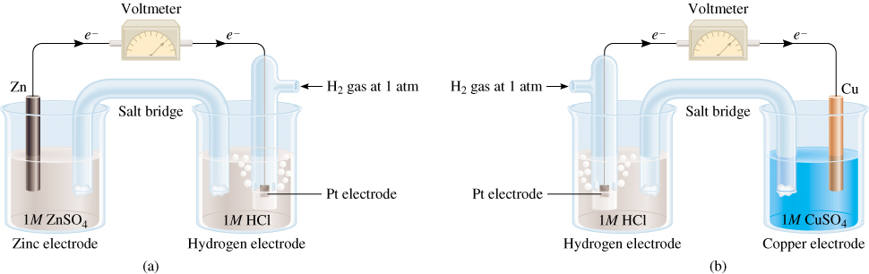
Cathode (+)
Anode (-)

Slide 4
Anode (-)
Cathode (+)

