Slide 1
The potential generated by a reduction half-reaction at an electrode measured relative to the standard hydrogen electrode under standard condition (temperature of 25 ºC , ion concentration of 1 M and partial pressure of gas at 1 atm).
Standard Reduction Potential
Eº_{red} measured the ease of reduction under standard conditions.
o
Eº_{red}
E_{Cu /Cu}
Example :
2+
Reduction
Cu²⁺(aq) + 2e⁻ Cu(s)
Eº = + 0.34 V

Slide 2
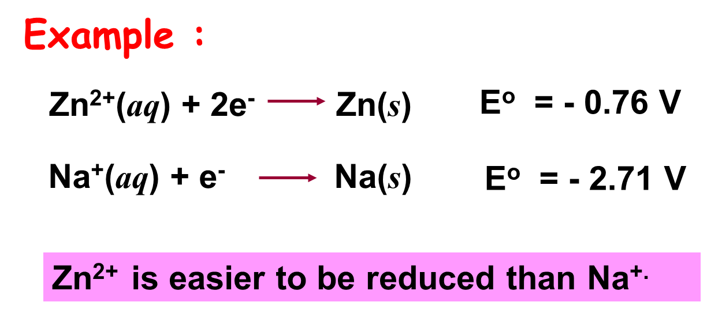
The more positive Eº_{red} (or less negative), the easier the species undergo reduction.
Example :
Zn²⁺(aq) + 2e⁻ Zn(s)
Eº = - 0.76 V
Cu²⁺(aq) + 2e⁻ Cu(s)
Eº = + 0.34 V
Cu²⁺ is easier to be reduced than Zn^{2+.}

Slide 3
To obtain the standard oxidation potentials, the reduction half-reactions are reversed and the sign of Eº changes.
Example :
o
Eº_{red}
E_{Cu /Cu}
2+
Reduction
Cu²⁺(aq) + 2e⁻ Cu(s)
Eº = + 0.34 V
Eº_{ox}
o
E_{Cu/Cu}
2+
Oxidation
Cu(s) Cu ²⁺(aq) + 2e⁻
Eº = - 0.34 V

Slide 4
The more –ve the Eº_{red} value, the greater tendency for the reverse reaction (oxidation) to occur or
The more +ve Eº_{ox} (or less -ve), the easier the species undergo oxidation.
Zn²⁺(aq) + 2e⁻ Zn(s)
Eº = - 0.76 V
Eº_{ox} = + 0.76 V
Cu²⁺(aq) + 2e⁻ Cu(s)
Eº = + 0.34 V
Eº_{ox} = - 0.34 V
Cu²⁺ is easier to be reduced than Zn^{2+.}
Zn is easier to be oxidised than Cu.

Slide 5
Changing the stoichiometric coefficients of a half-cell reaction does not change the value of Eº.
Example :
Cu²⁺(aq) + 2e⁻ Cu(s)
Eº = + 0.34 V
2Cu²⁺(aq) + 4e⁻ 2Cu(s)
Eº = + 0.34 V

Slide 6
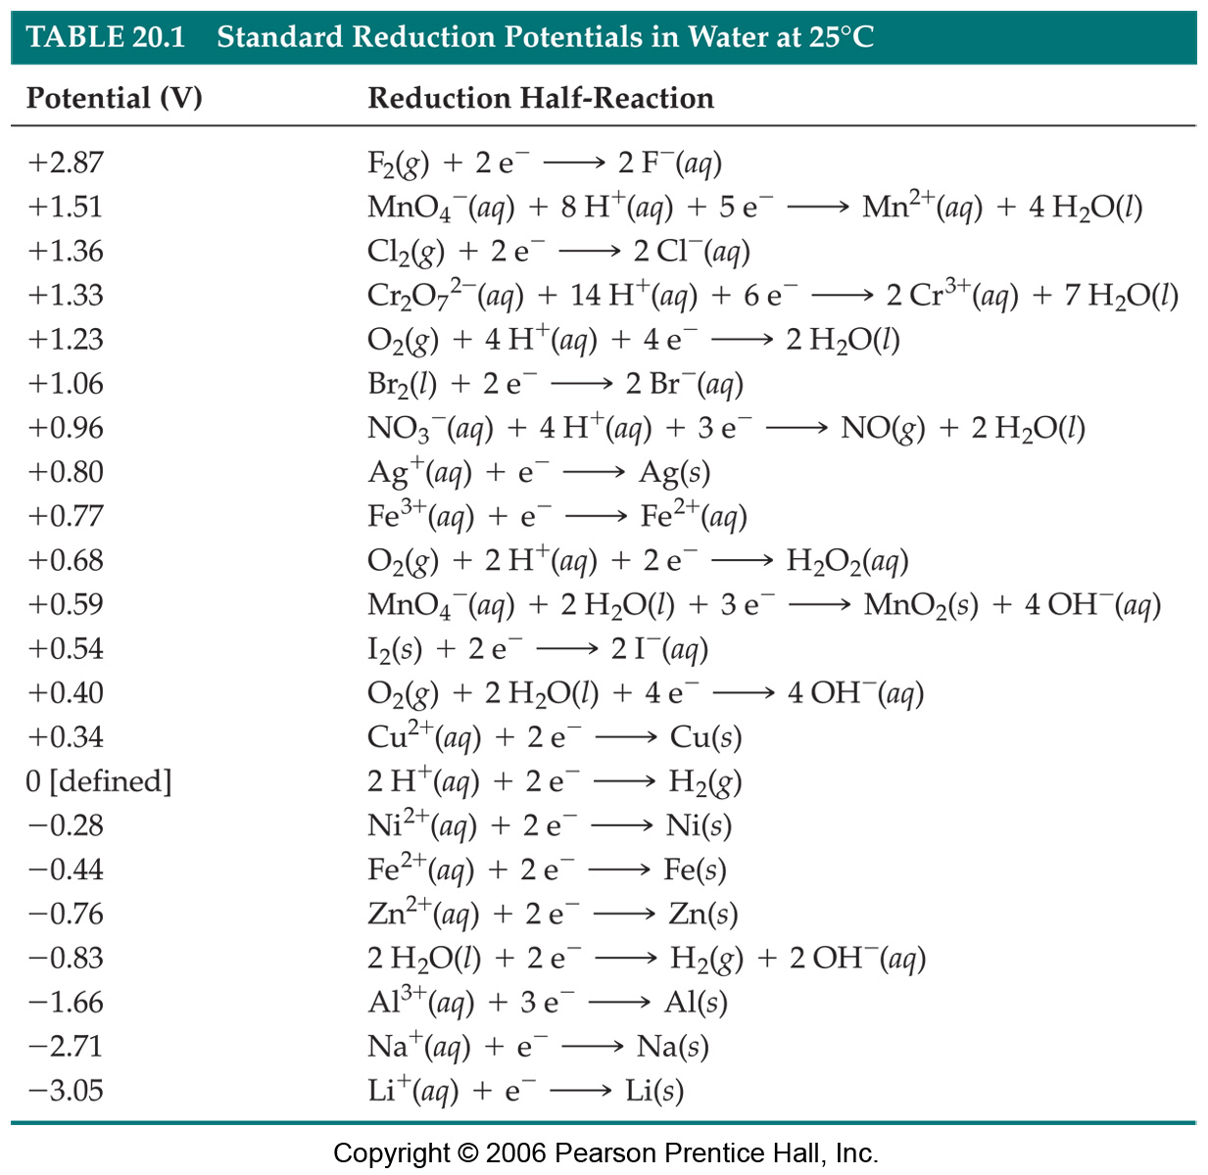
Standard Reduction Potentials
Strongest oxidising agent
Reduction potentials for many electrodes have been measured and tabulated.
O
Stronger oxidising agent
Stronger reducing agent
Strongest reducing agent
R

Slide 7
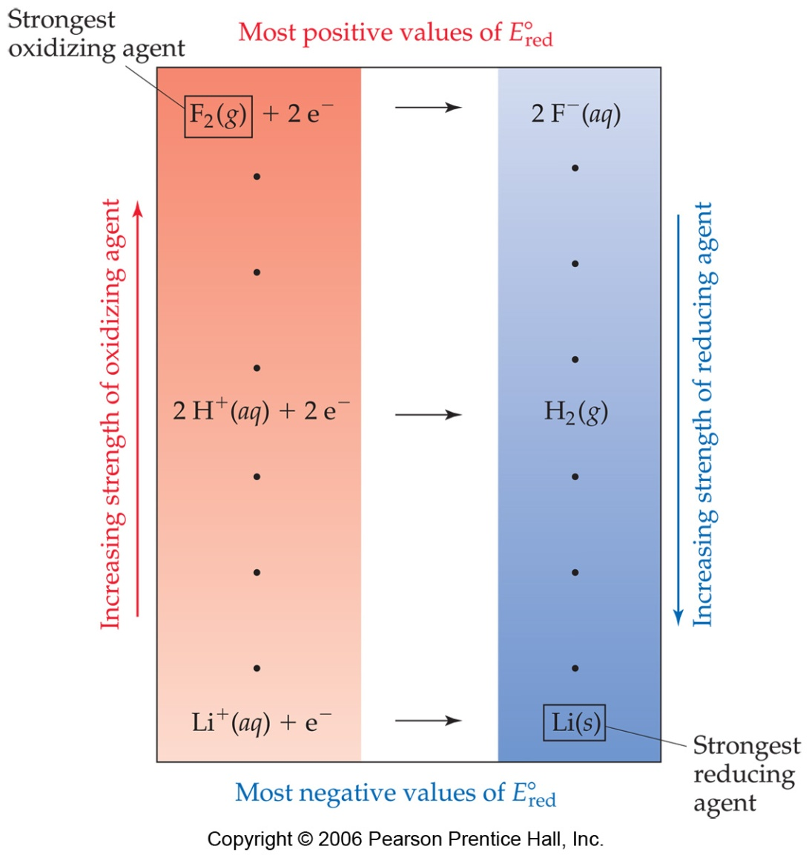
Oxidizing and Reducing Agents
⬇ More positive Eº
More easily electron is gained
More easily reduced
Stronger oxidizing agent
⬇ More negative Eº
More easily electron is lost
More easily oxidised
Stronger reducing agent

Slide 8
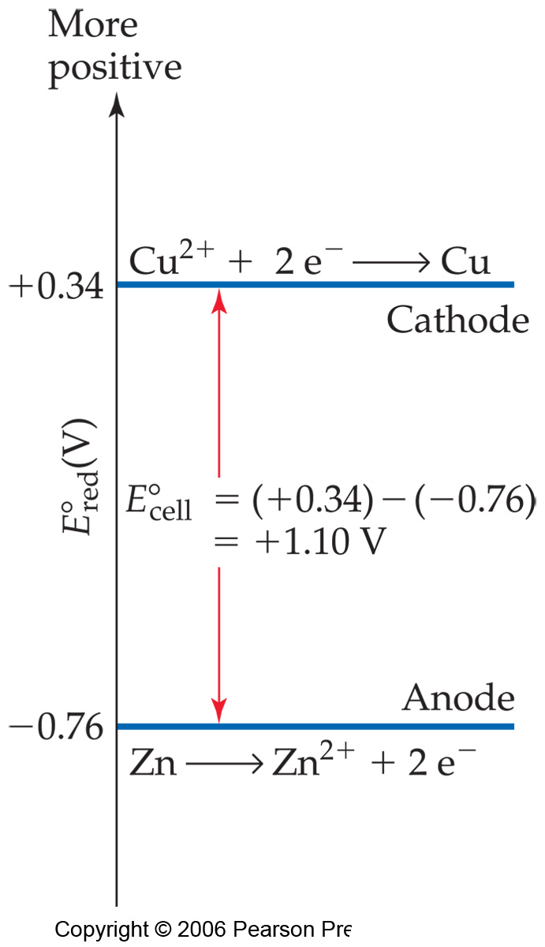
Oxidizing and Reducing Agents
The greater the difference between the two, the greater the voltage of the cell.

