Slide 1
Preventative management
To protect and preserve cattle hooves

Slide 2
Lameness Score | Clinical Description | Assessment Criteria
1 | Normal | The cow stands and walks with a level back posture. Her gait is normal.
2 | Mildly lame | The cow stands with a level back posture, but develops an arched back posture while walking. Her gait is normal.
3 | Moderately lame | An arched back posture is evident both while standing and walking. Her gain is affected and is best described as short striding with one or more limbs or feet.
4 | Lame | An arched back posture is always evident and gait is best described as one deliberate step at a time. The cow favors one or more limbs or feet.
5 | Severe lameness | The cow additionally demonstrates an inability or extreme reluctance to bear weight on one or more of her limbs or feet.
Preventative management in a herd requires knowing the prevalence of lameness and the animal group(s) affected.
This can be determined using a lameness scoring system.

Slide 3
There are several areas on the farm that can lead to bovine lameness.
They include nutrition, feeding management, animal behavior, stress, cow comfort, and infrequent hoof trimming.
Lameness is usually a multifactorial problem. Even though nutrition receives attention as being the main cause, other areas should be evaluated. http://igrow.org/livestock/beef/treating-lameness-in-cattle/

Slide 4
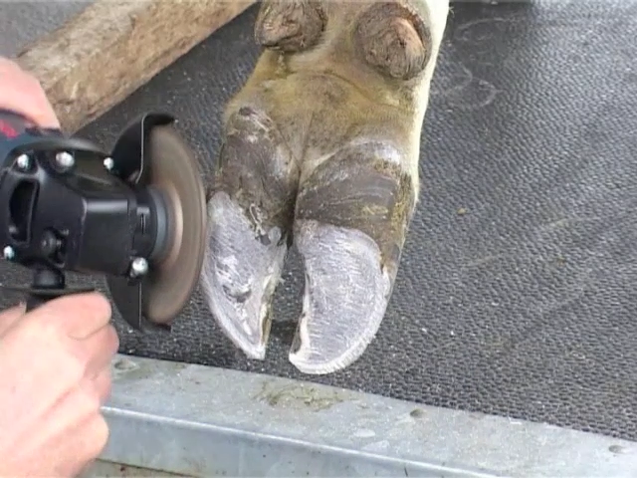
Hoof trimming
Regular hoof trimming may increase the functional life of a dairy cow by a lactation.
Correctly trimming cow’s feet can give the claw stability and enable the cow to distribute weight equally between the claws.
Routine trimming, which removes even small amounts of the horn from the sole, can stimulate horn producing tissues.
This can accelerate production of a new healthy horn. It is recommended to trim feet at least once or twice a year. The ideal times would be once at dry-off and again around 100 days in milk.

Slide 5
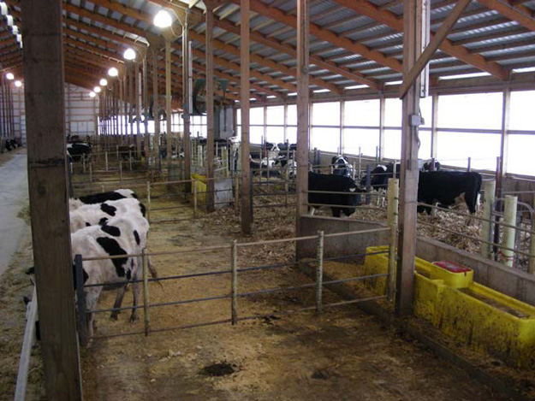
Stall comfort
Adequate stall space should be provided to allow reclining and ruminating for about 10 to 14 hours per day.
The dimensions of the stall must be proper for the size of the animal that is being housed.
Large cows need a stall length of seven to eight feet.
Soft bedding is essential. Sand is optimal stall bedding, providing cows comfort and traction.
In addition, sand must be free of small stones, which can penetrate the sole horn.

Slide 6
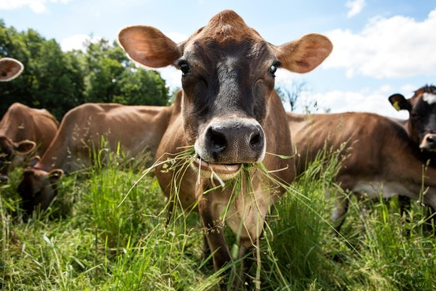
Nutrition
There are several areas in nutrition that can help reduce the risk of foot problems.
They include carbohydrates, protein, trace minerals, and vitamins.
Formulating the ideal ration to maintain good hoof health is not always enough.
Nutrition should be weighed along with other factors in preventing bovine lameness from being a herd problem.

Slide 7
Nutrient guidelines for high producing dairy cattle that help prevent lameness.
 | Stage of lactation
 | Earlyª | Mid | Late
Crude protein, %DM | 17-18 | 16-17 | 15-16
Soluble protein, %CP | 30-34 | 32-36 | 32-38
Degradable protein, %CP | 62-66 | 62-66 | 62-66
Undegradable protein, %CP^{b} | 34-38 | 34-38 | 34-38
Forage NDF, %DM | 21-24 | 25-26 | 27-28
Total NDF, %DM | 28-32 | 33-35 | 36-38
NFC, %DM | 32-38 | 32-38 | 32-38
Copper, ppm^{c} | 11-25 | 11-25 | 11-25
Zinc, ppm | 70-80 | 70-80 | 70-80
Vitamin A, IU/lb. DM | 3500-4500 | 3500-4500 | 3500-4500
Vitamin E, IU/lb. DM | 20-30 | 20-30 | 20-30
Source: Dairy Reference Manual, NRAES-63. Note: Table refers to milk production equivalent to a Dairy Herd Improvement rolling herd average of 18,000 pounds of 4 percent fat-corrected milk. ªRefers to cows approximately the first 15 weeks of lactation. If cows fresh less than four weeks are kept in a separate group or fed individually, or if laminitis is encountered in first-calf heifers, use the following modified specifications: crude protein, 19%; undegradable intake protein, 38%; forage neutral detergent fiber, 24%; minerals, the higher levels indicated in the table. Dry matter intake during the first month may range from 2.2% body weight at calving to 2.8% body weight at 14 days and 3.3% body weight at 30 days. ^{b}Use more than one high-protein ingredient to meet undegradable protein intake needs. Often lysine and sometimes methionine are the most limiting amino acid. ^{c}Use the higher copper levels when low-serum copper occurs on rations containing usual levels of 10 to 12 ppm. Induced copper deficiency may result from excessive intake of iron, manganese, molybdenum, and sulfur.

Slide 8
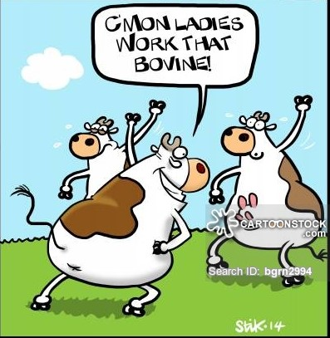
Behaviour and stress
Dairy cows should be allowed to lie down 10 to 14 hours per day.
Their lying time can be reduced because of poorly designed housing or stalls that are uncomfortable or too few in number.
Prolonged standing causes sore feet that can become susceptible to disease.
Exercise is important for stimulating blood flow through the feet and keeping the tissues healthy.

Slide 9
Too little exercise can cause sluggish blood flow, edema, and swelling.
Too much exercise and concussion on concrete floors, especially for heifers that have been on pasture, can cause trauma and mechanical damage and a greater incidence of sole ulceration.
Preventing laminitis in heifers may consist of a separate heifer group where animals are acclimated to their new environment allowing for increased resting time and minimized aggression.

Slide 10
