Slide 1
Complications, prognosis and post operative care

Slide 2
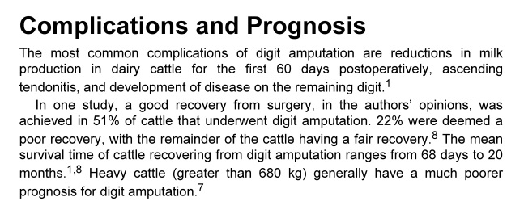

Slide 3
Post op for Limb Amputation

Slide 5
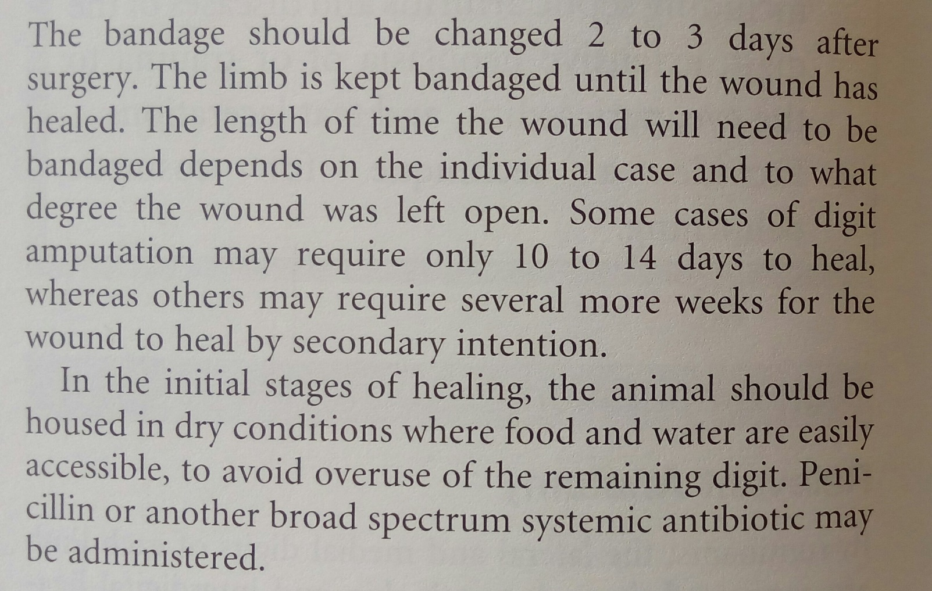
Post-op for Digit amputation

Slide 6

https://www.youtube.com/watch?v=-0nyT1ObgUc

