Slide 1
Hoof care-Treatment
In cattle

Slide 2
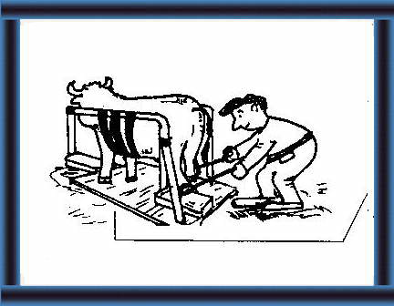
Treatments can consist of hoof trimming, foot baths, and/or topical applications.
Depending on the problem, a veterinarian and hoof trimmer should be consulted as to the best method of treatment.
A combination of several treatment protocols may be necessary to correct individual and herd problems

Slide 3
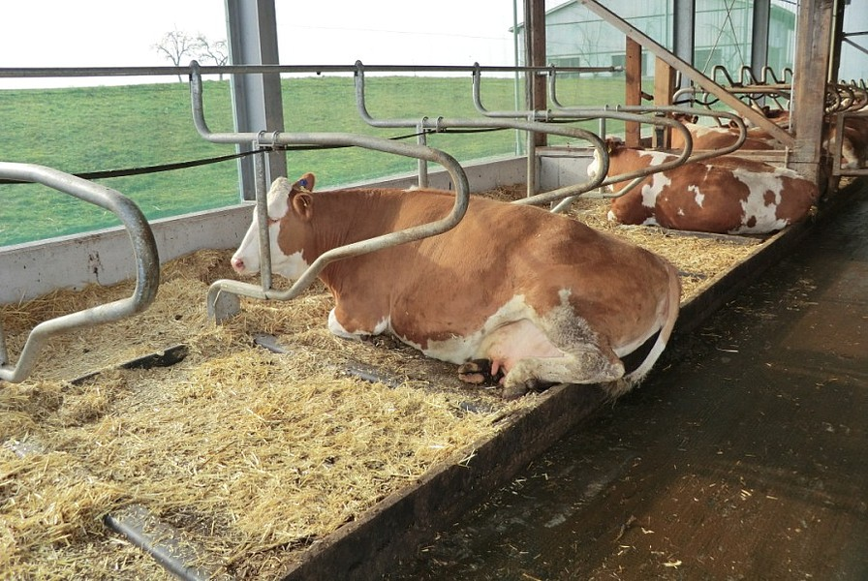
Restoring feet to proper hardness
If feet are too soft avoid having cows stand in moist sod for extended periods of time.
Allow cows to stand in dry soil or sand, even if it means piling it on concrete for cows to stand on.
If feet are too hard, allow cows to stand or graze on sod, especially when it is moist or dew-laden, but not soft or muddy

Slide 4
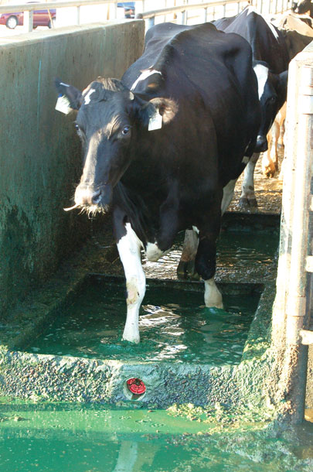
Routinely use a dry mineral mixture in a walk-through foot box.
The foot bath should contain five percent copper sulphate. The depth of the solution should be at least four inches.
The foot bath should be located where cattle must pass through it several times a day.
An alternative to the foot bath is a dry bath containing one part copper sulphate to nine parts hydrated lime.

Slide 5
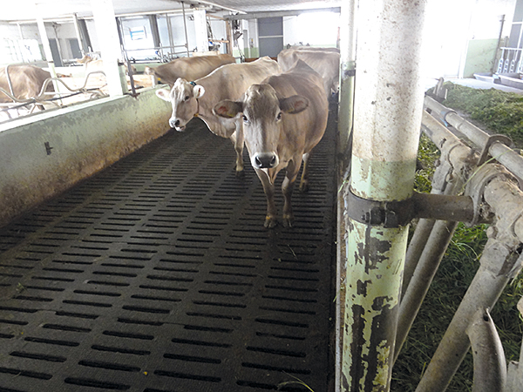
For herd problems, moist clay can be used in a foot box or vat, but slats may be necessary in the container to prevent slipping.
Plain water can be used if it is drained and replaced frequently.
For individual problems, a hoof ointment can be rubbed into the coronary ban at the hairline of the foot.

Slide 6
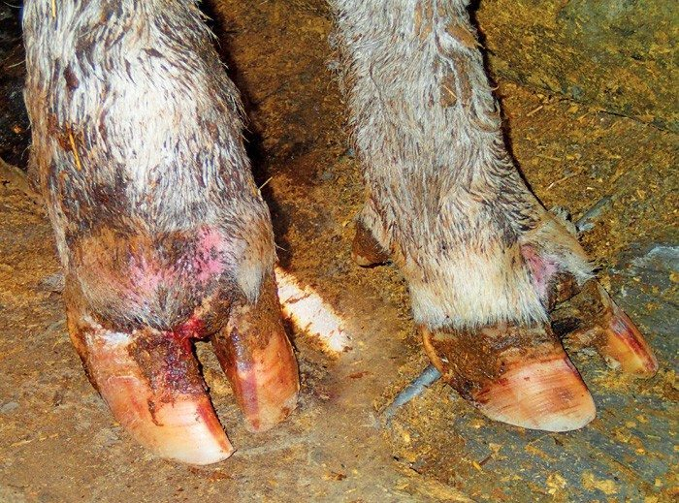
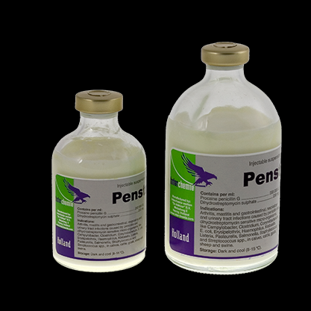
Foot Rot
Treatment consists of parenteral administration of antibiotics and/or plus local therapy.
The interdigital area should be washed and any loose necrotic tissue removed.
Topical dressings of antibiotics, sulfas, or antiseptics have been used with success.

Slide 7
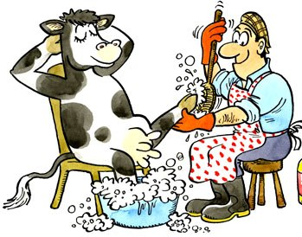
If the infection has spread to deeper tissues, a drawing ointment may be beneficial.
Affected animals should be separated from the herd and confined to prevent the spread of the organism.
Isolating individual cows, rigid sanitation in high-density areas, and use of a foot bath has proven helpful in controlling the spread of foot rot.

Slide 8
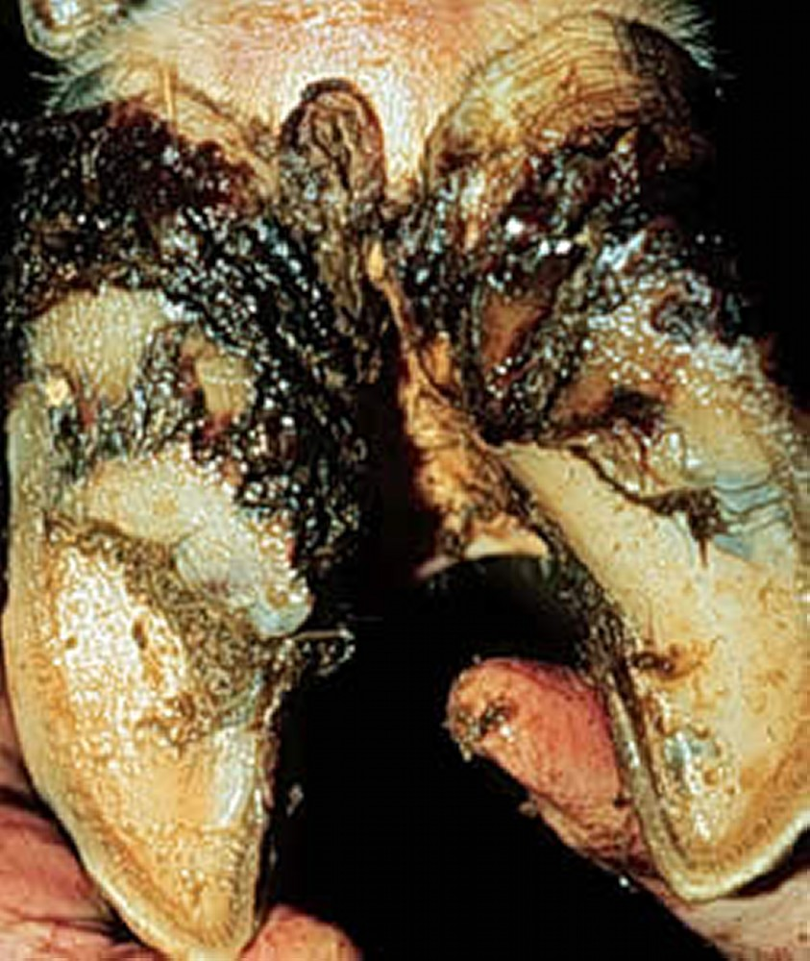
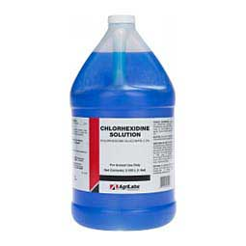
Heel Erosions
Treatment should be first directed toward removal of all the unsound horn.
After cleaning, the exposed area may be treated with a disinfectant liquid.
The cow should be confined for several days until the newly exposed sole hardens.

Slide 9
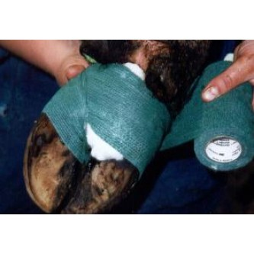
In more severe cases in which sensitive tissue is exposed, a protective bandage applied over an astringent medication may be necessary in addition to confinement.
Herd control involves genetic selection for strong feet and legs without excessive slope to the pastern.
Feet should be trimmed regularly, avoid excessive exposure to wet environments and utilize a dry foot bath.

Slide 10
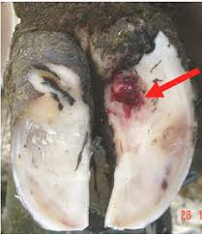
Sole Ulcers
Initial treatment of sole ulcers is to relieve the pressure on the ulcer.
Therapeutic trimming consists of paring out the affected area around the ulcerated sole or lesion, which helps to relieve pressure and allows healing to occur.
Topical application of copper sulphate and/or astringents followed by bandaging is necessary to control infection and prevent regrowth of the granulation tissue.

Slide 11
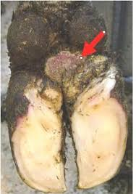
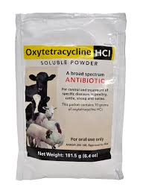
Digital Dermatitis
There are no treatments labelled for this condition since the specific cause of foot wart is unknown, thus the use of drugs requires a label and instructions from a veterinarian.
In the initial stage of the disease, because of the pain, allowing animals to walk normally is critical.
This means treatment of the infected area by removing debris from the specific lesion plus using a topical application of caustic chemicals and/or antibiotics.

Slide 12
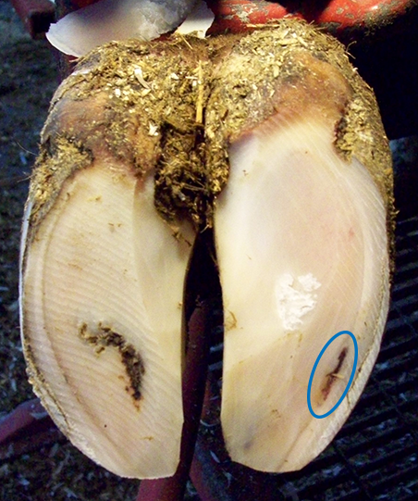
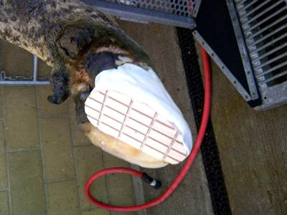
White line disease
The objective is to functionally trim the claw, remove weight from the injured (usually outer) claw, and remove sufficient wall surrounding a lesion to expose healthy horn at the borders of the lesion.
The heel of the affected claw should be trimmed level or lower than the sound claw, providing the sole does not become too thin. Affected claws should be blocked if this is not possible.
Severely affected animals should be housed on a bedded pack until they have recovered.
Animals receiving a block should be re-examined in 4–5 weeks, with the block removed if healing has occurred, or replaced for an additional 4–5 weeks if more time is needed.

Slide 13
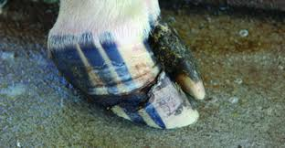
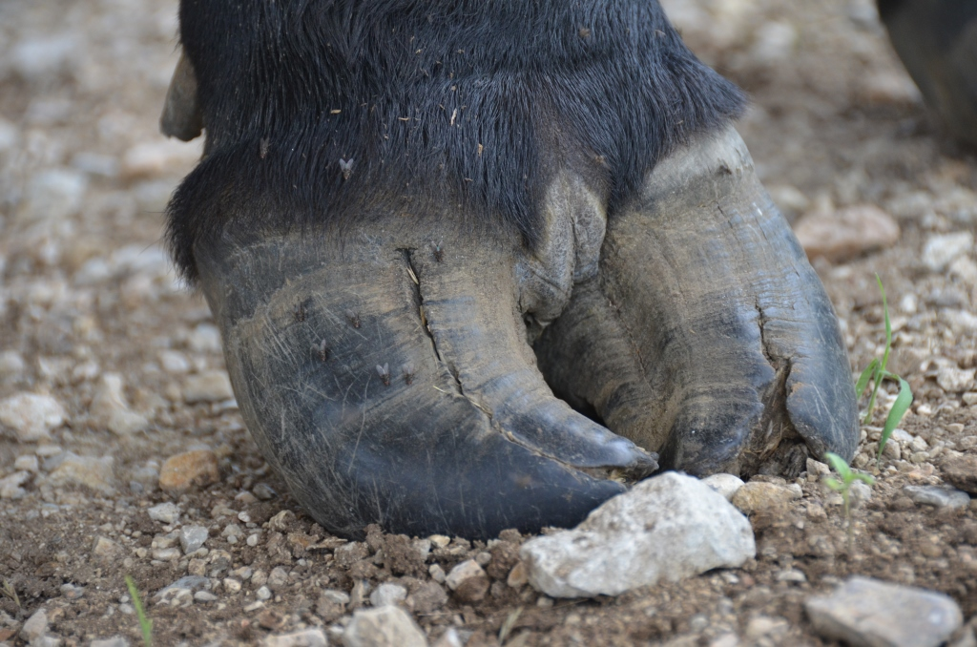
Wall cracks
http://www.developmentvet.aun.edu.eg/animal%20surgery/L_21e.htm

