Slide 1
Post-Operation
Exploratory Laparotomy

Slide 2
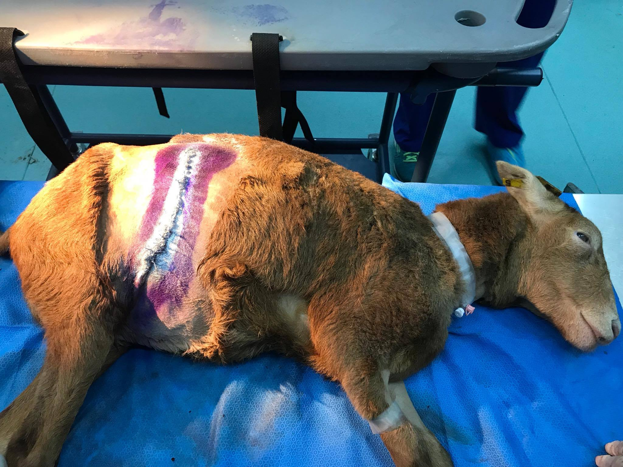
Immediately after surgery

Slide 3
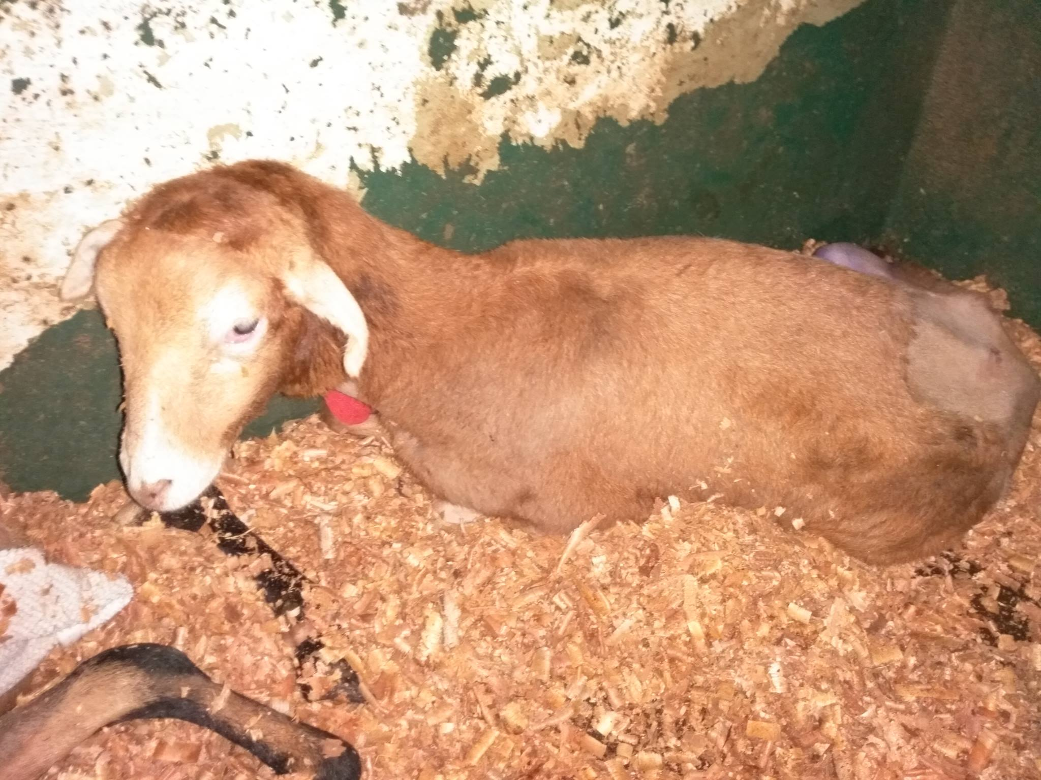
Patient in the recovery pen

Slide 4
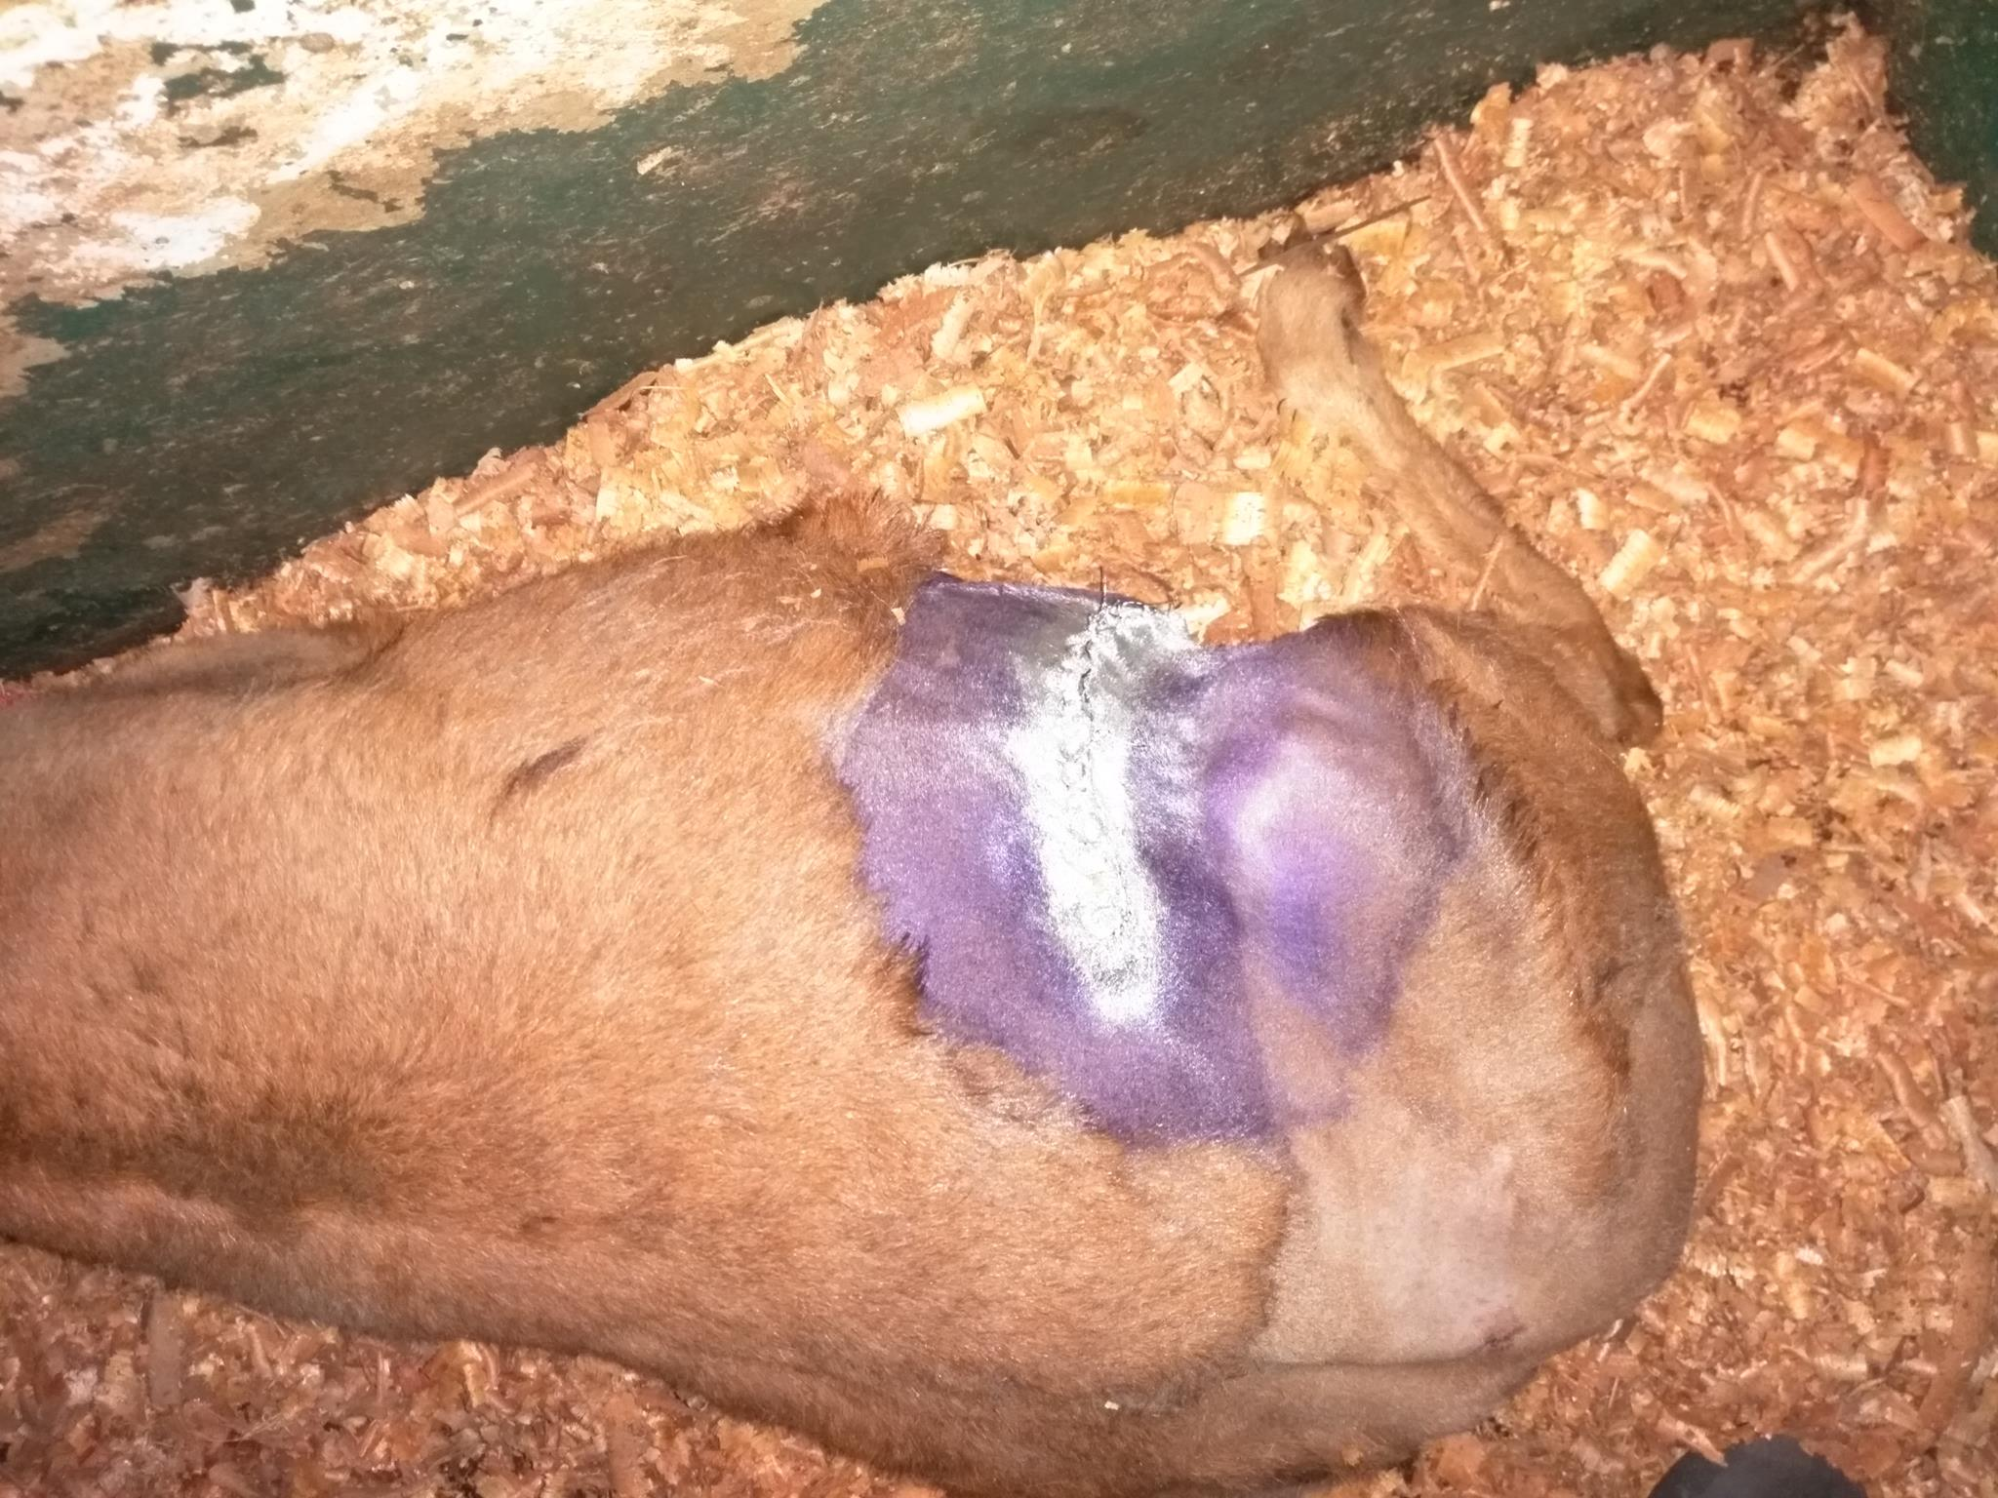

Slide 5
Post-Operation
Immediately after surgery the sheep was taken to the recovery pen and placed in sternal recumbency.
1ml of Tetanus Anti-toxin was given.
After 15 minutes she made her first attempt to stand. Approximately after 1 hour she was standing.
For the following two days after surgery she was given Flunixin at 0.8mg/kg IV.

Slide 6
Post-Operation
The next day after surgery some lameness was observed with her hind legs.
Note her hooves were not trimmed and may have attributed to this cause.
Action plan at this time was to trim the hooves and observed for a couple more days.
Penicillin Streptomycin was given on the 3rd day (Friday) after surgery. At this time no lameness was observed without trimming the hooves.
On the 5th day(Sunday) after surgery, her hooves were trimmed. She was BAR, eating, also strong rumen contractions were heard. No swelling at the incision site.

Slide 7
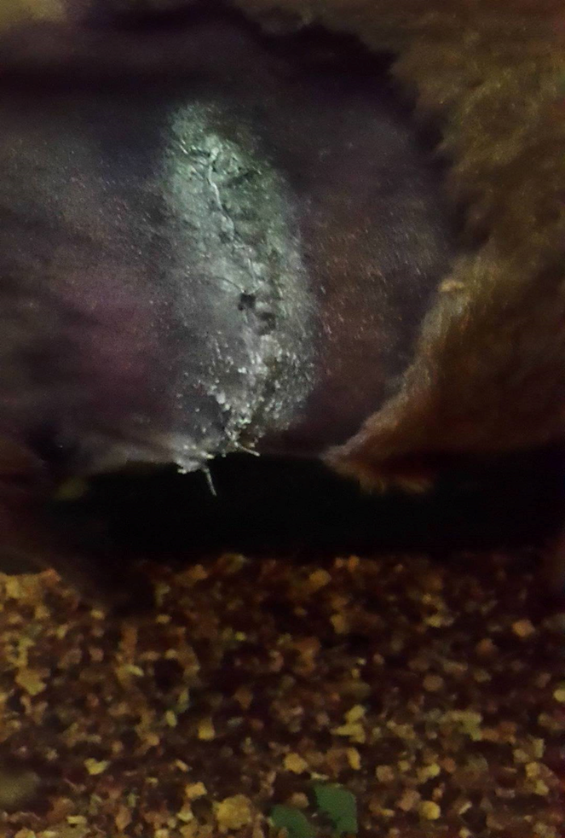
Post-Operation 5 days after urgery.

Slide 8
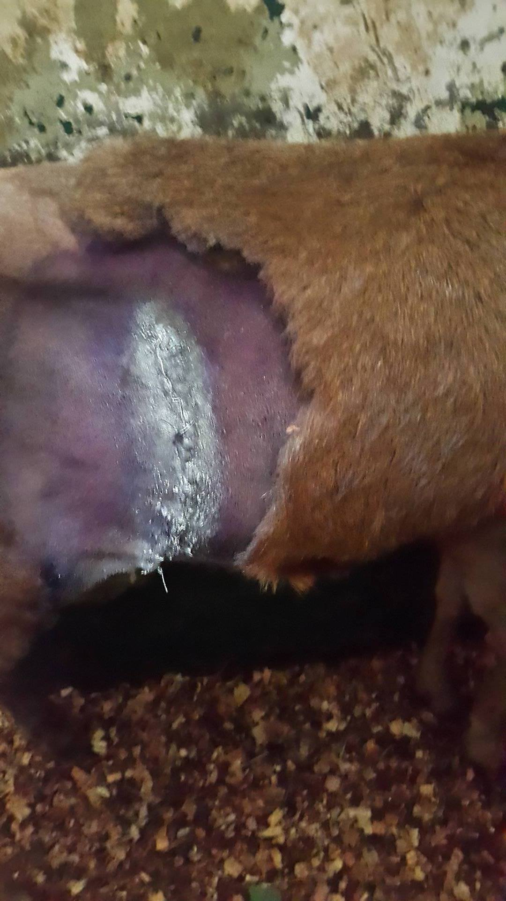

Slide 9
Complications
Dead space due to poor apposition of the muscle layers. This allows accumulation of fluid which promote infection.
Systemic toxicity from local and regional anaesthesia.
Trauma to the incision site. (Especially when the animal is trying to stand/ recover from anaesthesia)

Slide 10
Client Consideration
The Client should be advise to:
Restrict movement of the sheep for 2 weeks. Therefore should be kept in a clean pen.
Keep the wound dry and clean at all times. Spray anti-myiasis twice daily.
Have accessible clean fresh water and normal feeding routine should resume.
Return after 14 days to remove the stitches by the veterinarian.
Call the veterinarian immediately if the sheep is recumbent or has stopped eating.

