Slide 1
Herniorrhaphy for Big Joe
Lab 7

Slide 2
Indication
A hernia is formed by the protrusion of certain abdominal organs through an acquired or congenital opening in the abdominal wall. The hernia always has three constituents present which include the hernia ring; the hernia sac which is composed of the peritoneum; and hernia contents which may include a loop of intestine or a portion of the uterus, stomach or omentum. According to their location, hernias are classified as umbilical, inguinal, scrotal

Slide 3
Equipment
Hog snare
Rope/Halter
Electrical Scale
Cotton Gauze
Electrical Clippers
Thermometer
Stethoscope
Sterilize Surgical Pack
Needles and Syringes
Scrubs & Covered toe shoes
Gloves, surgical mask, hair net and shoe covers.
7 % Iodine, 70% Alcohol, Chlorohex scrub
Sterilize Basic Surgery pack
1.0 Catgut, 2.0 Lactomer (polysorb), 2.0 Nylon
Saline drip bag and stand
Surgical tape
Head rest (saline drip bag)
IV catheter 18”
Extra Large Hemostat (Doyen Intestinal)
Forceps
Trolley (transportation)
Pulse oximeter
Heating pad
Tetravet Antibiotic spray
Silver Bandage spray
Metabicheras forte dodge (larvicidal)
Hep-saline solution.

Slide 4
Signalment
Name: Big Joe
Sex: male
Weight: 70.5kg
Species: Porcine
Breed: Yorkshire
ASA grade: 1
Body condition score: 3/5

Slide 5
Body condition scoring chart for pigs

Slide 6
Distance Examination
Big Joe was Bright, Alert and Responsive
He was very inquisitive.
There was a large mass near the genital area

Slide 7
Physical Examination
https://www.youtube.com/watch?v=cz2DhMcOGCk
Youtube video above is on Physical examination of pigs.
Upon physical examination of the mid-ventral abdomen revealed a warm, soft but firm swelling confined to the preputial area. A 4cm (two finger widths) opening was palpated along the midline beneath the preputial swelling.
Temperature 39 ºC
Pulse rate: 100 bpm
Resp Rate: 40
Capillary Reflex Time: ˂ 2 sec
Weight 70.5kg

Slide 8
Drugs
Drugs | Dose/ Concentration | Calculations | Volume per site | Withdrawal Time | Route &Comments
Anaesthetic/ Sedative |  | $$\frac{Weight x Dose}{Concentration}$$
Lidocaine | Toxic dose*: 2% of 10 mg/kg Recommended Max dose for pig: (half toxic dose*) 2% of 5 mg/kg Recommended Loading dose for cow: 2% of 1 mg/kg | Toxic Dose* $\frac{70.5 x 10}{20}$ = 35.25ml Maximum Vol can be administered*: $\frac{70.5x 5}{20}$ = 17.6 ml Loading dose: $\frac{70.5 x 1}{20}$ = 3.53ml Splash dose: 10 ml Lidocaine + 10 ml Saline = 20 ml mixture | Loading dose: 3.5 ml | 4 days for meat | IV for loading dose SC for splash dose Onset: 15 min Duration: 60 min Note: Splash dose of Lidocaine was administered intermittently when the animal exhibited signs of pain over the incision site. *Note: this is the toxic dose for Ruminants but was used as a guideline for the pig, even though pigs can tolerate more Lidocaine.

Slide 9
Drugs
Drugs | Dose/ Concentration | Calculations | Volume per site | Withdrawal Time | Route &Comments
Anaesthetic/ Sedative |  | $$\frac{Weight x Dose}{Concentration}$$
Xylazine | Recommended Loading dose 2% of 1.0 mg/kg ʱ | Loading Dose: $\frac{70.5x 1}{20}$ = 3.53 ml | Loading Dose: 3.5 ml | 4 days for meat | IM Onset: 10 min Duration: 45 min ʱ Note: 1.0 mg/kg was the actual volume used in the surgery, but it is recommended that for the loading dose for pigs of Xylazine is 2.0 mg/kg
Ketamine | Recommended Loading Dose 10% of 5 mg/kg | Loading Dose: $\frac{70.5 x 5 }{100}$ = 3.53 ml | Loading Dose: 3.5ml | 3 days for meat | IM Onset: 10 min Duration: 45 min

Slide 10
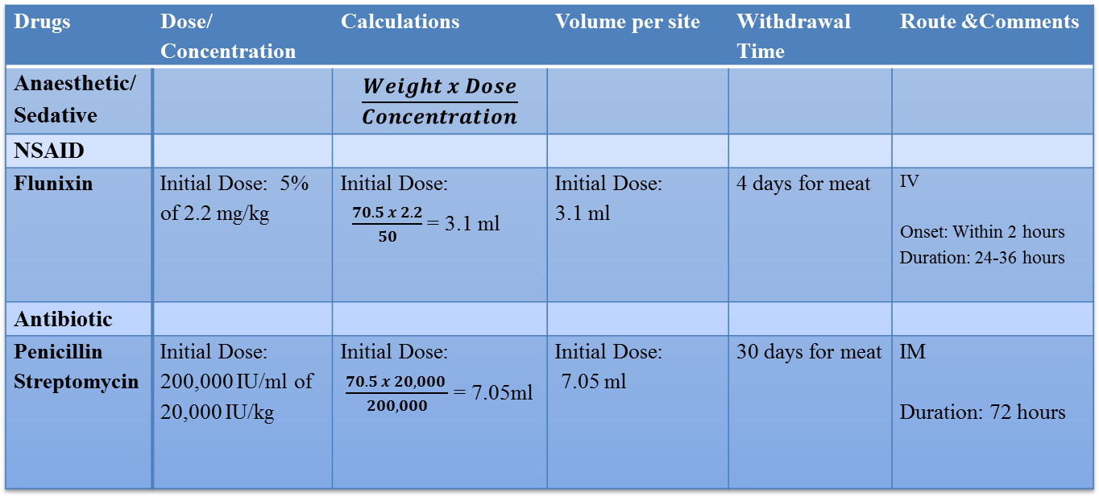
Drugs
Additional volumes of Ketamine an Xylazine were given IV intermittently every 30 mins or as needed approx. 1.8ml. Total Ketamine given 14.2ml. Total Xylazine given 10.7ml.
Total 2 % lidocaine used including for splashing was 28.5 ml not crossing the toxic dose 35.25ml

Slide 11
Reversal Drug
Drugs | Dose/Concentration | Calculations | Volume | Route & Comments
Atropine | 0.54 mg/ml of 0.04mg/kg | $\frac{0.04 x 70.5 }{0.54}$ = 5.22ml | 5.2 ml | IV/IM Used for Bradycardia
Epinephrine | 0.1 % of 0.02 mg/kg | $\frac{0.02 x 70.5}{1}$ = 1.41 ml | 1.4 ml | IM Used for anaphylactic shock Signs include respiratory depression, excess salivation, urticaria, rhinitis, facial and limb oedema
Tolazoline | 10 % of 1 mg/kg – 2 mg/kg (Recommended 2-4 times xylazine dose) | Lower Limit: $\frac{1 x 70.5}{100}$ = 0.705 ml Upper limit = $\frac{2 ×70.5}{100 }$ = 1.41ml | Lower Limit = 0.71 ml Upper limit = 1.41 ml | IV slowly Used to reverse xylazine. If signs of xylazine toxicity (bradycardia, hypotension and respiratory depression) are seen administer the lower limit, 0.71 ml. If signs continue after some time add 0.71 ml or less to reach the upper limit. BUT do not cross the upper limit.

Slide 12
Continuous Infusion Rate
Drugs | Concentration | Dose | Calculation
Xylazine IV | 20mg/ml | 1mg/kg/hr | $\frac{1}{5}$ X 1000= 200 $\frac{200}{20}$= 10ml
Ketamine IV | 100mg/ml | 5mg/kg/hr | $\frac{5}{5 }$ X 1000 = 1000 $\frac{1000}{100}$ = 10ml
Lidocaine IV | 20mg/ml | 1mg/kg/hr | $\frac{1}{5}$ X 1000= 200 $\frac{2000}{200}$ = 10 ml

Slide 13
Drip Rate
Drip rate =
$$\frac{\text{\{}\text{Weight} \text{of} \text{animal}\text{ (}\text{kg}\text{) }\text{×} \text{Fluid} \text{rate}\text{ (}\text{ml}\text{/}\text{kg}\text{/}\text{hr}\text{) }\text{×} \text{Drip} \text{factor}\text{ (}\text{drop}\text{/}\text{ml}\text{)\}}}{\text{\{60 (}\text{min}\text{/}\text{hr}\text{) }\text{×}\text{ 60 (}\text{seconds}\text{/}\text{min}\text{)\}} }$$
Drip Rate $\frac{\text{\{}\text{70.5}\text{ (}\text{kg}\text{) }\text{×}\text{ 5 (}\text{ml}\text{/}\text{kg}\text{/}\text{hr}\text{) }\text{×}\text{ 20 (}\text{drop}\text{/}\text{ml}\text{)\}}}{\text{\{60 (}\text{min}\text{/}\text{hr}\text{) }\text{×}\text{ 60 (}\text{seconds}\text{/}\text{min}\text{)\}} }$
= 1.95 drops/second ~ 2 drops/second

Slide 14
Preparation for Surgery
The snare was place around Big Joe’s snout, then he was moved from the hospital pen to the large animal unit.
He was then placed unto an electrical scale and weighed. (70.5kg)
After which, he was restrained and then sedated using Xylazine (3.5ml) and ketamine(3.5 ml)injections. Following that he was given Flunixin (3.1ml) and Pen-strep (7.1ml) on the opposite side of the neck. These loading volumes of drugs were administered IM via the neck muscle.
The smegma was extruded from the prepuce.
After 8 minutes, he was turned into dorsal recumbency and a wide margin around the hernia was clipped as clean as possible.
Following that chlorohexidine solution in water was used to wipe the area with unsterile gauze.
Big Joe was placed onto the trolley in lateral recumbency and rolled to the large animal theatre.

Slide 15
Preparation for Surgery
Upon reaching the large animal theatre, Big Joe was transferred onto the operating table in dorsal recumbency. His hind legs were stretched out and tied with a double half-hitch knot to the table to secure him.
Also a saline bag was place underneath his head for support.
Then the ear vein was accessed to place a catheter in, so the IV line could be attached with the saline bag to the animal.
After securing the IV line, ketamine (3.5 ml) and lidocaine (3.5 ml) was slowly injected into the line.
The surgeons began their scrubbing of the surgery site, using chlorohexidine solution, Iodine and sterile gauze.
Following that Big Joe was draped and now ready for the surgery to begin.

Slide 16
Preparation for surgery- sedated and ready for clipping

Slide 17
Preparation for surgery: Scrubbing video. (please press play)

Slide 18
Preparation for surgery: Big Joe scrubbed and draped.(video please press play)

