Slide 1
Pinky-Intra Operation Pictures
A flow of the procedure

Slide 2

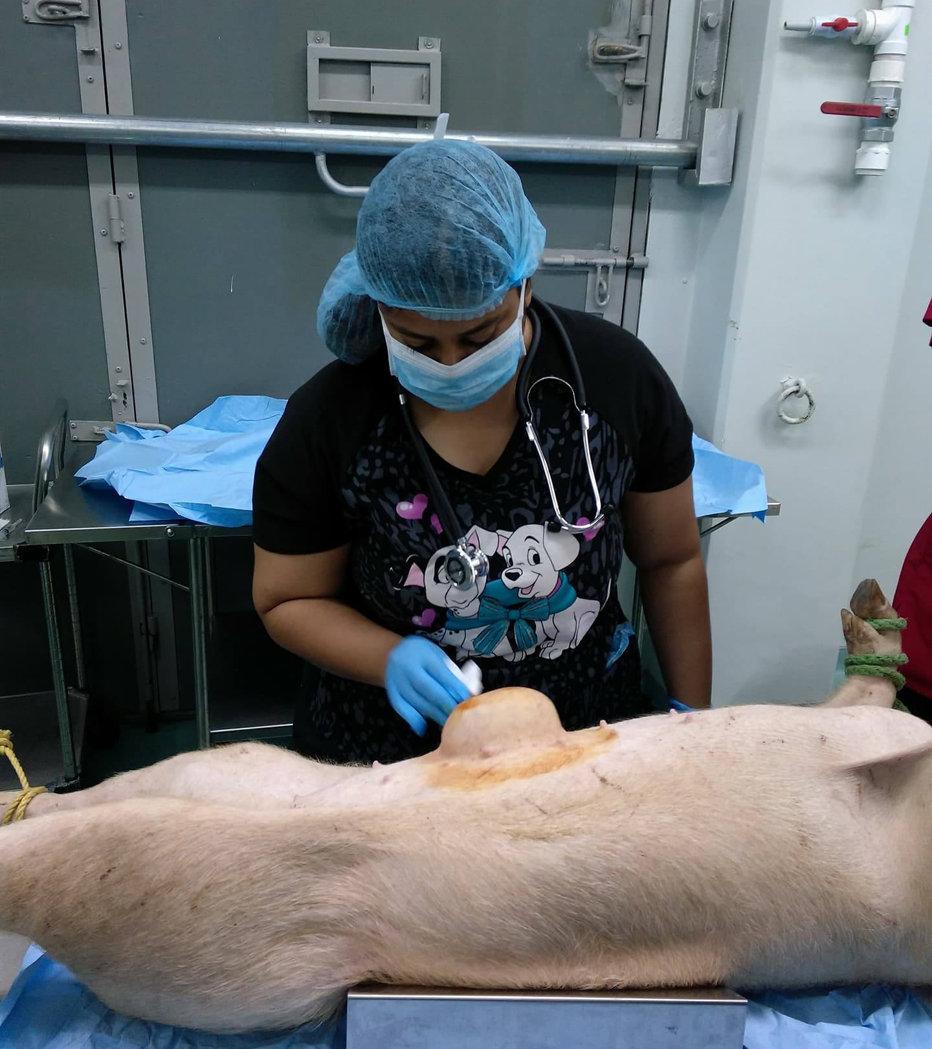
1. Pinky Non-reducible hernia

Slide 3
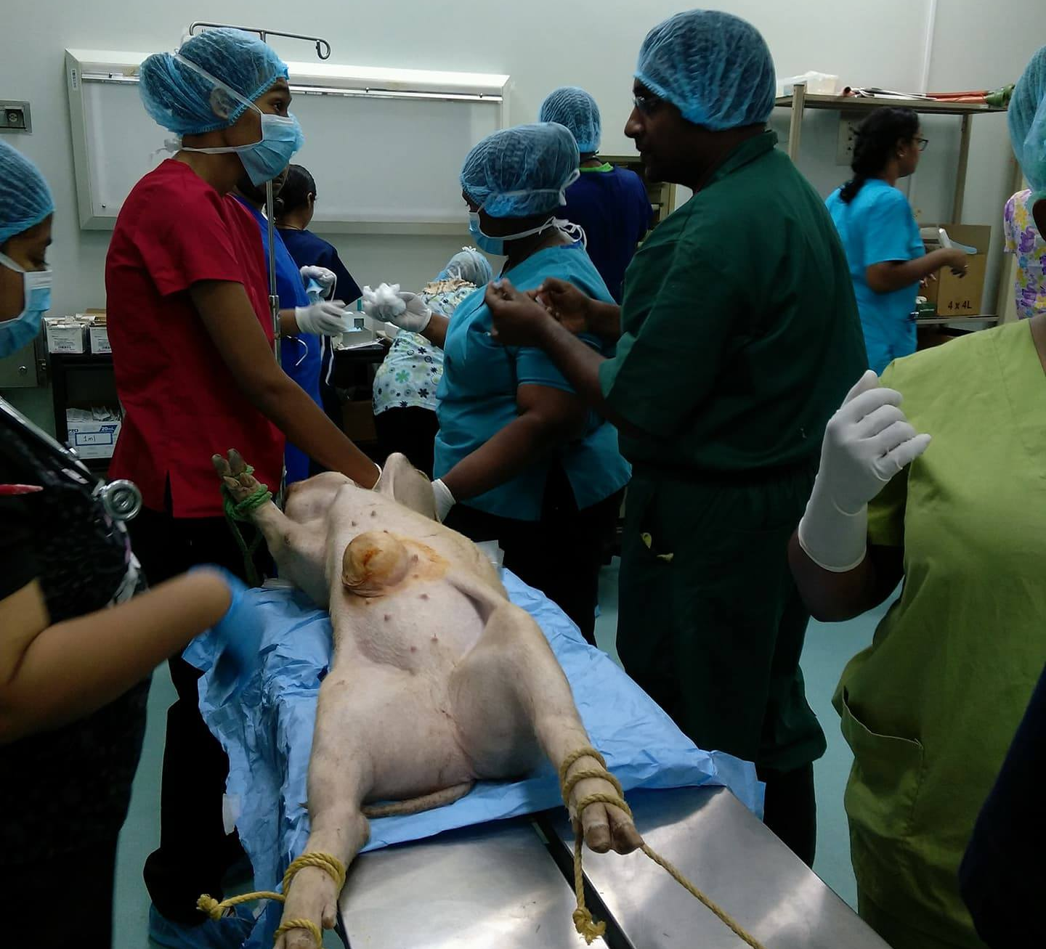
2. Pinky restrained and swabbed

Slide 4
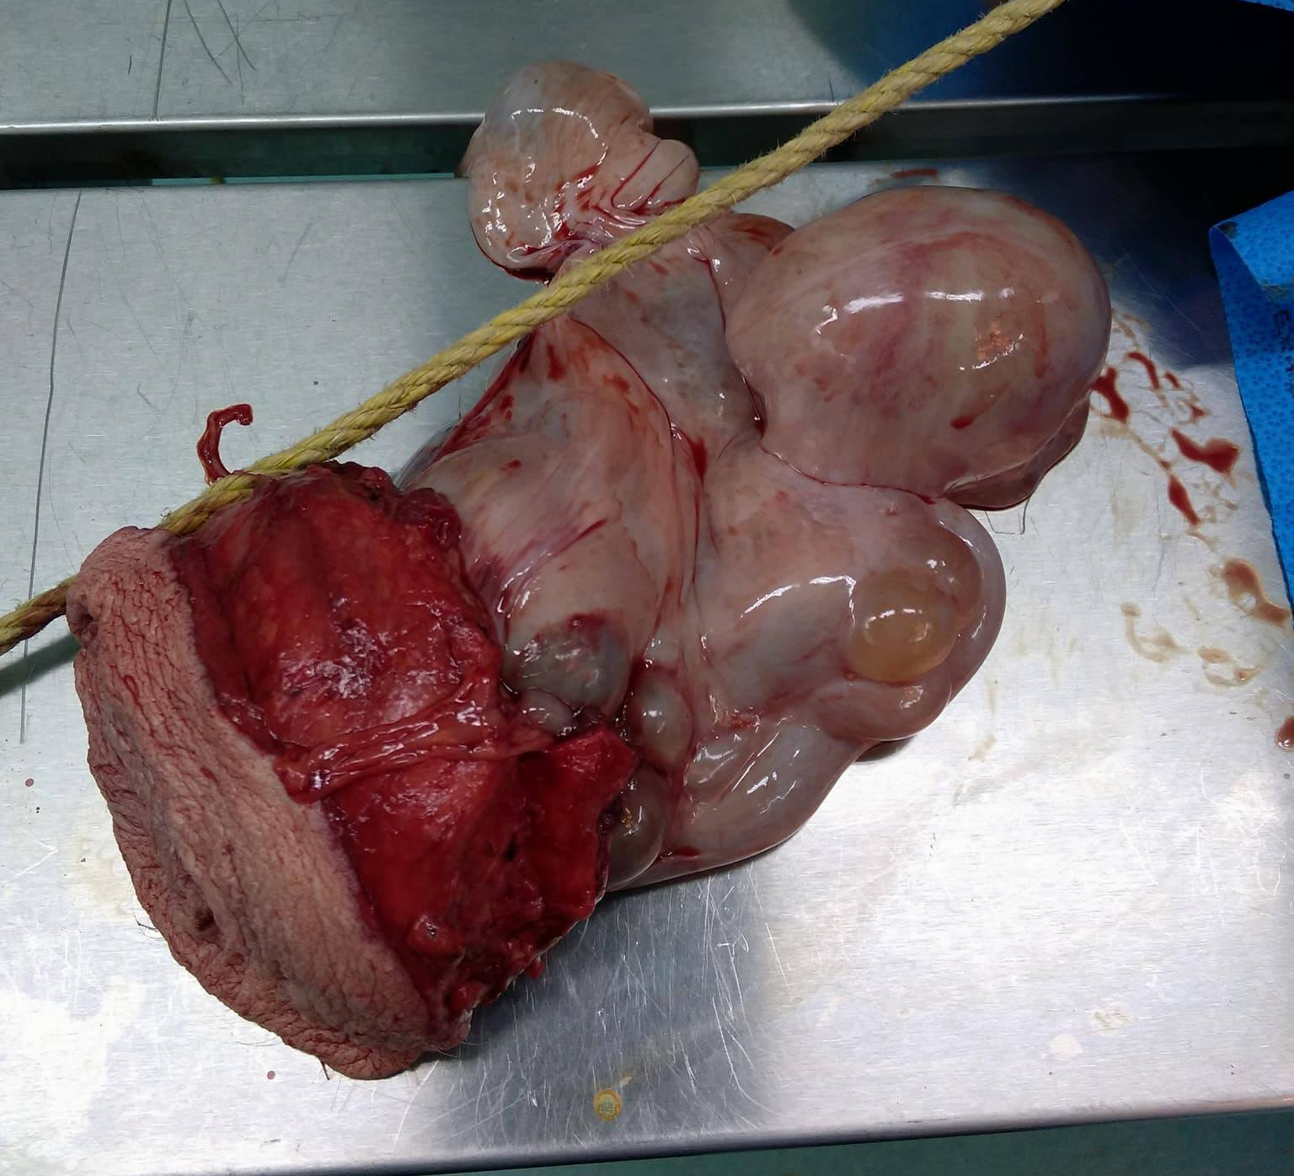
3. Pinky's Herniated Tissue

Slide 5
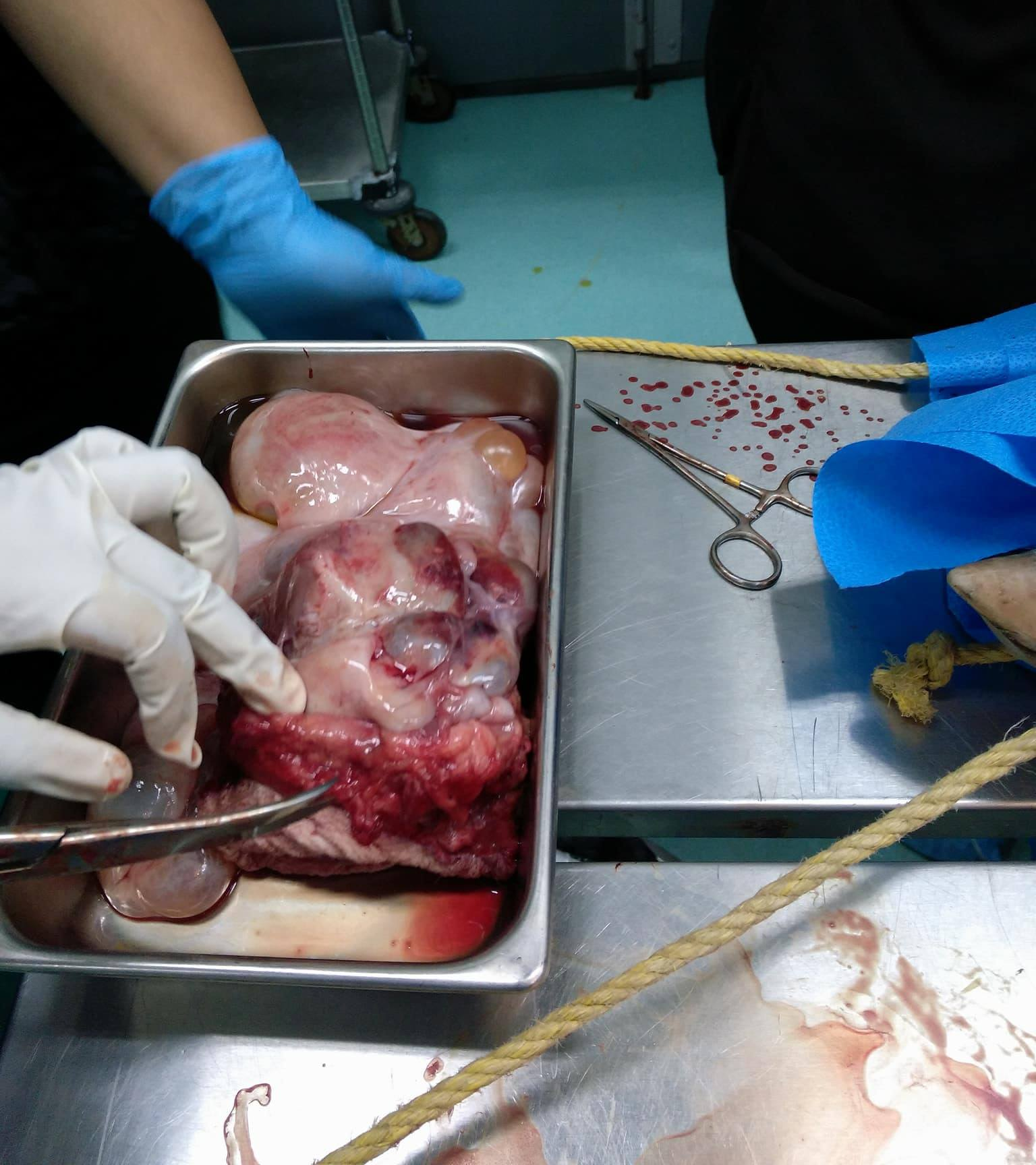
4. Pinky's Herniated Tissue

Slide 6
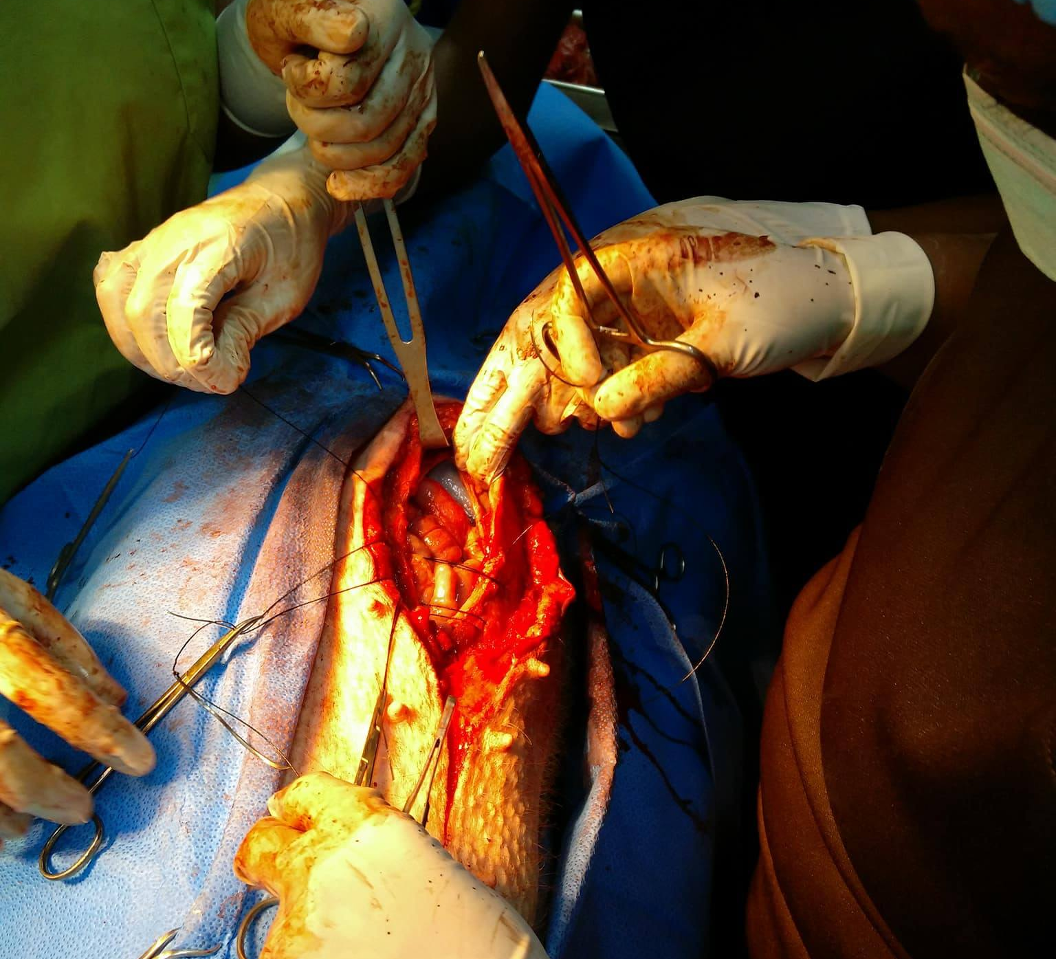
5. Pinky Vest over Pants on Abdominal muscle

Slide 7
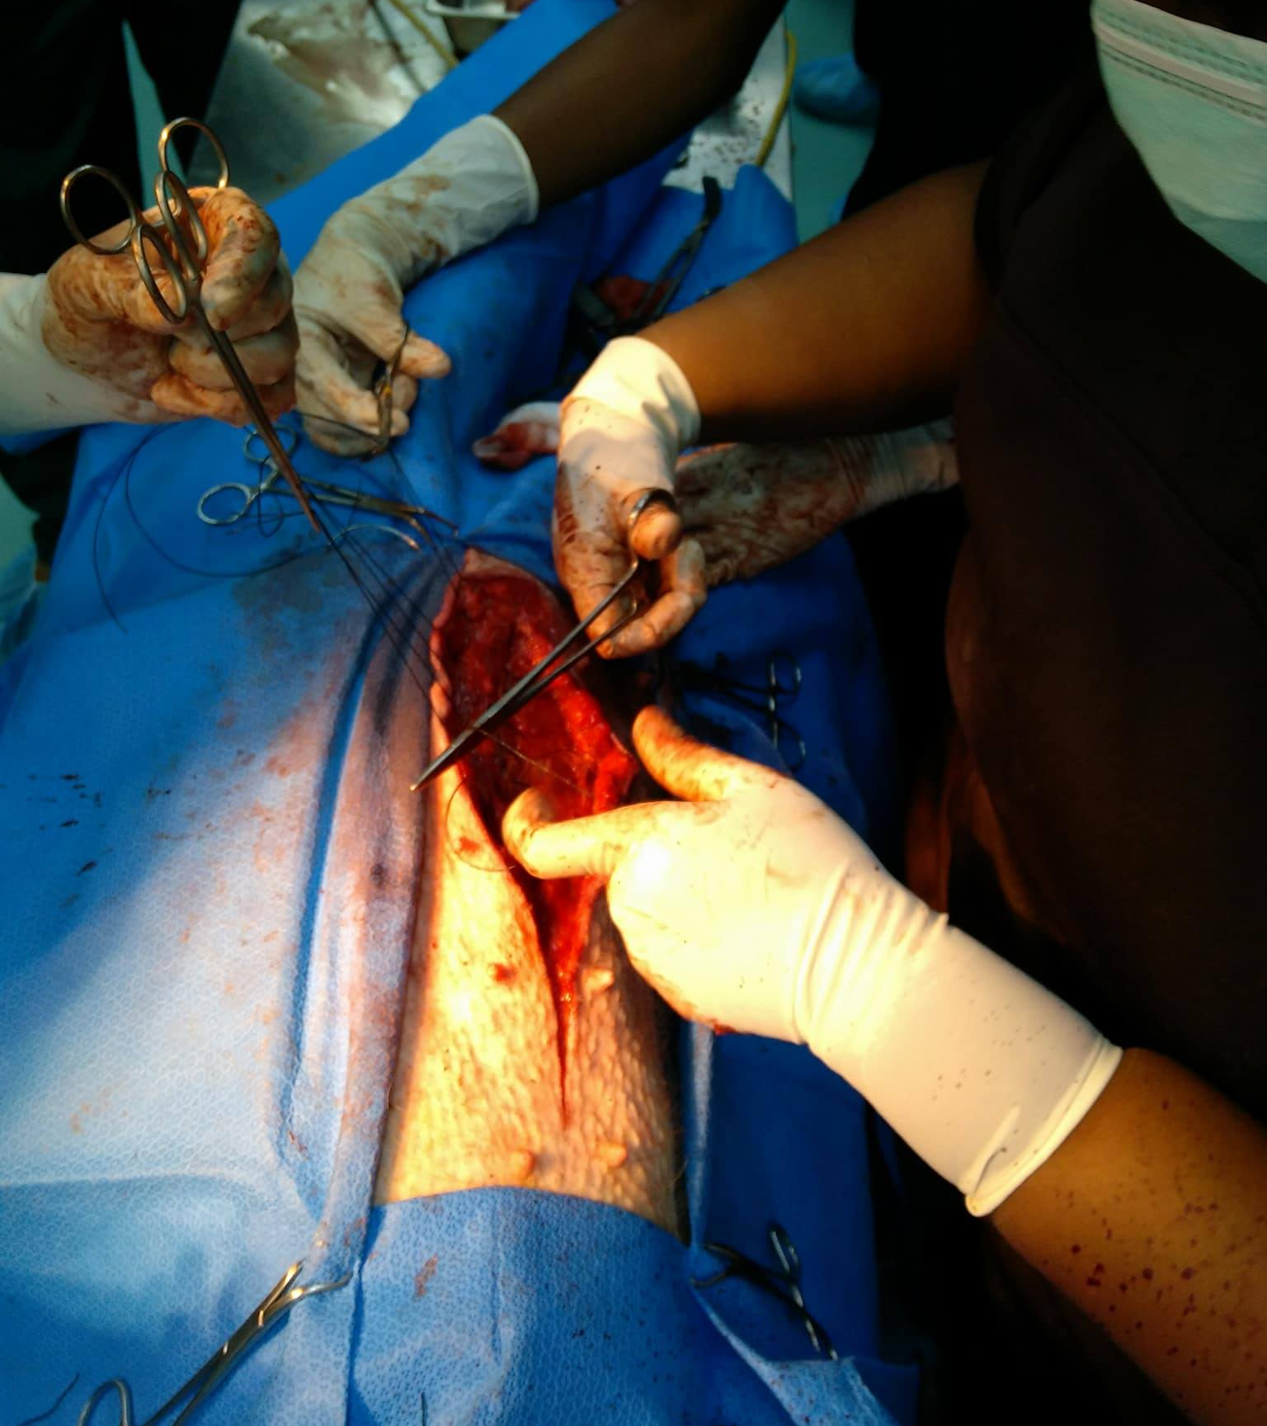
6. Pinky Vest over Pants on Abdominal muscle

Slide 8
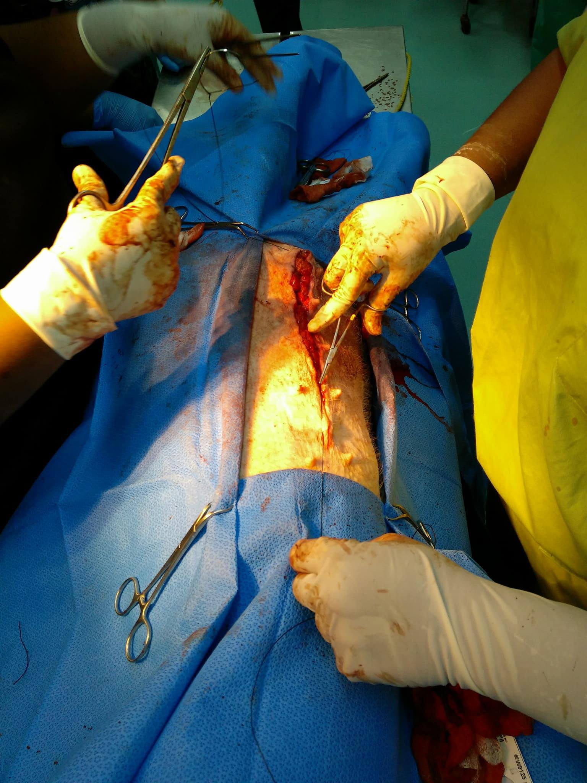
7. Pinky Simple continuous through Subcutaneous

Slide 9
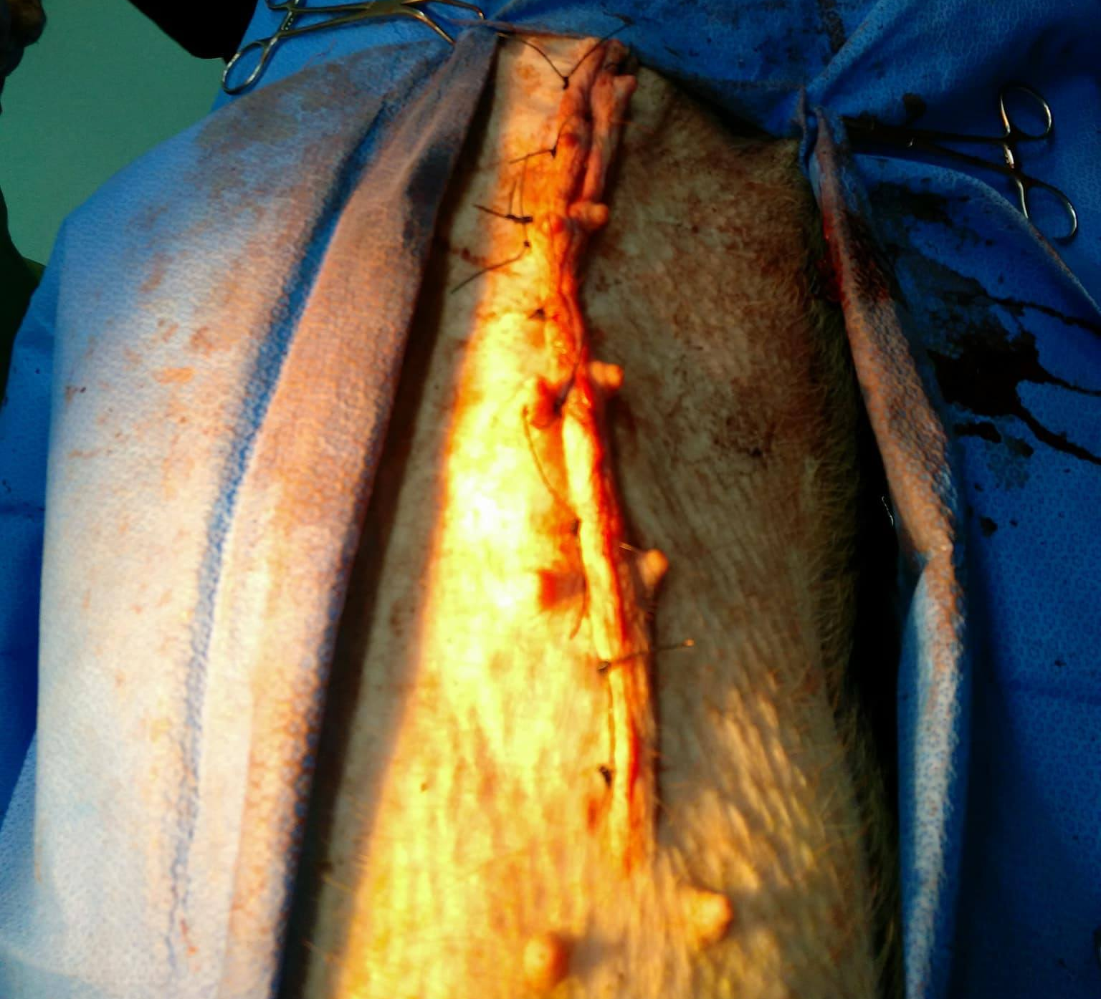
8. Pinky Horizontal Mattress on skin

Slide 10
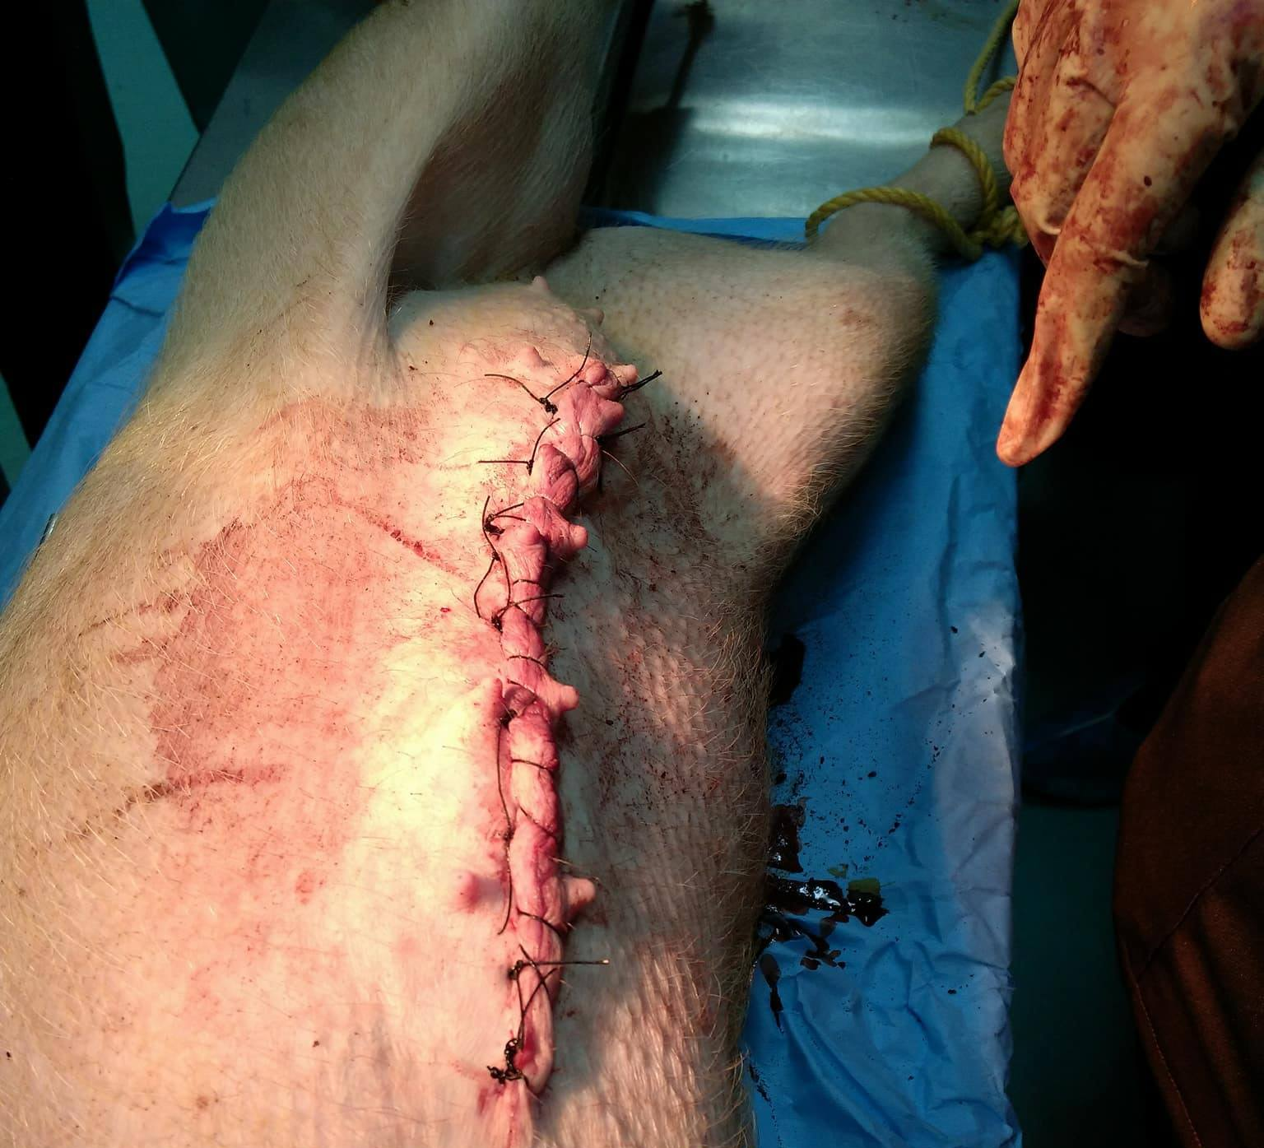
9. Pinky Horizontal Mattress on skin

