Slide 1
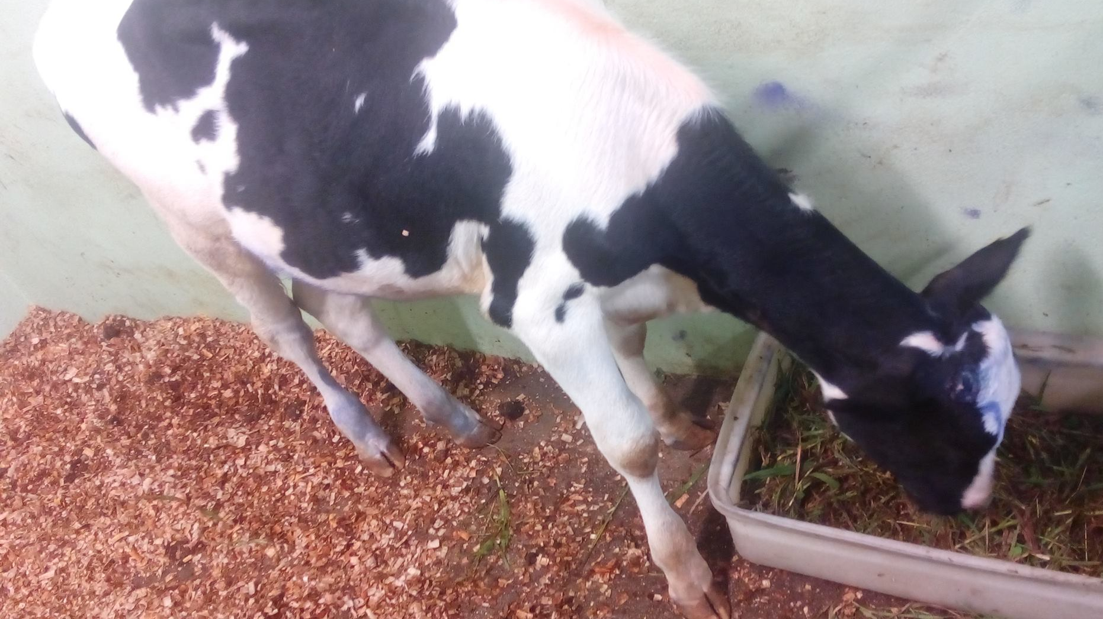
OBSERVATION POST-OP on Peppy
z

Slide 2
Peppy immediately after surgery
z
z
Parameters of Peppy immediately after surgery
Temperature: 36.5°C
Pulse : 52 beats/min
Respiration: 24 breaths/min

Slide 3
Treatment post-op
1. Every day for 7 days assess Peppy utilizing the Distance exam and Physical exam.
Focus on Heart rate, Breathing rate and Temperature, Mucous membrane colour, Capillary refill time, Rumen contractions, Hydration level, Faeces appearance and quantity, Appetite and Activity/Demeanour.
Observe wound carefully for signs of Pain upon touch, Fly strike, Discharges, Haemorrhage, Swelling and Abnormal heat/coldness.
Spray wound
Fill out SOAP form as seen below.
2. Administer Penicillin-Streptomycin as before every 3 days for 2 doses/times.

Slide 4
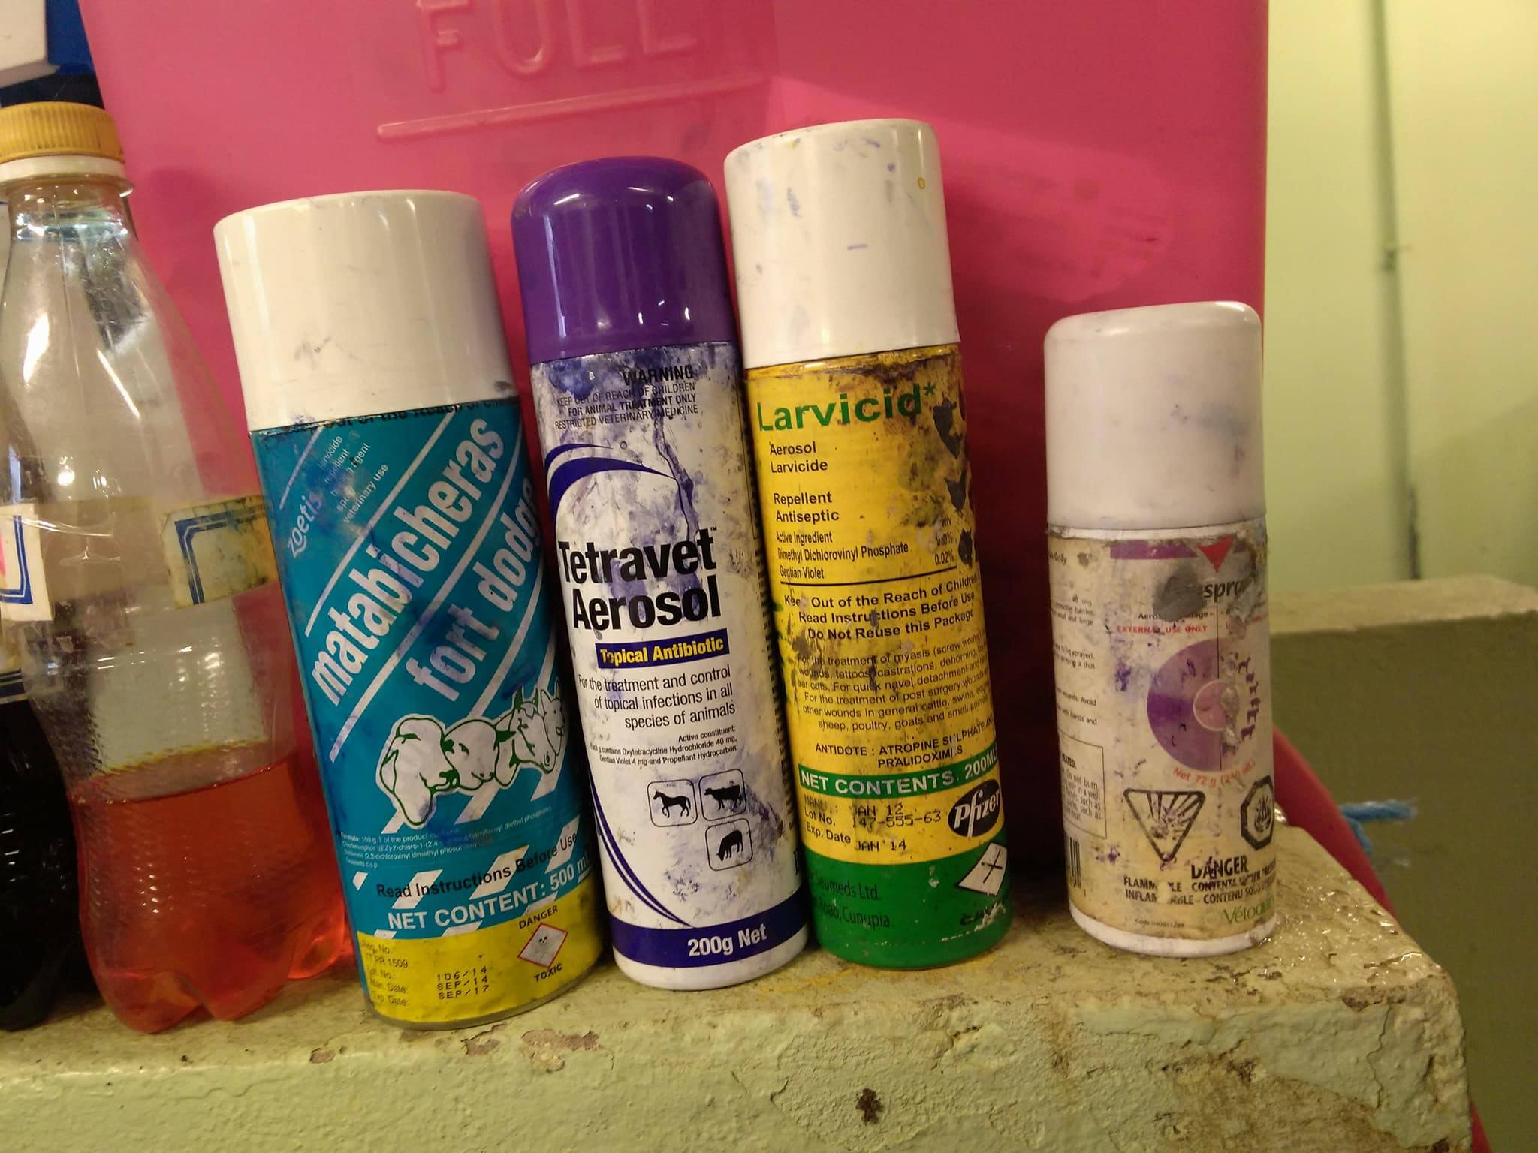
Sprays used after surgery
z
z
1. Antibiotic spray was applied directly to the wound- Tetravet
2. Aluminium powder barrier was applied directly to the wound- Alu spray
3. Larvicide/Screw worm spray was applied around the wound- Metabicheras fort dodge

Slide 5
Day 1 Post Operation
Upon distance examinations of Peppy she appeared bright, alert and responsive with normal parameters.
Parameters of calves 1 day Post Op:
Temperature 38.7°C
Pulse 52 beats/min
Respiration 40 breaths/min
There was no vocalization which indicated no pain was felt from affected areas.
There was no abnormal behaviour which indicated the surgical procedure affected the animal negatively.
There was haemorrhage, discharge or swelling from the surgical site which indicated the area.
There were no flies present on or around the surgical site which indicated there was proper post-op management and the screw worm spray worked effectively.

Slide 6
Wound 1 day post op
z
z

Slide 7
Wound 1 day post op after spray
z
z

Slide 8
Day 3 Post Operation
Upon distance examinations of Peppy she appeared bright, alert and responsive with normal parameters.
Parameters of calves 1 day Post Op:
Temperature 38.9°C
Pulse 52 beats/min
Respiration 28 breaths/min
There was no vocalization which indicated no pain was felt from affected areas.
There was no abnormal behaviour which indicated the surgical procedure affected the animal negatively.
There was haemorrhage, discharge or swelling from the surgical site which indicated the area.
There were no flies present on or around the surgical site which indicated there was proper post-op management and the screw worm spray worked effectively.

Slide 9
Wound 3 day post op after spray
z
z

Slide 10
Peppy 3 day post op
z
z

Slide 11
SOAP -up to 3 day post op

