Slide 1
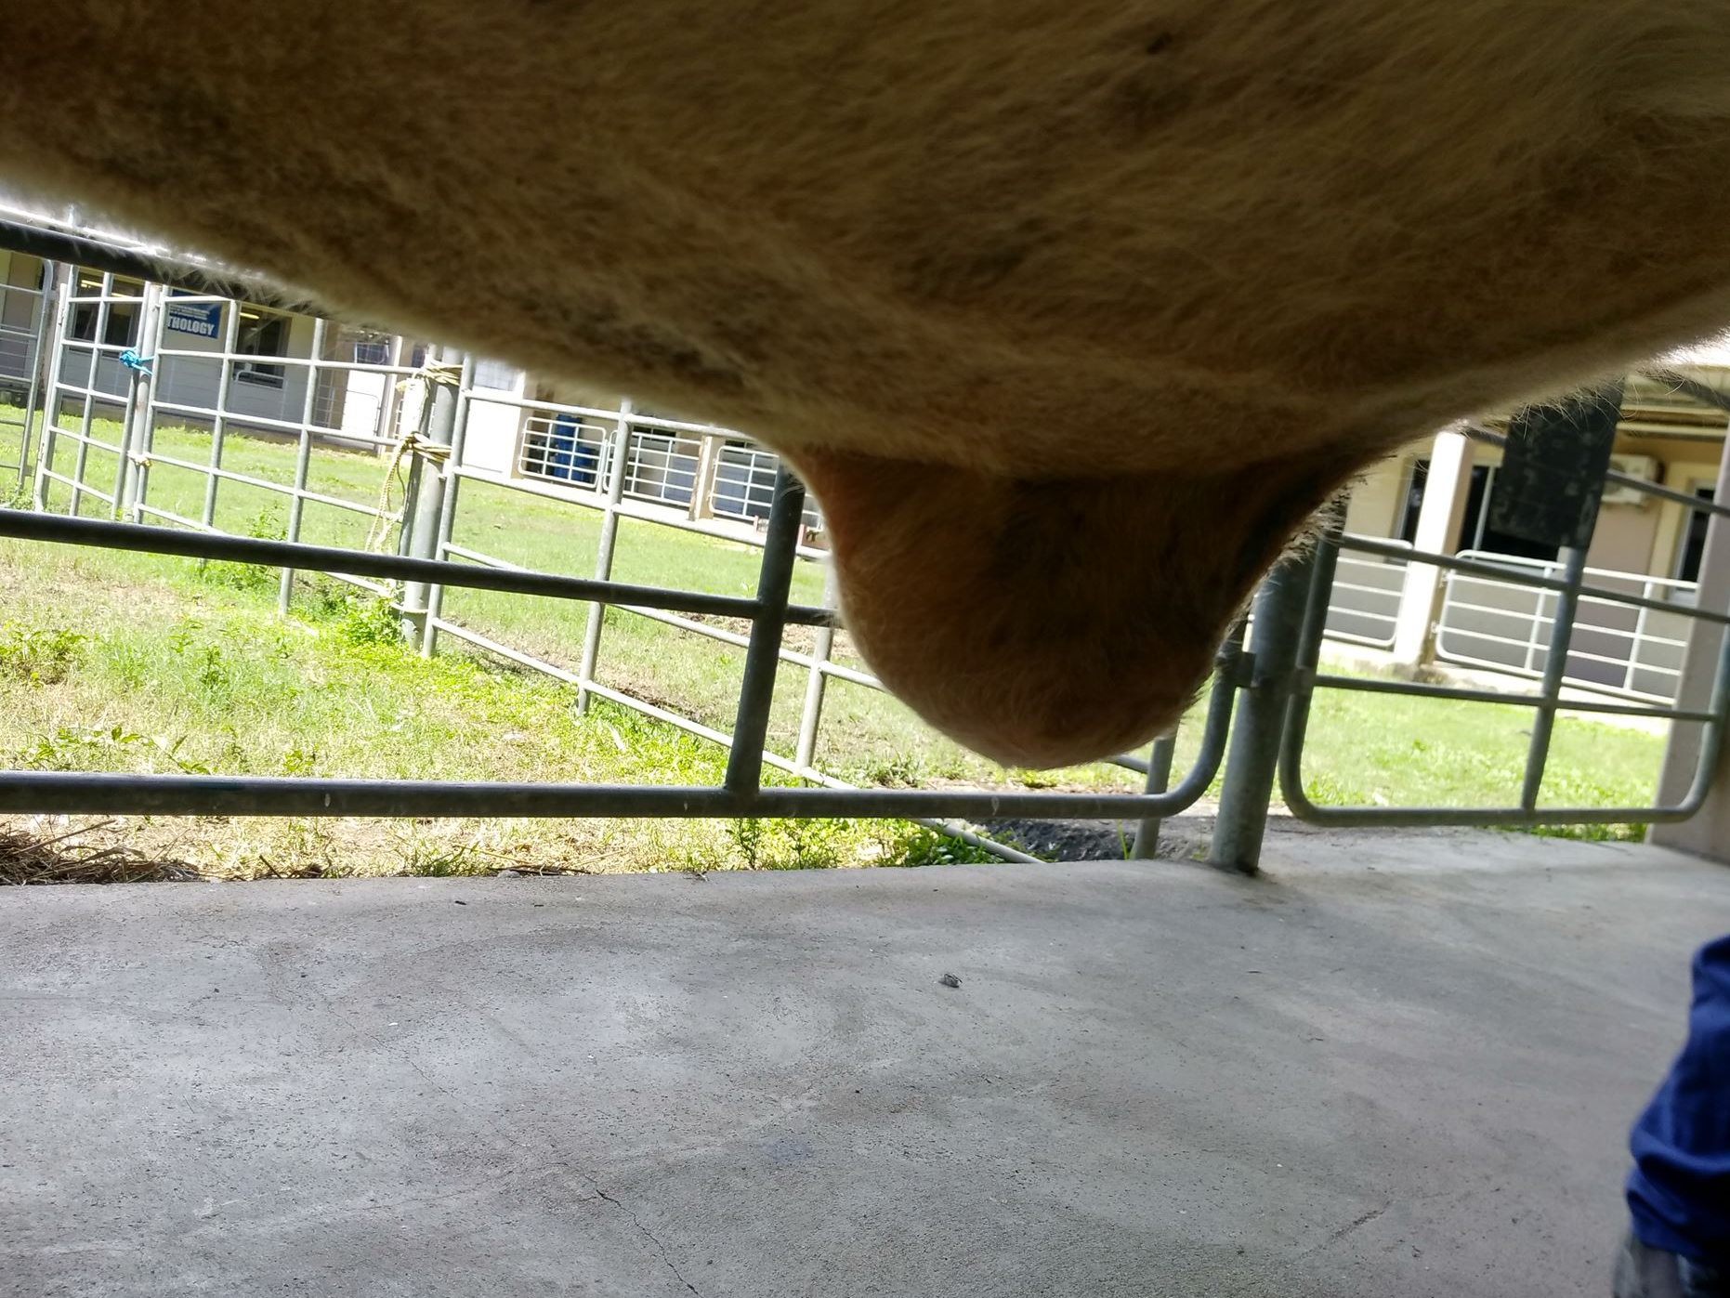
Signalment
ID # 237
Name: Peppy
Sex: Female
Age: 6-8months
Breed: Holstein
Species: Bovine
Weight: 103 kg
ASA Grade: 1

Slide 2
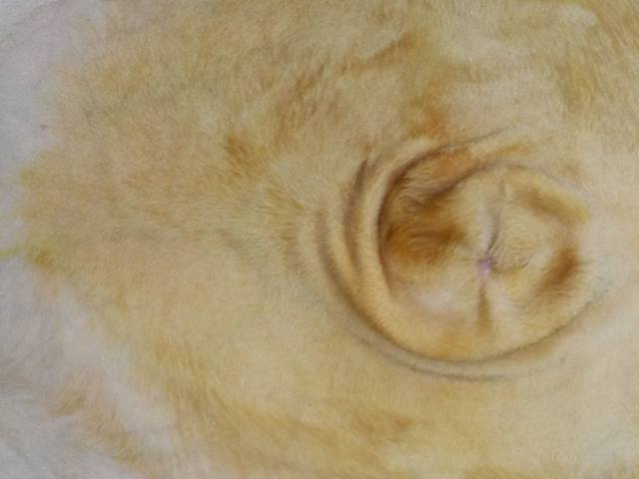
Distance Examination
Respiration Rate: 28 bpm
Behaviour: BAR
Body Condition: 2.5/5
Contours: Normal
Limbs, gait and posture: Normal

Slide 3
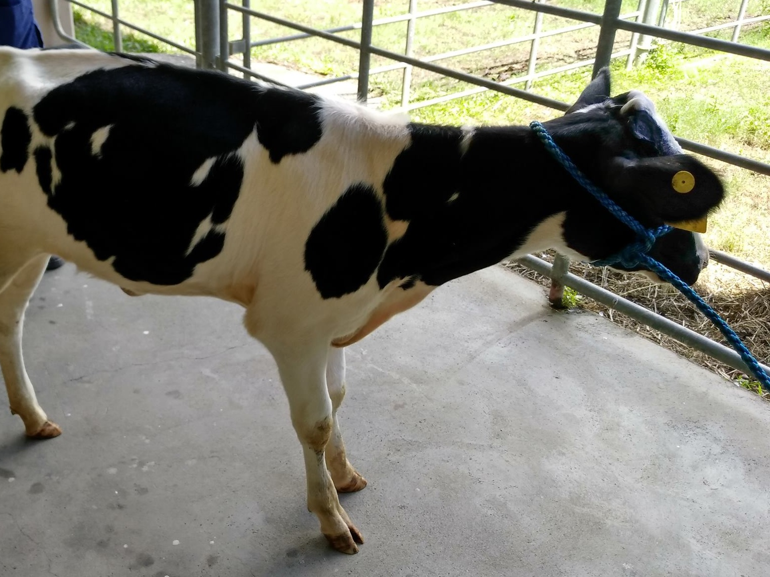
Physical Examination
Heart Rate: 48 bpm
Temperature: 37.5$°C$
Palpations of the hernia was performed.
Peppy was determined to have a 7 by 6 cm sized, reducible hernia, with a thick firm cord and a small hernia ring. It dripped a thick white pus like material.

Slide 4
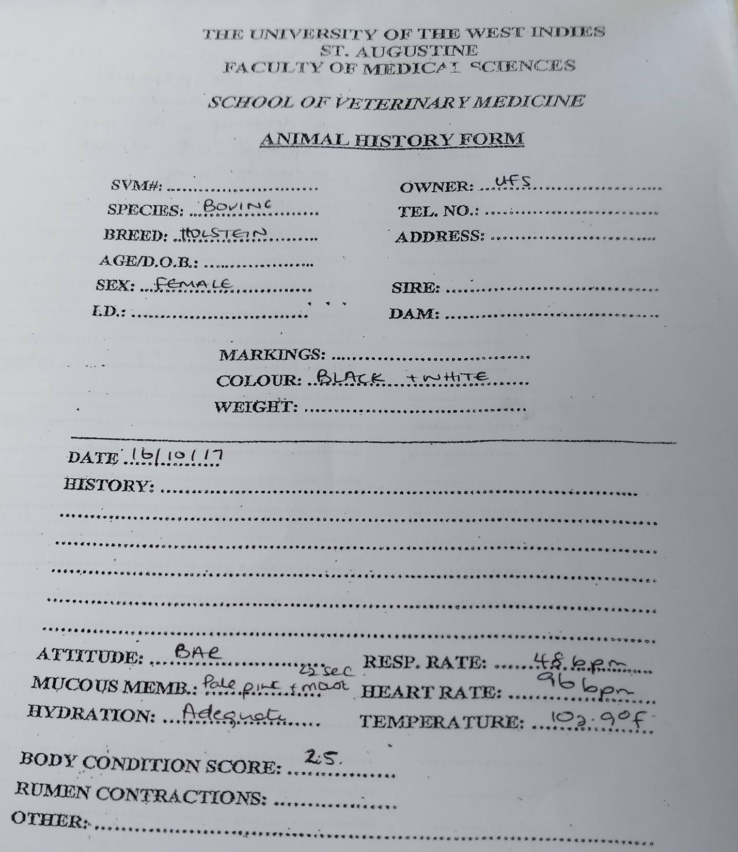
Peppy’s History

