Slide 1

PINKY’S COMPLICATED
UMBILICAL HERNIA REPAIR:
INTRA-OPERATION

Slide 2
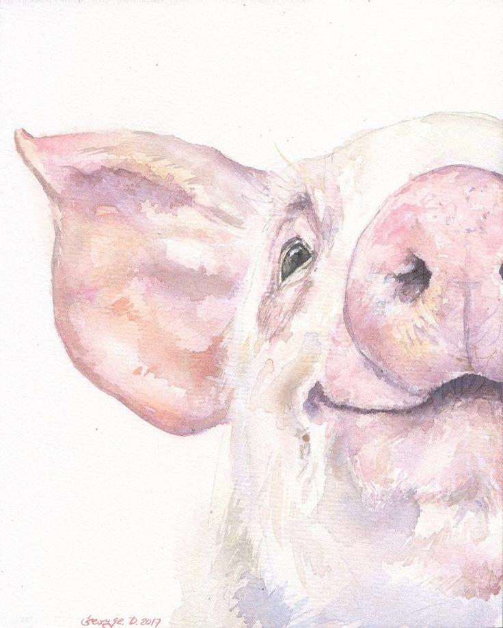
PINKY’S SURGICAL PROCEDURE
The anaesthesia team monitored the Pinky throughout the surgery with the Pulse oximeter and manually with a stethoscope for Heart rate and Respiration rate.
Using a #24 scalpel, passing along the lateral sides of and connecting 3cm to the mass, a 4cm cranial, elliptical incision was made, removing the skin flap. The first incision was made at 2:28pm
Using blunt curved mayo scissors, a blunt dissection of the subcutaneous layer as well as, the tissue adhesions around the mass was performed. This also involved moving laterally around the mass, to ensure that the tissue adhesions were completely separated from the mass.
When the patient showed signs of discomfort, splash blocks of Lidocaine were used to ease pain.
When the tissue adhesions were being detached, ligatures were used to prevent excessive bleeding.
The surgeon’s finger was then placed inside the peritoneum, through a 2cm lateral incision made on the abdominal wall.
By sweeping the finger around the mass and the peritoneum, it was deduced that there were further adhesions to the mass. The mass had remnants of the umbilicus and it was also attached to both the omentum and the body wall.

Slide 3
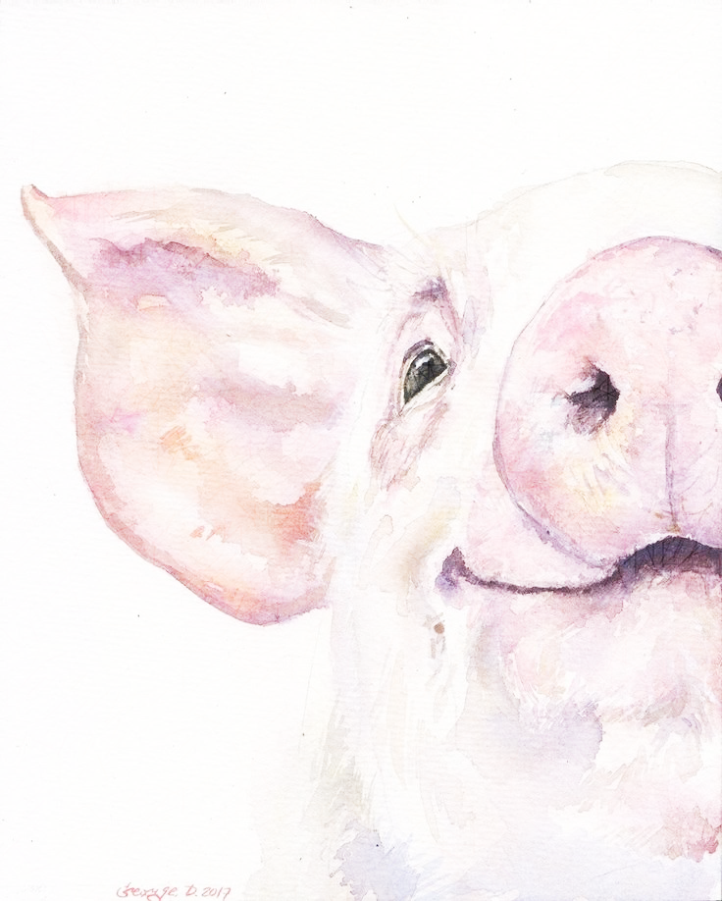
PINKY’S SURGICAL PROCEDURE
Using a blunt mayo scissors, the mass was removed from the body wall. The mass was then placed upon a steel awaiting tray.
Sterile gauze was used to clean the wound when the mass was removed.
After determining the hernia ring, the abdominal muscles and layers were sutured using non-absorbable suture material, such as nylon. The vest over pants tension relieving suturing pattern was utilised. This pattern was performed 6 times.
The intestines were kept into the peritoneum using Parker retractors. The retractors also aided in the successful suturing of the tissues, while holding the layers upward. Sterile gauze was also in the case of any excessive bleeding.
Using a continuous suture pattern, the subcutaneous layer was sutured with an absorbable suture material, such as #2 lactomer.
Using an interrupted horizontal mattress, tension relieving suture pattern, the skin was sutured with nylon. To ensure non-exposure of the inner layers of the epidermis and the dermis, a simple continuous suture pattern was also done. The final suture was done at 5:03pm.

Slide 4

PINKY’S SURGICAL PROCEDURE
15. The surgical site was then cleaned with gauze diluted in chlorhexidine. Sterile gauze was also used to clean any additional blood around the body and surgical site. The site was also sprayed with Tetravet, followed by AluSpray and larvicide.
16. The mass was dissected and taken for histological analysis.
17. On the Anaesthetist side, boluses of saline were given intravenously to keep the blood pressure normal because she will be loosing blood in the surgery. That ensures adequate lung perfusion and so tissue perfusion with oxygen for Pinky throughout the surgery.
18. The CRI was increased or decreased accordingly to the needs of the surgeons.

