Slide 1
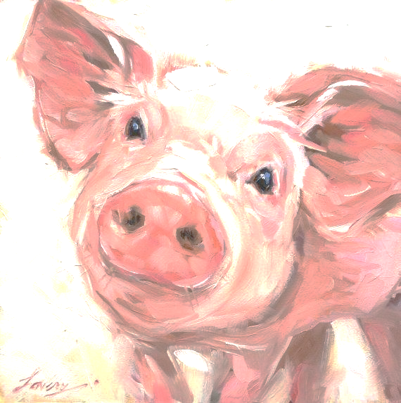
PINKY’S COMPLICATED UMBILICAL HERNIA REPAIR: PRE-OPERATION

Slide 2
PROCEDURE/ SURGICAL PREPERATION
Sedation
3.8 mls of Xylazine 2% ,
3.8mls of ketamine 10%
Both were given intra muscularly
Anti-biotics
3.8mls of Penstrep was given intramuscularly
Pinky was brought across to the SVM large animal theatre when she was completely sedated and was placed in dorsal recumbency
CRI/SALINE BAG COMPOSTION
10mls Xylazine 2%
10 mls Ketamine 10%
10 mls Lidocaine 2%

Slide 3
PROCEDURE/ SURGICAL PREPERATION
Insertion of IV catheter into ear vein
Due to the vasodilatory effects of xylazine, a vein on her right ear was isolated and a catheter was put in for intravenous access. The catheter was connected with the fluid line so that drugs would be accessed intravenously.
3.4mls of Flunixin and 3.8mls of Lidocaine 2% were inserted into the IV access.
The fluid line was then opened allowing IV access of the sedatives to reach Pinky.
The CRI was initially set at 2 drops per second.

Slide 4
PROCEDURE/ SURGICAL SITE PREPERATION
PREPARATION OF THE SURGICAL SITE
Pinky did not need clipping as there was no hair present at the surgery site. The surgery site was cleaned with chlorhexidine.
The surgery site was swabbed 4 times alternating between 7% povidone-iodine and 70% alcohol.
Each cleaning was done from the inside to the outside, in one direction and it was ensured there was no double-wiping.
Drapes were then positioned accordingly.
Pinky was all prepped for surgery and ready to become a new pig!

