Slide 1
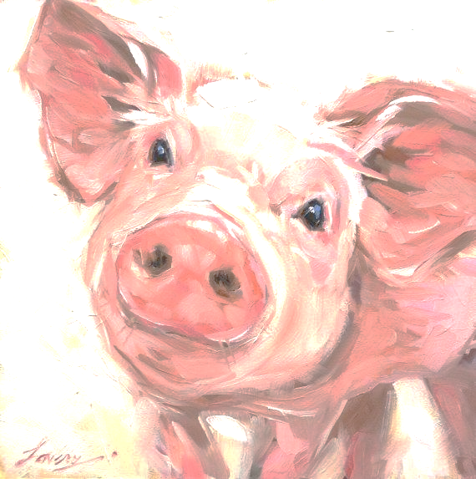
PINKY’S COMPLICATED UMBILICAL HERNIA REPAIR: PRE-OPERATION

Slide 2
SIGNALMENT
NAME: PINKY ASA GRADE: 1
SEX: FEMALE
AGE: UKNOWN
SPECIES: PORCINE
BREED: LARGE WHITE
WEIGHT: 76.4 KG

Slide 3
DISTANCE EXAMINATION
Pinky was observed to be bright, alert and responsive (BAR)
She was standing firmly on all four feet and had no signs of lameness
There were no apparent signs of lesions such as abscesses, wounds, abrasions etc.
There were no signs of abnormal discharges
There were no sings of any abnormal behaviour.
HOWEVER THERE WERE SIGNS OF HER BEING TOO CUTE!!!!

Slide 4
RESTRAINT & PHYSICAL EXAMINATION
Pinky was restrained using a hog snare.
TPR and MM/CRT parameters were examined and recorded.
TEMPERATURE: 38.1°C
PULSE RATE: 108 beats per minute
RESPIRATION RATE: 52 breaths per minute
MM/CRT: < 2 seconds
There were no abnormalities other than the hernia. Upon palpation, the hernia felt firm and upon squeezing, our fingers felt as though it was slipping off the mass and grabbing skin. It was considered to be non-reducible.

