Slide 1
Superior Check Ligament
Intra-operation

Slide 2
Surgical Procedure
A 10 cm skin incision is made cranial to the cephalic vein, over the flexor carpi radialis tendon and extending from the level of the distal chestnut proximal.
The incision is continued through the subcutaneous tissue an the antebrachial fascia.
A transverse branch of the cephalic vein may or may not require ligation.

Slide 3
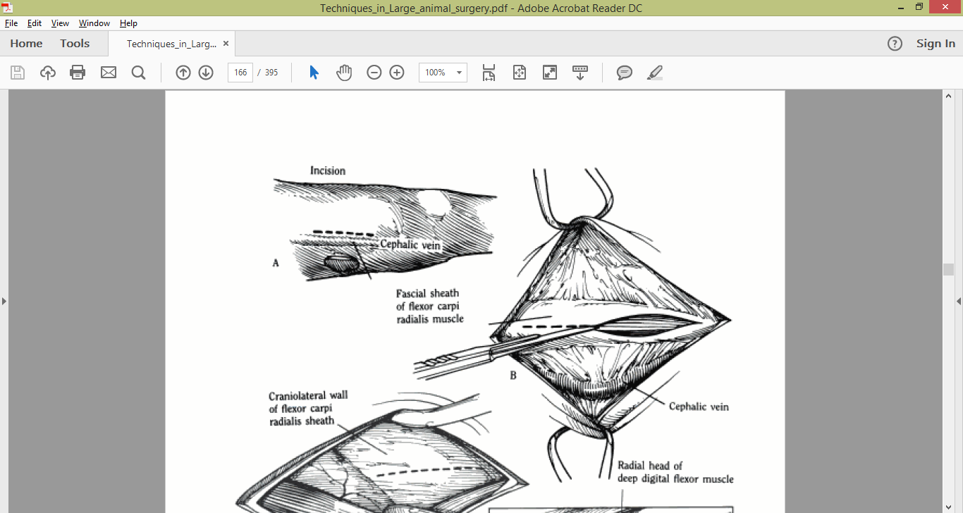
Surgical Procedure

Slide 4
Surgical Procedure
The fascia sheath of the flexor carpi radialis is incised.
The Gelpi retractors are placed to expose the medial wall of the sheath, which adheres to the superior check ligament.
A stab incision is made through the craniolateral wall of the sheath and superior check ligament.

Slide 5
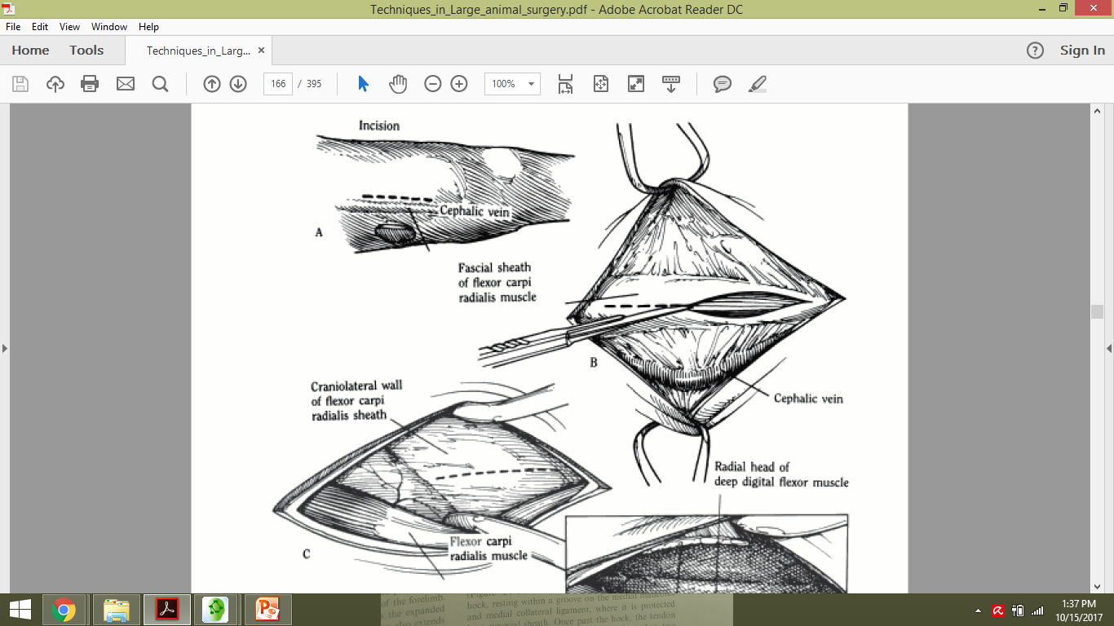
Surgical Procedure

Slide 6
Surgical Procedure

Slide 7
Surgical Procedure
The incision is continued proximal and distal to sever the ligament completely.
Complete incision through the check ligament is evident by visualizing the muscular portion of the radial head of the deep digital flexor tendon beneath and separation of the superficial digital flexor muscle.

Slide 8
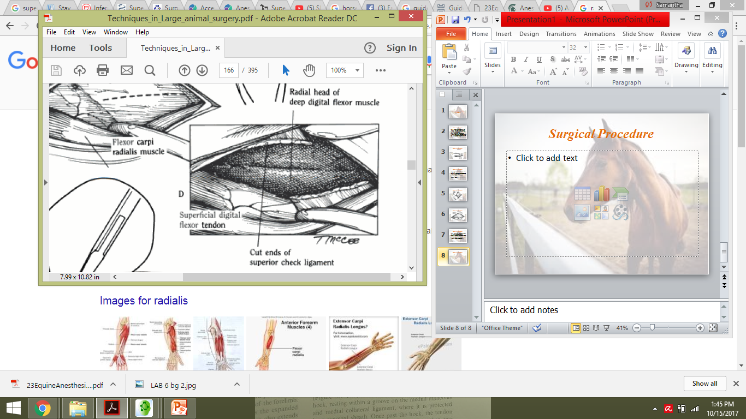
Surgical Procedure

Slide 9
Surgical Procedure
After complete transection of the ligament, the membranous roof of the carpal synovial sheath is seen distally. The muscle belly of the radial head of the deep digital flexor tendon is seen in central and proximal areas of the incision.
The incision in the flexor carpi radialis sheath is closed with simple interrupted sutures of 2-0 synthetic absorbable material. The antebrachial fascia and subcutaneous tissue is closed with a continuous suture 2-0 synthetic nonabsorbable material. The skin is closed with interrupted sutures of 2-0 nonabsorbable material.

Slide 10
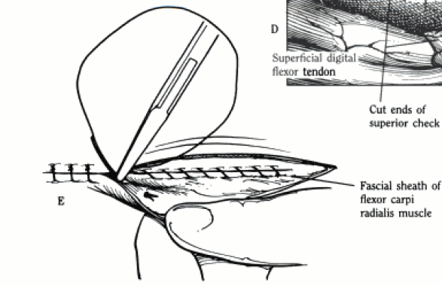
Surgical Procedure

