Slide 1
Medial Patellar Ligament Desmotomy Intra-operation

Slide 2
Surgical Procedure
A 1 cm incision is made over the medial border of the middle patellar ligament close to the attachment of the ligament to the tibial tuberosity.

Slide 4
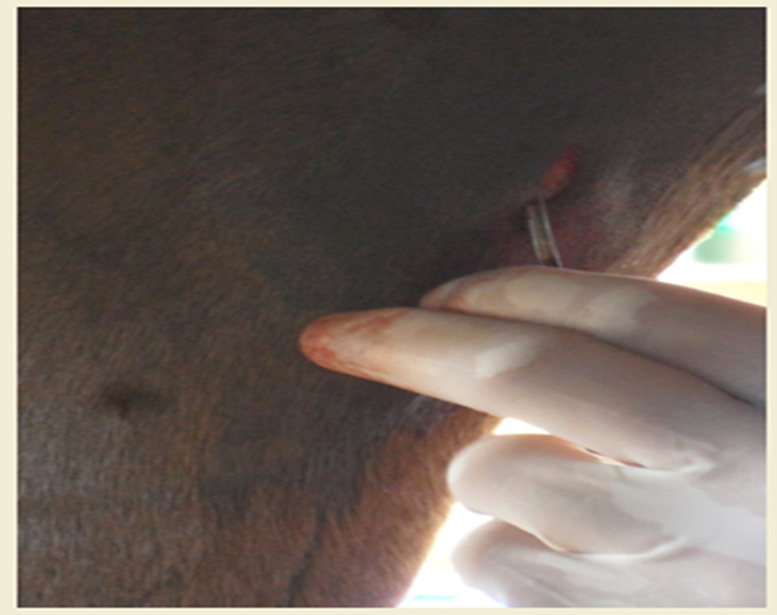

Slide 5
Surgical Procedure
A curved Kelly forceps are then forced through the heavy fascia and are passed beneath the medial patellar ligament. This creates a channel for the insertion of the bistoury knife beneath the medial patellar ligament.

Slide 8
Surgical Procedure
The bistoury knife is inserted so that the side of the knife lies flat beneath the patellar ligament.
When the knife is positioned, the cutting edge is then turned outward.
The left index finger palpating the end of the knife through the skin to ascertain its correct position, the ligament will be cut in a sawing movement.

Slide 10
Surgical Procedure
One must ensure that the blade of the bistoury knife completely encloses the medial patellar ligament before it is severed.
Once the ligament has been severed, one or two non-absorbable interrupted sutures are placed in the skin incision.

Slide 13
Video
https://www.youtube.com/watch?v=HnAtELeiMFs

