Slide 1
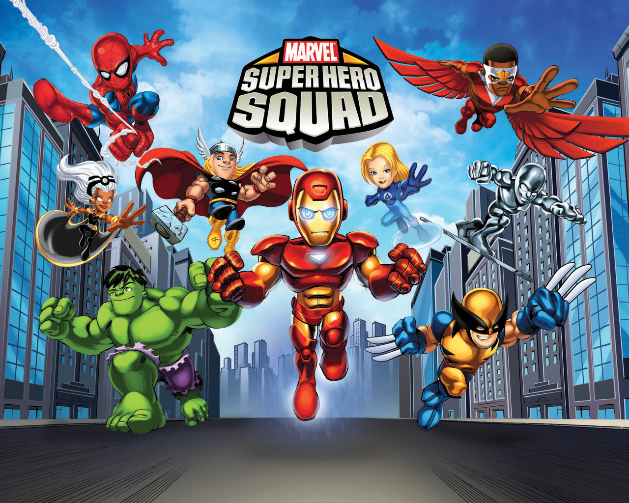

Slide 2
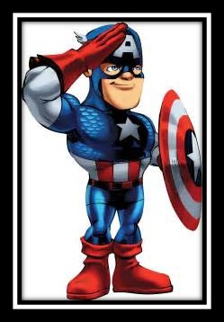
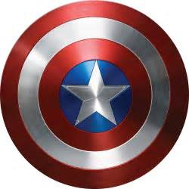
Captain America wears a costume that bears an American flag motif, and is armed with a nearly indestructible shield that he throws at foes.
Although Captain America often struggles to maintain his ideals as a man out of his time with its modern realities, he remains a highly respected figure in his community which includes becoming the long-time leader of the Avengers.
Click to watch how Capt America get his shield
Click to see a flying Shield!

Slide 3
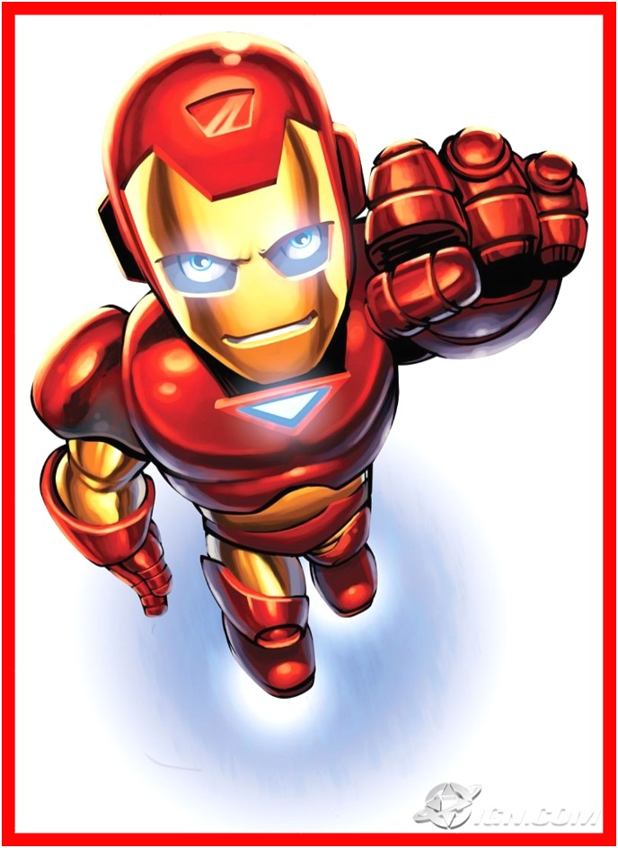
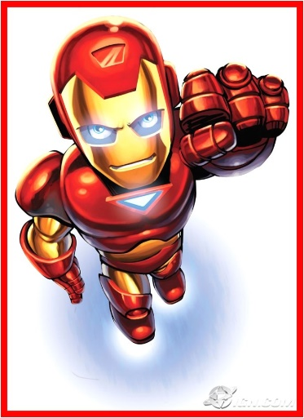
A wealthy American business magnate, playboy, and ingenious engineer, Tony Stark suffers a severe chest injury during a kidnapping in which his captors attempt to force him to build a weapon of mass destruction.
He instead creates a powered suit of armor to save his life and escape captivity.
Click to watch how Ironman suit-up
Click to see flying Iron mans

Slide 4
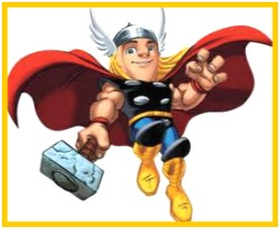
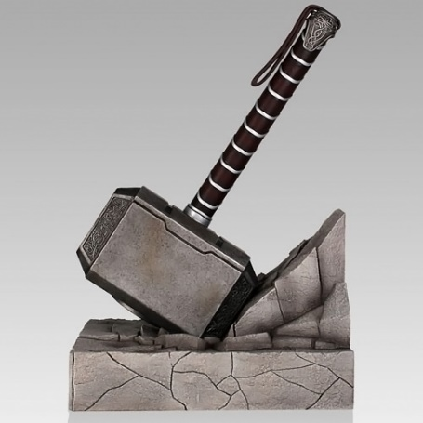
In Norse mythology, Thor (/θɔːr/; from Old Norse Þórr) is a hammer-wielding god associated with thunder, lightning, storms, oak trees, strength, the protection of mankind, and also hallowing and fertility.
Click to watch how Thor gets back his power
Click to see flying hammer

