Slide 1
Open-Open Castration In Bulls

Slide 2
Surgical castration is the most certain method of castration because the testicles are removed completely. It is best performed before or after fly season and when calves can be turned into a dry area after the surgery. Surgical castration can be performed on any age calf. It is easier to learn on calves with larger testicles. However, larger and older calves experience more stress and usually bleed more than younger calves.
Good restraint is essential to minimize the risk to calves and operators.
Instruments for surgical castration include the Newberry knife, scalpel,and emasculator.

Slide 3
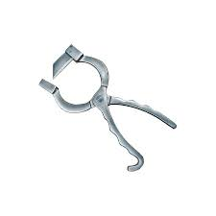
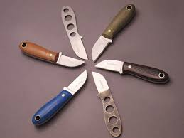
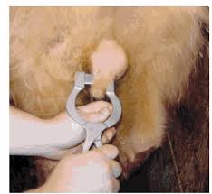
Equipment

Slide 4
Technique
Wash and clean your hands and surgical equipment using an antiseptic solution. Position yourself at the side or rear of the calf and reach forward between the hind legs.
Make sure the scrotum is clean. You may use a mild surface disinfectant (such as iodine) to prepare the incision sites.
Make an incision to open the skin of the scrotum using Method A or B.

Slide 5
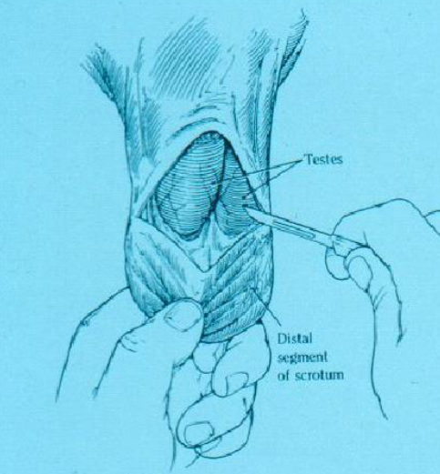
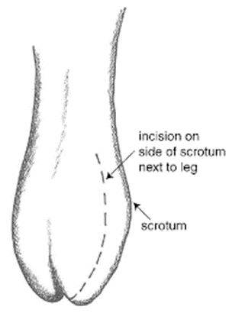
Incision Method A
Make the incisions on the outside of the lower half of each side of the scrotum (Figure 6).
If you are right handed, use your left hand to force one testicle to the bottom outside of the scrotum. Once the testicle is in the proper site, hold it there and use a scalpel to make a generous incision over the testicle. The incision may extend into the testicle itself.
Incision Method B
Use one incision to remove the bottom third of the scrotum. To do this, first push the testicles up toward the body so the lower third of the scrotum is empty.
Grasp the tip of the scrotum between your thumb and forefinger. Use a sharp scalpel to cut across the scrotum just above your thumb and finger. This cut will completely remove the tip of the scrotum and the testicles will fall down or can be pulled down by reaching up into the open scrotum
Method A
Method B

Slide 6
Pull the testicle through the incision. It will be covered with a thin, but tough, white membrane. Separate this from the testicle by pulling it away near the tip of the testicle.
The remaining tough cord contains the artery, veins and spermatic cord.
In older calves, use an emasculator (Figure 8) to crush and cut both blood vessels and spermatic cord at the same time. An emasculator lessens the risk of bleeding. (The emasculator must be placed on the cord correctly in order to crush the cord properly).
In younger calves (<3 months), it is common to separate the blood vessels from the vas deferens. Shave through the vas with the scalpel. Gently pull the vessels until the strand breaks.
Repeat on the other side.

Slide 7
There should not be any tissue hanging from the scrotum once the castration is complete.
If using incision Method B, the castration is complete. If using Method A, once both testicles have been removed, make an incision completely through the bottom half of the median septum to ensure good drainage.

Slide 8
Advantages and Disadvantages:
not bloodless, bleeding is a risk
sure castration because the testicles are removed
more time to perform than banding
risk of infections because of open wounds
not recommended for castrating bull calves at a feedlot with wet, muddy conditions
greater reduction in weight gain after castration compared to Burdizzo
surgical wounds heal more quickly than those from rubber ring
risk of injury to the surgeon

