Slide 1
Closed Castration in Bulls : Burdizzo Method

Slide 2
This is the method of castration which is most likely to fail in untrained hands, because, unlike ringing and surgical castration, you cannot tell that you have successfully castrated the calf. However, with training and experience using emasculators is a relatively quick and simple method of castration.

Slide 3
The keys to ensuring emasculators work for you and the calf are:
Use clean equipment - dirty emasculators increase the risk of infection
Proper restraint - use a crush if you have one. The calf needs to be kept still during the procedure
Clamp one side then the other - do not clamp across the whole of scrotum.

Slide 4
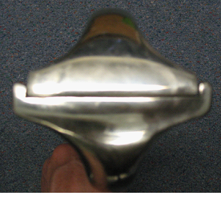
Before use check that the jaws meet and crush properly

Slide 5
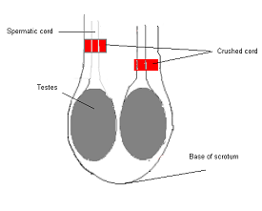
Method
Stand behind the calf, grasp the scrotum and check that there are two testes.
If there are, push the left spermatic cord to the outside of the scrotum
Open the emasculator and hold it so that the C-shaped side of the jaw is facing up.
Place the emasculator so that the left spermatic cord runs between the jaws. Get the cord as near to the right hand side of the jaws as possible. The aim is to crush as little of the scrotum as possible
Close the jaws and hold them for 5 seconds
Repeat on the right hand side - below the first crush

Slide 6
Advantages and Disadvantages:
bloodless
slow to perform and requires expertise
unreliable when done incorrectly, leads to stags
equipment becomes ineffective after long-term use and must be replaced
less reduction in weight gain after castration compared to surgical or latex-band

