Slide 1
Rubber Ring Method
Non-Surgical Bull castration

Slide 2
Rubber rings are an apparently simple method of castration - all it involves is simply putting a ring around the scrotum!
However, things can easily go wrong so they should be used only by competent trained personnel.

Slide 3
The keys to ensuring rubber rings work for you and the calf are:
Use new rings - if you use a pack that you have found down the back of the cupboard they may have lost their elasticity and, if so, won't work as well
Use clean equipment - dirty elastrators and rings increase the risk of infection
Only use rubber rings in calves < 1 week of age - using them in older calves causes more pain and distress and increases the risk of complications, particularly tetanus.

Slide 4
Only minimal restraint is needed - but make sure that the calf can't kick you or turn around easily.
Once you have the calf restrained, the first thing to do is check that both testes are present in the scrotum.
Occasionally, you may be able to massage them down if they are not.
If you can't get both testes, record the calf's number but do not castrate the calf.

Slide 6
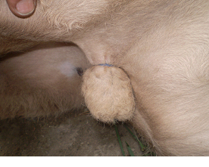
Once you have the two testes, squeeze them down to the base of the scrotum.
Then, with the prongs of the elastrator facing upwards, towards the calf's belly, squeeze the handles and expand the ring so it can be easily placed over the scrotum and placed just above the top of the testes.
Release the handles, slip the prongs from underneath the ring and check that both of the testes are fully below the ring.

Slide 7
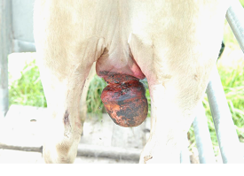
Rubber rings are quick and easy but should not be used in calves > 1 week of age.
Diagram of scrotum and testes after proper ringing

Slide 8
Advantages and Disadvantages:
bloodless, easy to perform
large lesions may form above the band site and persist for long times, making latex bands inappropriate for yearling cattle
wounds heal more slowly than those from surgical castration
newest versions of banders for older calves adjust the latex bands to correct tension
potential for missed testicles
band may break or band may not disrupt all circulation to the testicles
preferred for castrating at a wet, muddy feedlot
infections, including tetanus and blackleg, may warrant vaccination prior to banding
public concern about pain and animal welfare associated with banding older calves
lower weight gains following latex-band castration compared to surgical castration
EZE and Callicrate methods without anaesthesia for older bulls deemed inhumane and unethical

