Slide 1
Wonders of
The world

Slide 2
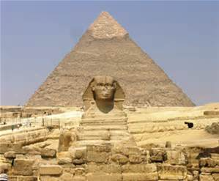
Ancient – Great Pyramid Of Giza
Giza is located west and south of modern Cairo, in the vast desert imagined by the ancient Egyptians to be the land of the dead. Guarded by the Great Sphinx, the plateau is dominated by the massive pyramids of Khufu (Gr. Cheops), Khafre (Gr. Chephren), and Menkaure (Gr. Mycerinus), all of whom ruled Egypt during the 4th Dynasty (c. 2500 BC). The royal pyramid complexes, which include temples, causeways, and satellite pyramids, are surrounded by tombs of the elite-members of the royal family, the nobility, and the priesthood. At the foot of the plateau, south of the Great Sphinx, lie the Cemetery and Town of the Pyramid Builders, where the men and women who constructed the royal and elite tombs on the main plateau lived, worked, and were buried.

Slide 3
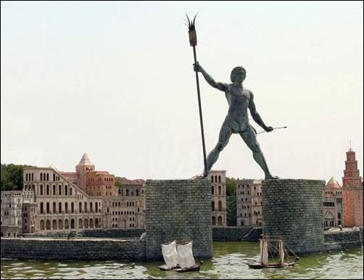
Ancient – Colossus of Rhodes
The Colossus of Rhodes was a statue of the Greek titan-god of the sun Helios, erected in the city of Rhodes, on the Greek island of the same name, by Chares of Lindos in 280 BC. One of the Seven Wonders of the Ancient World, it was constructed to celebrate Rhodes' victory over the ruler of Cyprus, Antigonus I Monophthalmus, whose son unsuccessfully besieged Rhodes in 305 BC. Before its destruction in the earthquake of 226 BC, the Colossus of Rhodes stood over 30 metres (98 feet) high, making it one of the tallest statues of the ancient world.

Slide 4
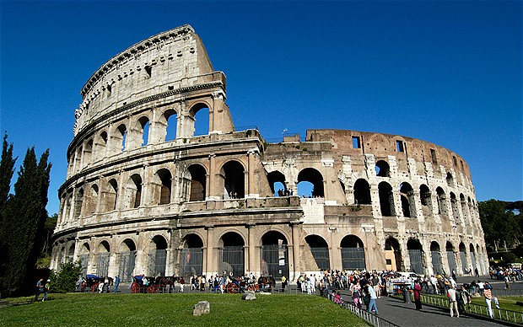
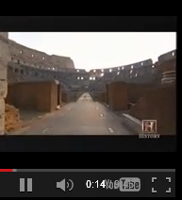
Modern - Colosseum
The Roman Colosseum is the most famous monument to have survived from the classical world. It was built nearly two thousand years ago for the purpose of hosting violent gladiator games. Thousands of men and animals fought for their lives in the sandy arena. A few gladiators and warriors found glory there. Some even found fame and riches but many more died an anonymous death, providing entertainment for eager Roman spectators.

Slide 5
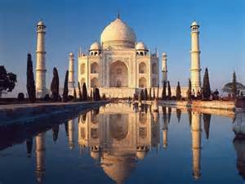
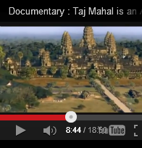
Modern - Taj Mahal
The Taj Mahal is the epitome of Mughal art and one of the most famous buildings in the world. Yet there have been few serious studies of it and no full analysis of its architecture and meaning. Ebba Koch, an important scholar, has been permitted to take measurements of the complex and has been working on the palaces and gardens of Shah Jahan for thirty years and on the Taj Mahal itself—the tomb of the emperor's wife, Mumtaz Mahal—for a decade.

