Slide 1
WELCOME!
This is a module to teach you all about the different types of fruits.
This knowledge may help you decide which type of pet to get.
Click a particular topic in the Navigation Map on the right to go to a particular topic.
Or use the navigation buttons at the bottom right to move between the pages or to return to this Home page.
Enjoy the module!
Types of Fruits
Domestic Fruits
Exotic Fruits
Water Melon
Papaya
Durian
Mangosteen

Slide 2
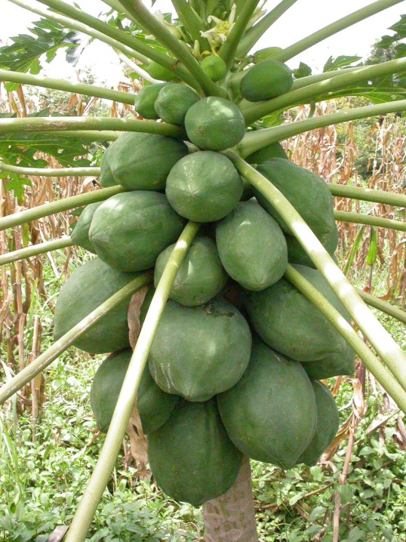
2
DOMESTIC FRUITS
Papaya
This is a fruit which you come to love once you develop a taste for it.
The orange-coloured flesh is very tempting indeed, but what puts
most people off, is the slight bitter aftertaste that accompanies the
otherwise sweet fruit. Have it on its own or team it with a mixed-fruit
Bowl and it is an energy booster.
For more information on domestic pets click this WEB-LINK.
Click the right arrow at the bottom right to see example of another fruit which is exotic type.

Slide 3
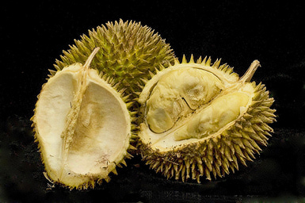
3
EXOTIC FRUITS
Durian
In contradiction to its medieval appearance on the outside,
durian flesh is actually soft, delicate, and creamy. Durian fruit
can be eaten with a spoon, much like a firm custard. The
handful of large, stone-like seeds can be easily removed. The
taste is reminiscent of the smell, but much sweeter.
For more information about dogs click this WEB-LINK.

