Slide 1
MCQ QUIZ – QUICK PROGRESS CHECK

Slide 2
Q1. How do you pick up a kitten?
A. By its head.
Click to Answer
B. By it tail.
Click to Answer
C. By the top skin of the neck.
Click to Answer
D. By its ears.
Click to Answer

Slide 3
WRONG!!!
TRY AGAIN
Click To Go Back

Slide 4
CORRECT!!!
WELL DONE

Slide 5
Q2. What type of food do you feed a baby kitten?
A. Milk.
Click to Answer
B. Fish.
Click to Answer
C. Fish cake.
Click to Answer
D. Pork chop.
Click to Answer

Slide 6
WRONG!!!
TRY AGAIN
Click To Go Back

Slide 7
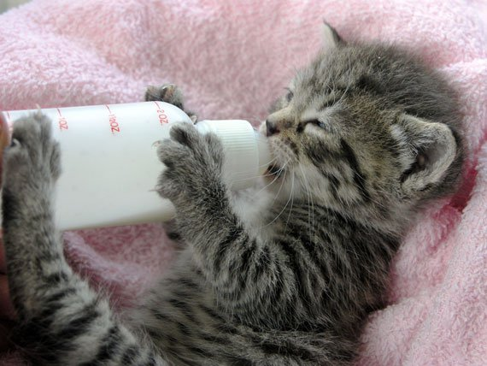
CORRECT!!!
WELL DONE

Slide 8
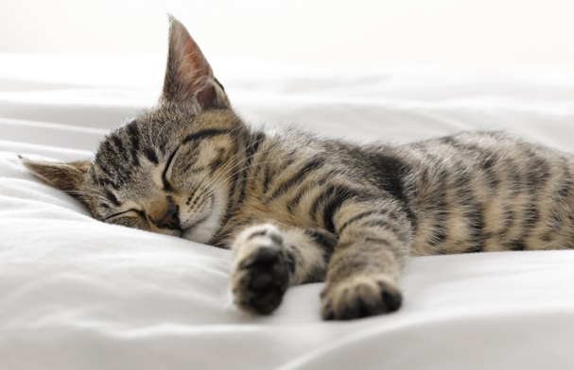
Q3. How to make a Kitten sleep?
Let the kitten
play till it tired .
Click to Answer
B. Let the kitten listen
to soft music.
Click to Answer
C. Feed till it full then
let the kitten sleep.
Click to Answer
Click to Answer
D. All of the above.

Slide 9
WRONG!!!
TRY AGAIN
Click To Go Back

Slide 10

CORRECT!!!
WELL DONE

