Slide 1
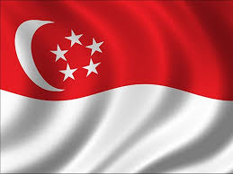
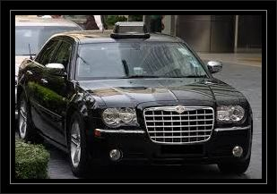
WELCOME TO SINGAPORE
Known as “The Garden City”, Singapore is one of the busiest ports and most important financial centers in the world. Singapore boasts broad streets with luxuriant trees and all kinds of flowers, decorated with lawns and well-tended flower-beds. It also enjoys more than 2000 higher plants and is reputed as “the garden city” of the world and “environment model” of Southeast Asia
Transport
Food paradise
Population
Click here and we are ready to go !!

