Slide 1
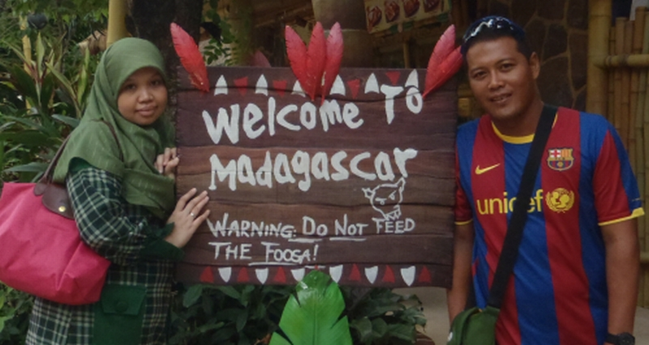
Attractions at Madagascar Zone
WELCOME

Slide 2
Attractions at Madagascar Zone
1. King Julien’s Beach Party
Click to view
2. Gloria’s Snack Shack
Click to view
3. Penguin Parade
Click to view

Slide 3
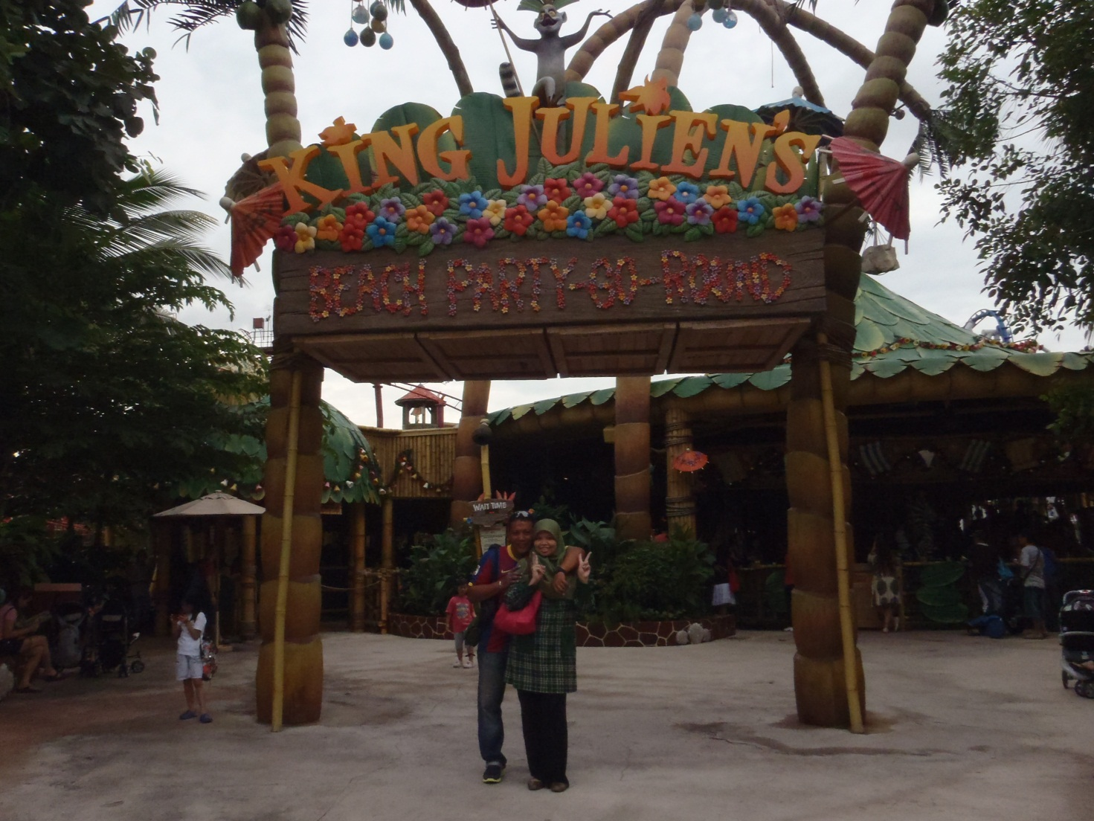
Attractions at Madagascar Zone

Slide 4
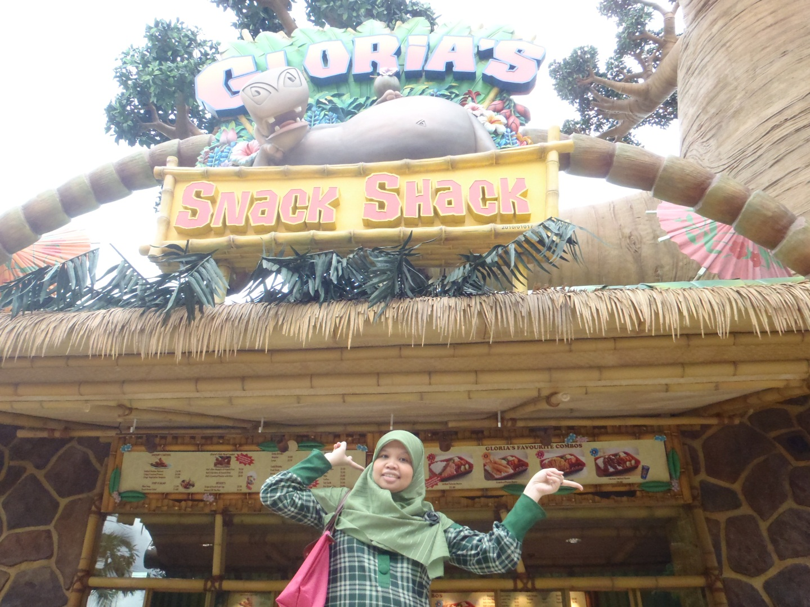
Attractions at Madagascar Zone

Slide 5
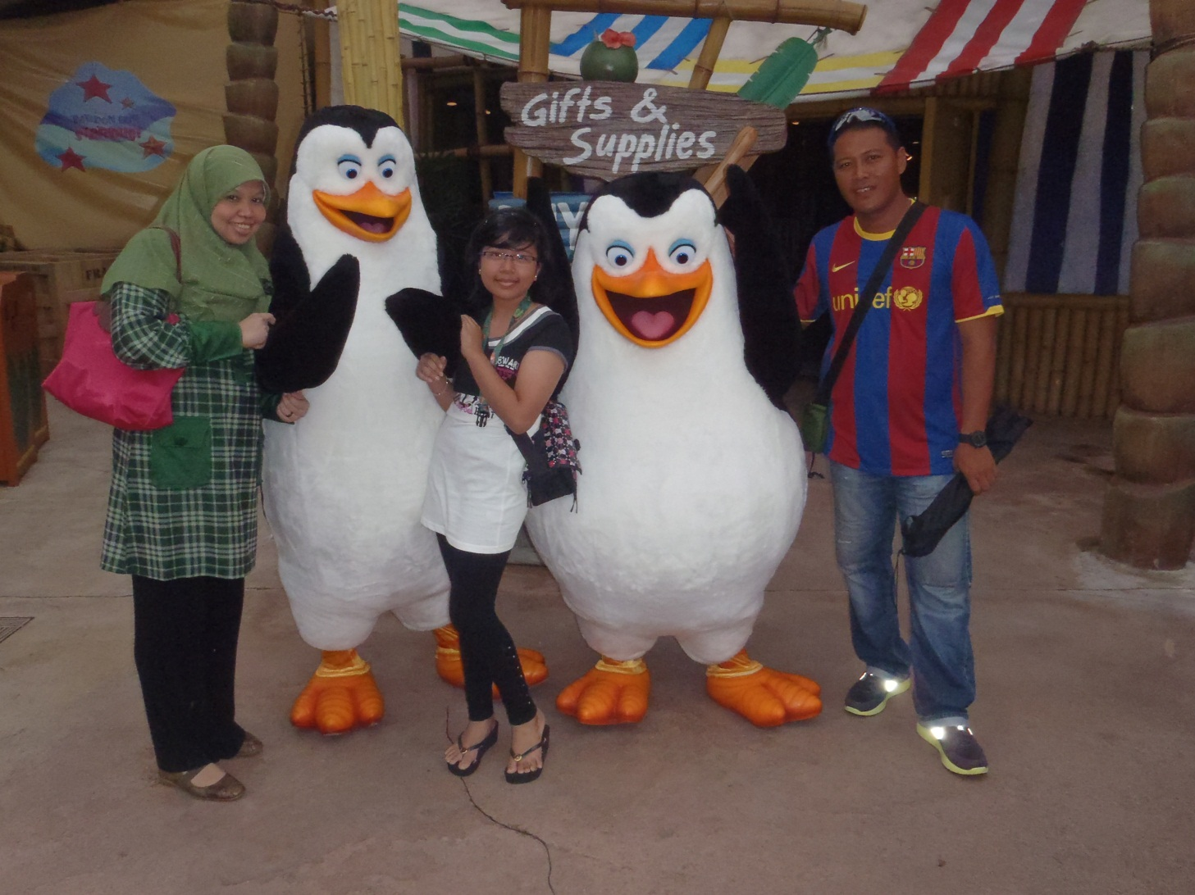
Attractions at Madagascar Zone

