Slide 1
1
CAT1
CAT2
DOG
DOG1
DOG2

Slide 2
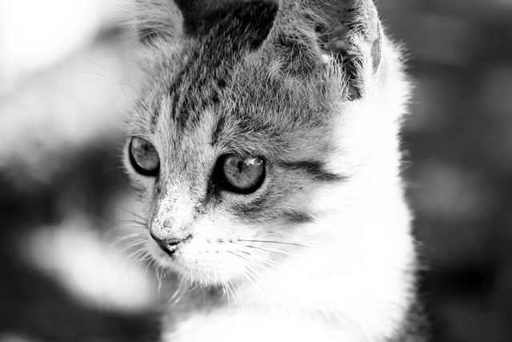
2
BABE CAT
This story is about life of SSG BABE from SCS 2 GOLF COY!!!

Slide 3
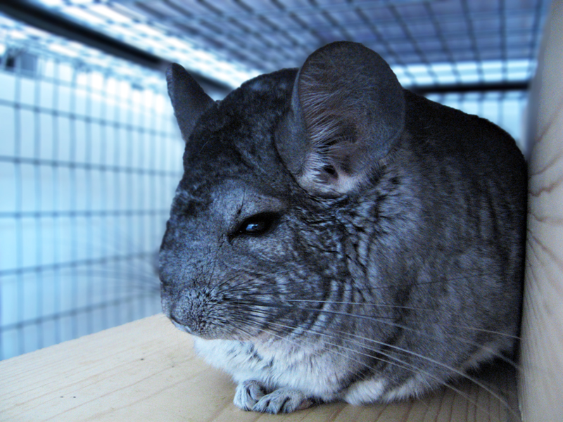
3
SURENDRA
WO SURENDRA love this PET ???

Slide 4
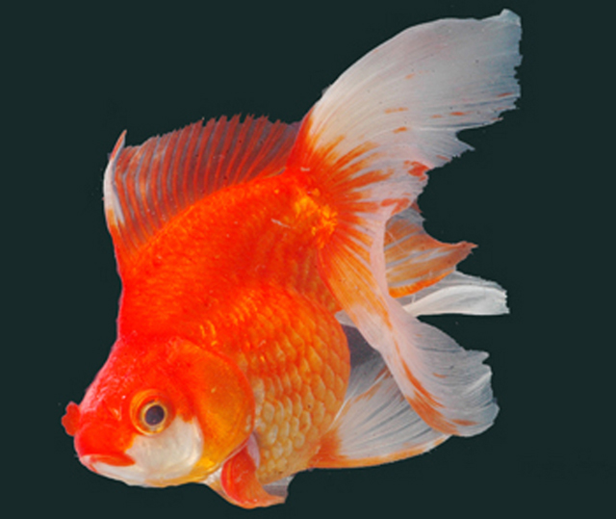
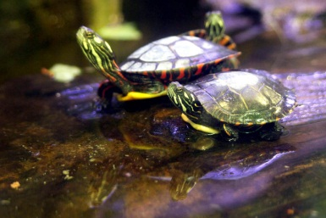
4
MUZZ
MUZZ looks like this Goldfish….

Slide 5
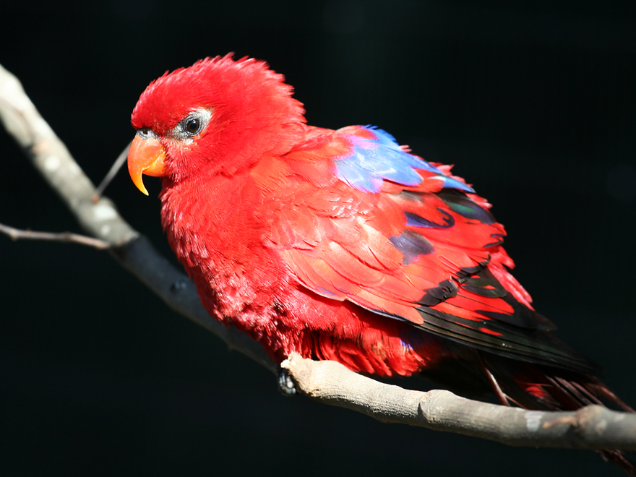
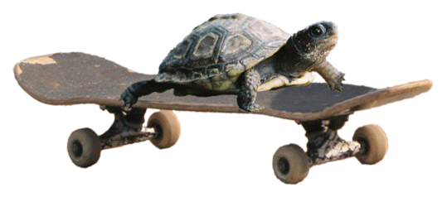
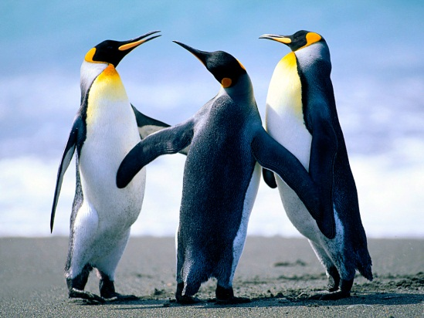
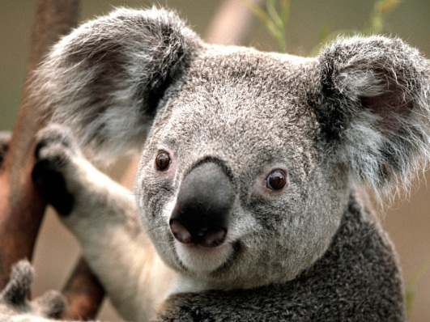
5
ANDY
HOW DOES ANDY LOOK ?????

