Slide 1
WELCOME!
This is a module to teach you all about the different types of shoes.
This knowledge may help you decide which type of shoe for what purpose.
Click a particular topic in the Navigation Map on the right to go to a particular topic.
Or use the navigation buttons at the bottom right to move between the pages or to return to this Home page.
Enjoy the module!
Type of shoes
Casual
Treking
Running
Walking
Sport
Working

Slide 2
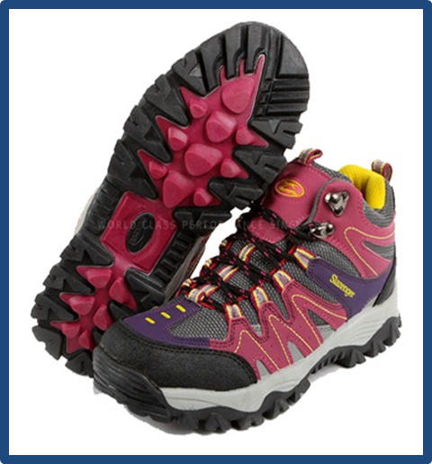
Trek Shoe

Slide 3
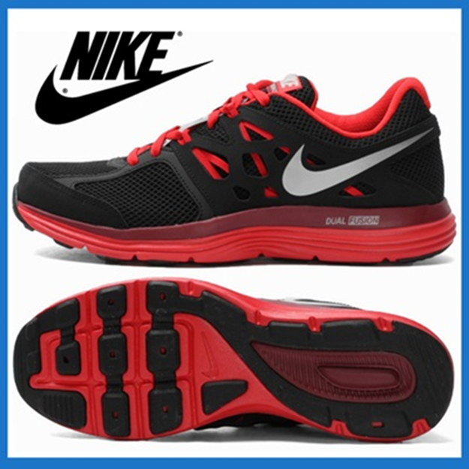
Running Shoe

Slide 4
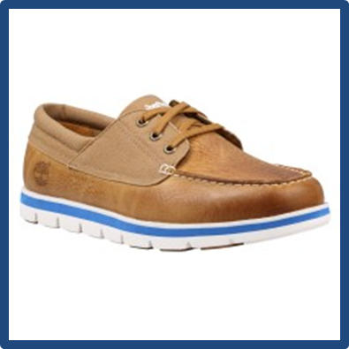
Walking Shoe

Slide 5
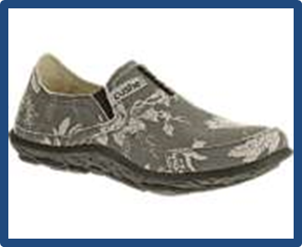
Working Shoe

Slide 6

