Slide 1
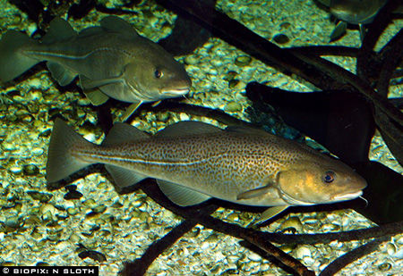
TYPES OF FISH
SALMON
GROUPER
COD

Slide 2
TYPES OF FISH
GROUPER
COD

Slide 3
TYPES OF FISH
COD

