Slide 1
Types of Pets
WELCOME!
This is a module to teach you all about the different types of pets.
This knowledge may help you decide which type of pet to get.
Click a particular topic in the Navigation Map on the right to go to a particular topic.
Or use the navigation buttons at the bottom right to move between the pages or to return to this Home page.
Enjoy the module!
Types of Pets
Domestic
Exotic
Cat
Dog
Parakeet
Terrapin

Slide 2
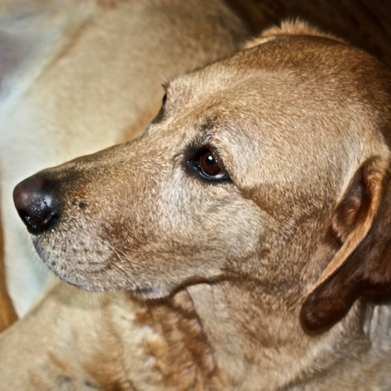
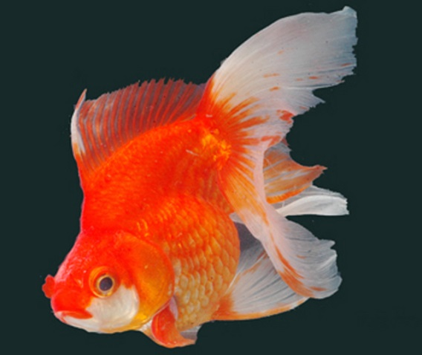
Types of Pets
DOMESTIC PETS
Generally domestic pets are animals that one keeps in a dwelling.
They are generally able to be domesticated through proper care and training.
They can be very small like a Gold fish or larger in size such as a dog.
They are most suitable for rearing and keeping in a home.
For more information on domestic pets click this WEB-LINK.
Click the right arrow at the bottom right to see examples of two popular domestic pets - dogs and cats.

Slide 3
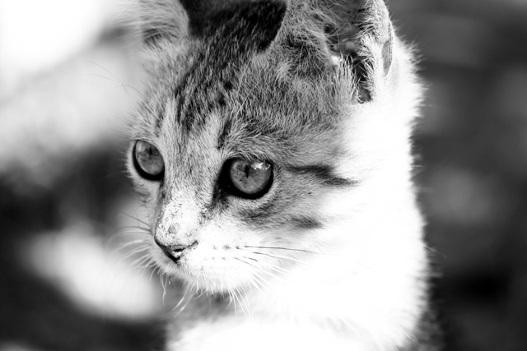

Types of Pets
CATS
Cats can be make nice pets too, especially if you prefer a more docile pet.
Generally cats are not as forth coming as dogs but they can make charming pets.
Again there are many possible breeds to own. From fur-less Don Sphynx to full-fur Ragamuffins!
For more information about different breeds click this WEB-LINK 1.
For more information about domestic cats click this WEB-LINK 2.
Or click the right arrow at the bottom right to find out more about Exotic Pets.

Slide 4
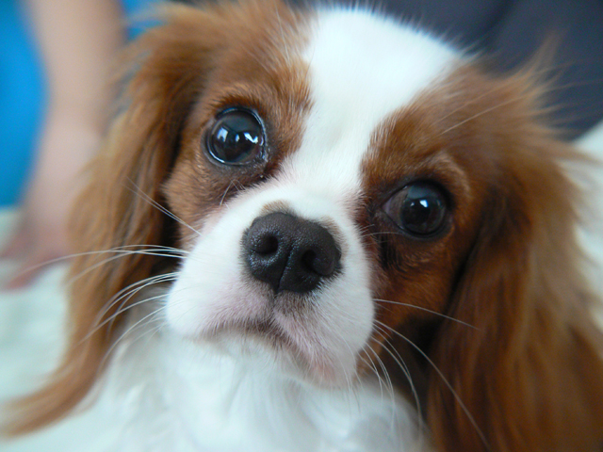

Types of Pets
DOGS
As the saying goes, "Dogs are man's best friend" and they can make great pets.
This is generally true if you take care good care of them and train them well.
But do be aware that not all breeds are the same.
Some dogs are more docile while are some more aggressive. Click the “Speaker” icon on the right to hear a dog barking. Do you think the dog is docile or aggressive?
For more information about dogs click this WEB-LINK.
Or click the right arrow at the bottom right to see information about cats instead.

Slide 5
Types of Pets

Slide 6

Types of Pets
PARAKEETS
Parakeets are coloured birds. Common colours are blue, yellow or green.
However, some can be very colourful like the Eastern Rosella!
Generally, parakeet are small or medium sized species of parrots .
Click the video on the right to watch and hear a parakeet.
For more information about choosing parakeets click this WEB-LINK.
Or click the right arrow at the bottom right to move on to information about terrapins.

Slide 7
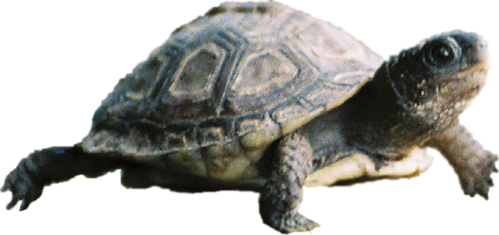

Types of Pets
TERRAPINS
Terrapins are a particular species of turtles, specifically of the Malaclemys type.
These turtles are not of the sea water variety.
However, they do need brackish water to live.
Brackish water is more salty than freshwater but much less than sea water.
For more information on how to care for terrapins click this WEB-LINK. Or click the YELLOW followed by the GREEN button to watch a terrapin do a stunt!
This is the last page of this module, click the "Home" button to go back to the Welcome start page.
WEB-LINK
Click to Read

