Slide 1
Type of Fishes
Fresh Water Fish
Tetra
Cat Fish
WELCOME!
This is a module to teach you all about the different types of fish.
This knowledge may help you decide which type of fish to get.
Click a particular topic in the Navigation Map on the right to go to a particular topic.
Or use the navigation buttons at the bottom right to move between the pages or to return to this Home page.
Enjoy the module!

Slide 2
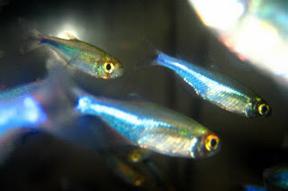
Neon tetra
Neon tetra is a attractive and most popular small fish for planted aquarium, Neon tetra has a silver white abdomen with prominent iridescent blue horizontal stripe with prominent an iridescent red stripe that begins from the middle of the body till the start of its tail. Neon Tetra is a peaceful schooling fish for planted and community aquariums. They should be kept in groups of more than 6 per group. Neon Tetra fish prefer soft, slightly acidic water for optimum health conditions, and avoid strong currents to help them swim easily. If the water quality is maintained and treated with live food, they will spawn easily and live longer. They are best kept in a heavily planted.

Slide 3
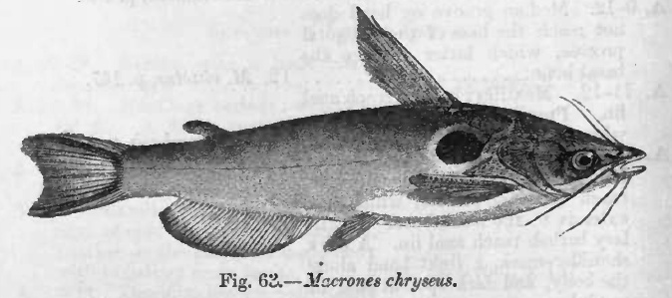
BAGRIDAE CAT FISH
The Bagridae are a family of catfish that originate from Africa and Asia from Japan to Borneo. These fish are commonly known as naked catfishes or bagrid catfishes.
Large bagrids are important as food fish. Some species are kept as aquarium fishes.
Physical characteristics
The dorsal fin is preceded by a spine. The adipose fin is present and can have a relatively long base in some species. The pectoral fin spine can be serrated. The body is completely naked (they have no scales). The maximum length is about 1.5 m (4.9 ft). Fishes of the Bagridae family have four pairs of well-developed barbels covered by a layer of taste bud-enriched epithelium.

