Slide 1
DIFFERENT TYPES OF GAMES
Indoor Games
  Chess
  Bowling
Outdoor Games
  Tennis
  Basketball

Slide 2
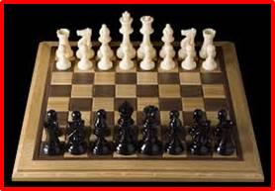
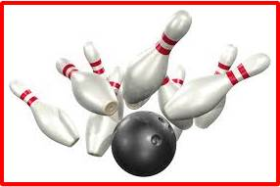
INDOOR GAMES
Chess
Bowling
BACK

Slide 3
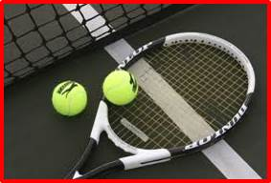
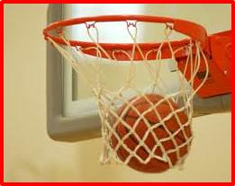
OUTDOOR GAMES
Tennis
Basketball
BACK

