Slide 1
1
Types of Bike
Motor
Manual
WELCOME!
This is a module to teach you all about the different types of Bike.
This knowledge may help you decide which type of biketo get.
Click a particular topic in the Navigation Map on the right to go to a particular topic.
Or use the navigation buttons at the bottom right to move between the pages or to return to this Home page.
Enjoy the module!

Slide 2
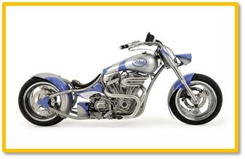
2
Motor
WEB-LINK

Slide 3
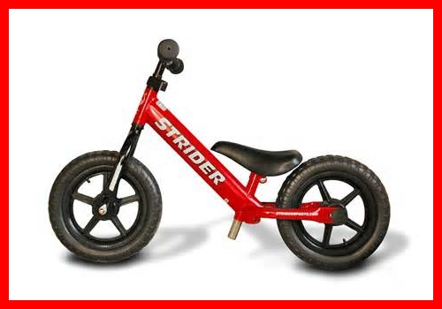
3
Manual
WEB-LINK

