Slide 1
Antiparasitic Drugs for Large & Small Animals
Extracted from:
Handbook of Veterinary Pharmacology by
Walter H. Hsu

Slide 2
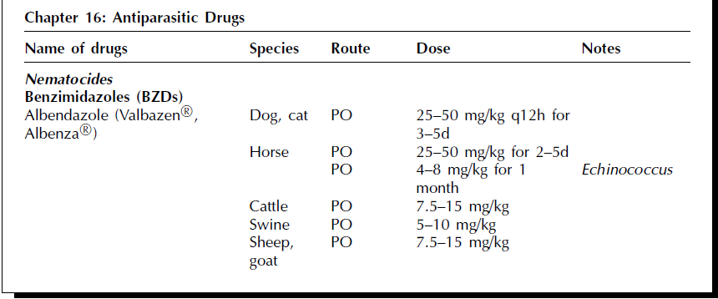

Slide 3
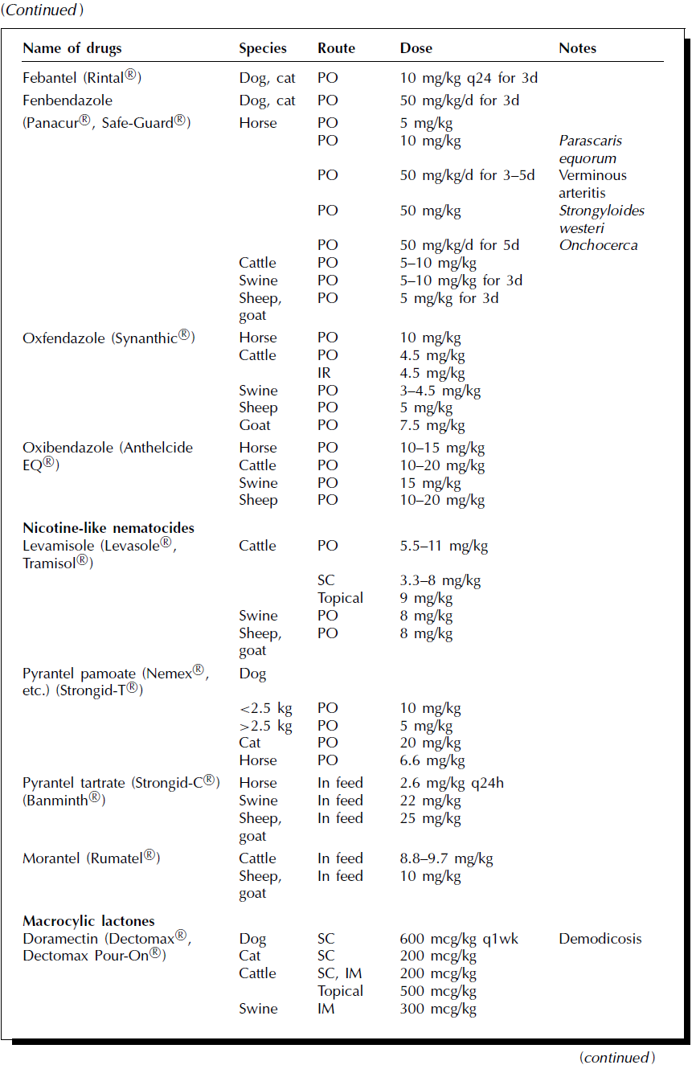

Slide 4
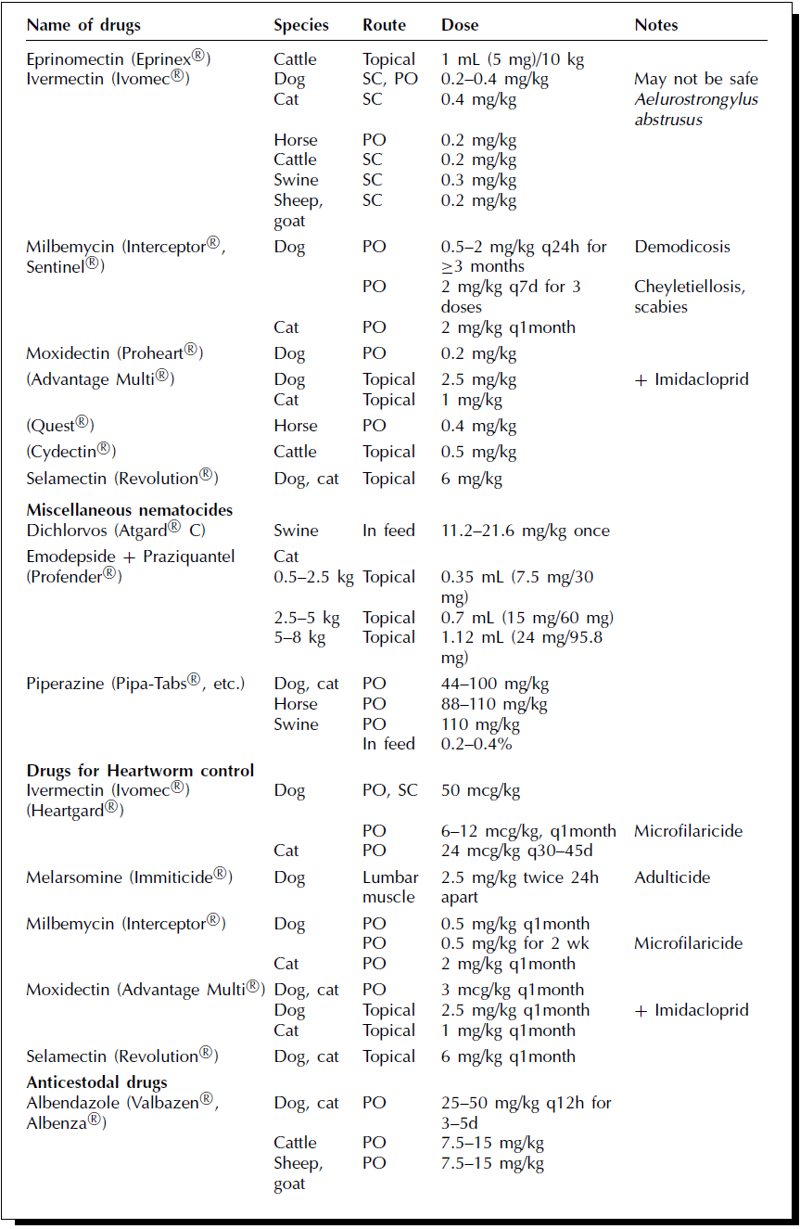

Slide 5
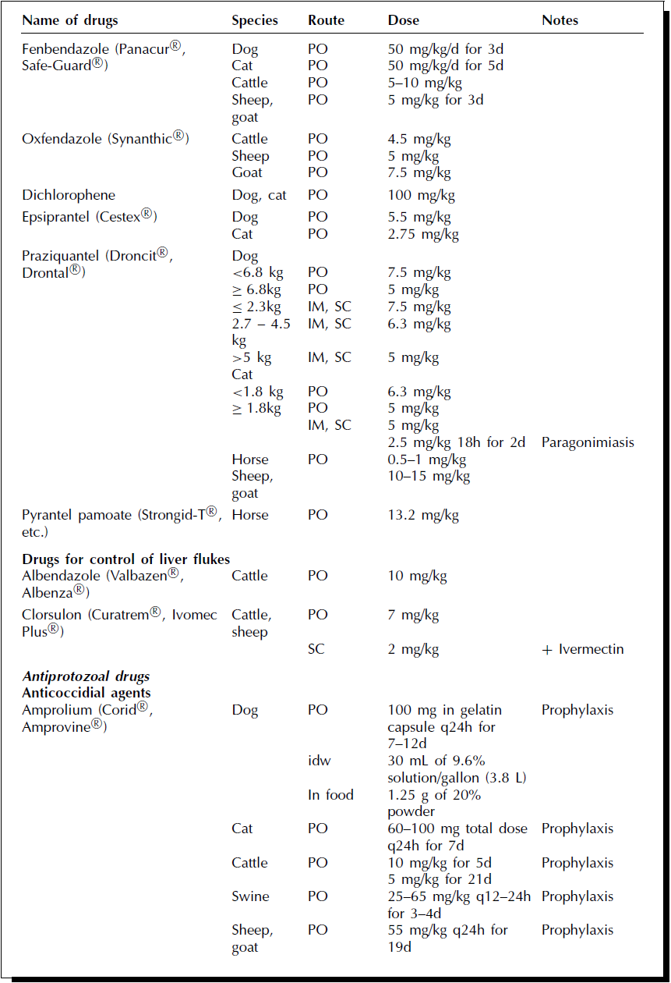

Slide 6
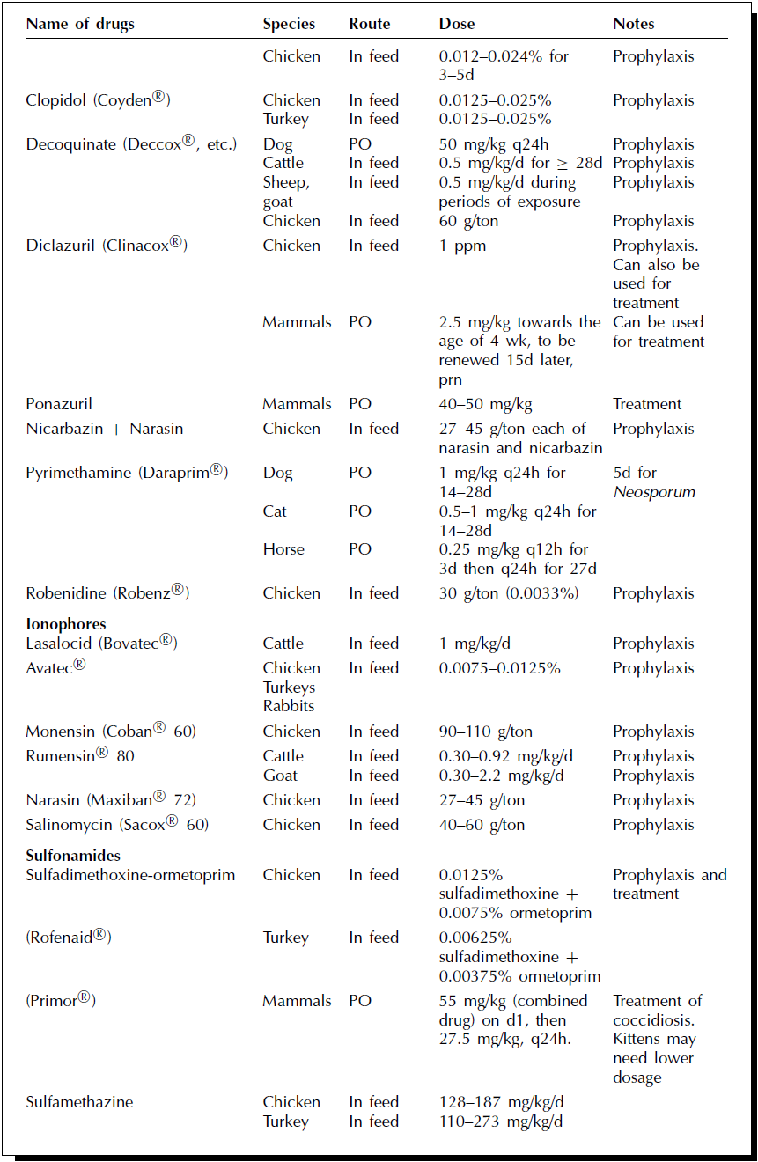

Slide 7
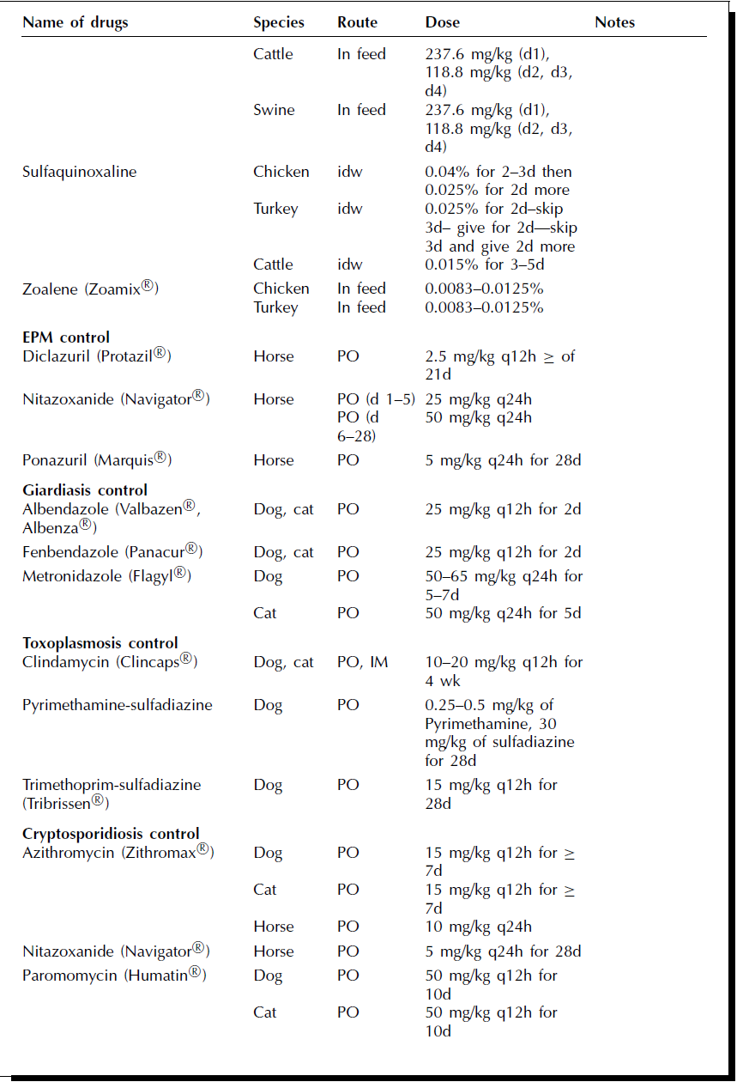

Slide 8
