Slide 1
Instruments for Prolapse
Extracted from:
Veterinary Instruments and Equipment: A Pocket Guide, 3rd Ed. - Teresa F. Sonsthagen

Slide 2
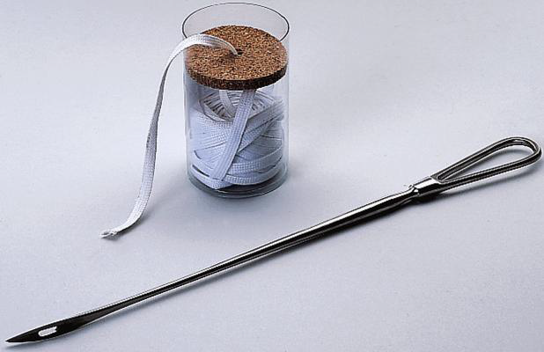
Umbilical Tape with Buhner Needle
To suture a large animal after abdominal surgery or to suture the vagina closed after a prolapse.

Slide 3
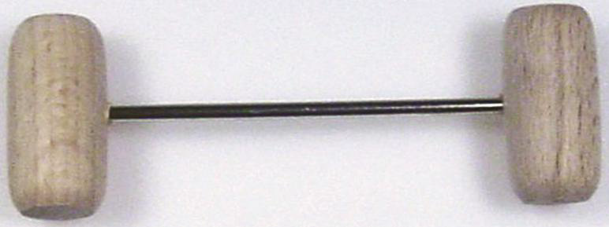
Vulva Suture Pins
To retain a uterine or vaginal prolapse.

Slide 4
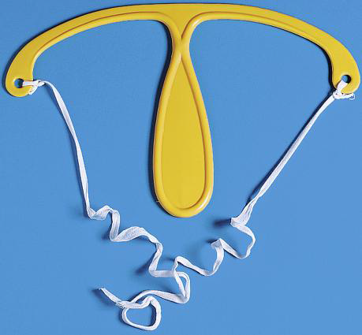
Ewe Prolapse Retainer
To retain a vaginal prolapse.

