Slide 1
Teat Instruments
Extracted from:
Veterinary Instruments and Equipment: A Pocket Guide, 3rd Ed. - Teresa F. Sonsthagen

Slide 2
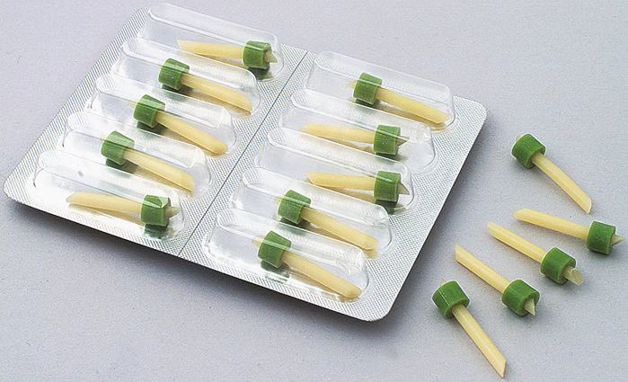
Teat Dilator
Used to open the teat canal.

Slide 3
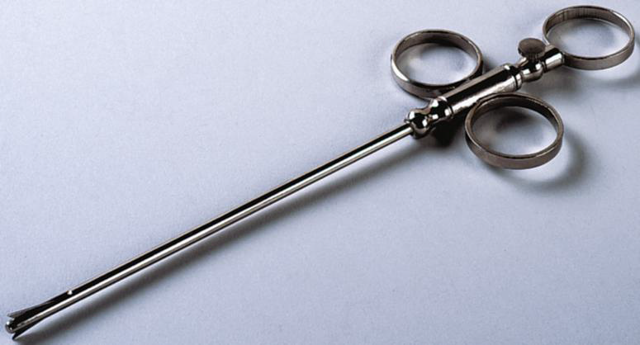
Teat Slitter
To make an incision from the inside to the outside.

Slide 4
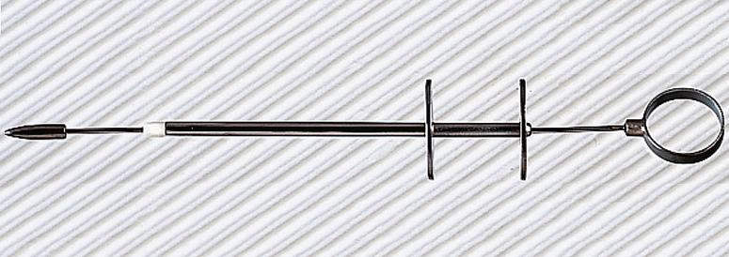
Teat Tumour Extractor
To remove tumours or other fibrous material from the teat canal.

Slide 5
Cornell Teat Curette
To scrape the inside of the teat canal and remove obstructions or tumors or to take biopsy specimens.

Slide 6
Lichty Teat Knife/Bistoury
To open stenotic teats by incising through scar tissue or other constricting tissue.
Sharp tip
Blunt tip

Slide 7
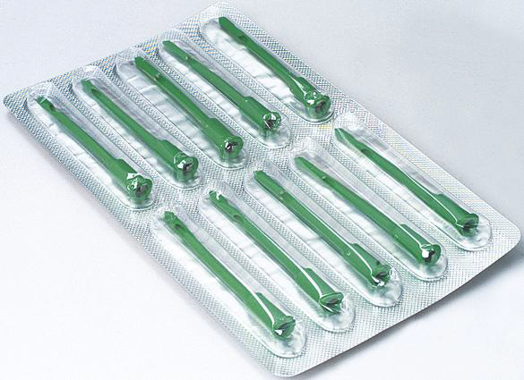
Udder-Infusion Cannula
Used to administer medications into the teat canal. Other possible uses include draining a mastitic quarter, keeping a teat canal or sphincter open during and after surgery, flushing an abscess, and performing a peritoneal tap.

Slide 8
Milking Tubes
To keep an injured teat open for milking. These can be inserted after surgery or after an injury that may cause the teat to swell. They help to keep the canal patent while the teat heals.

Slide 9
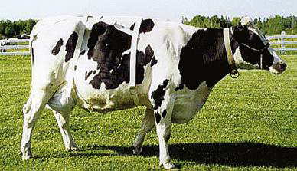
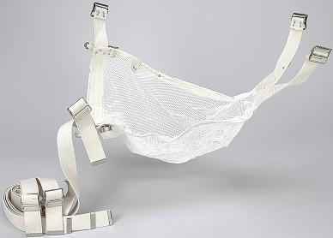
Udder Support
To support an injured or pendulous udder

