Slide 1
Evisceration

Slide 2
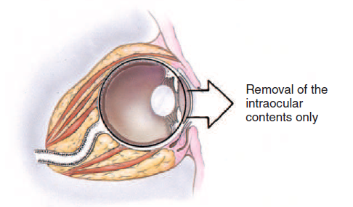
Aim

Slide 3
Procedure

Slide 4
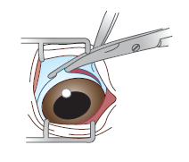
Step 1
The eye is exposed using the eye speculum and the limbal- or fornix-based flap is dissected to expose the sclera using Strabismus scissors.

Slide 5
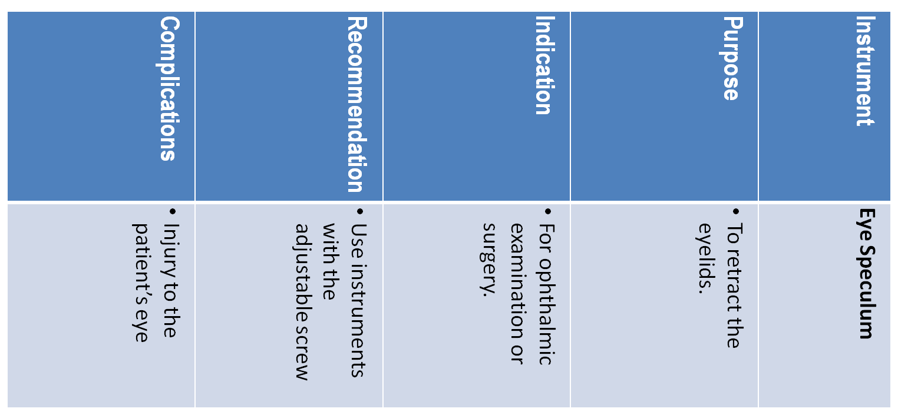
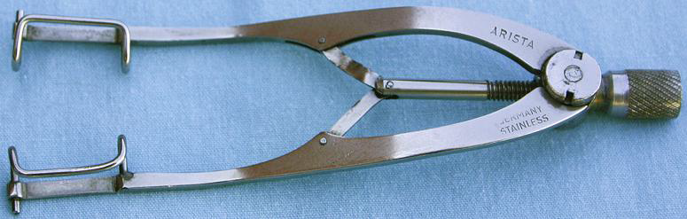

Slide 6
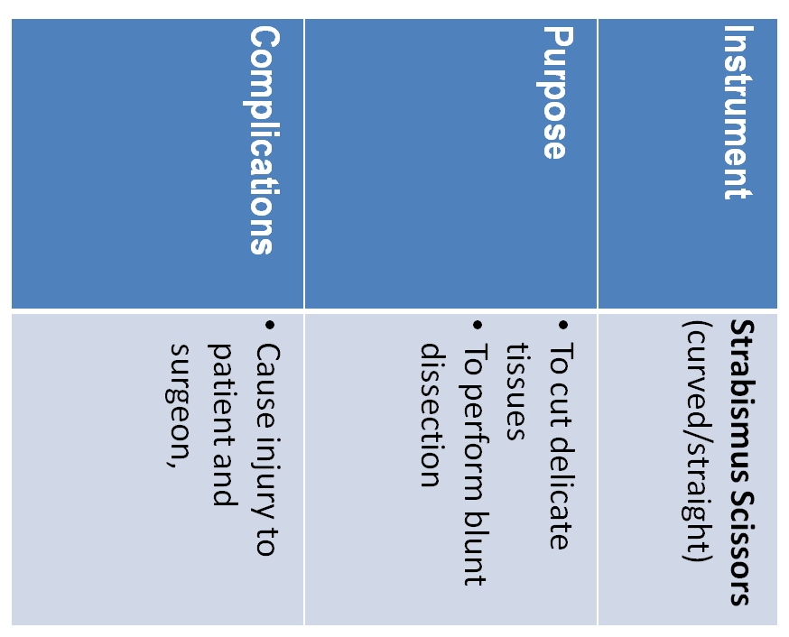
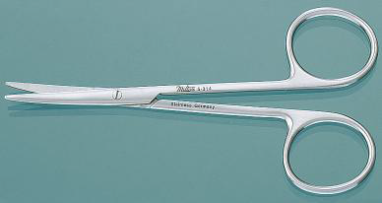

Slide 7
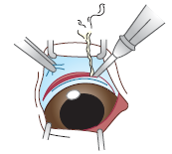
Step 2
A scleral incision is made with an
electroscalpel 3–4 mm posterior to the limbus of about 160°

Slide 8
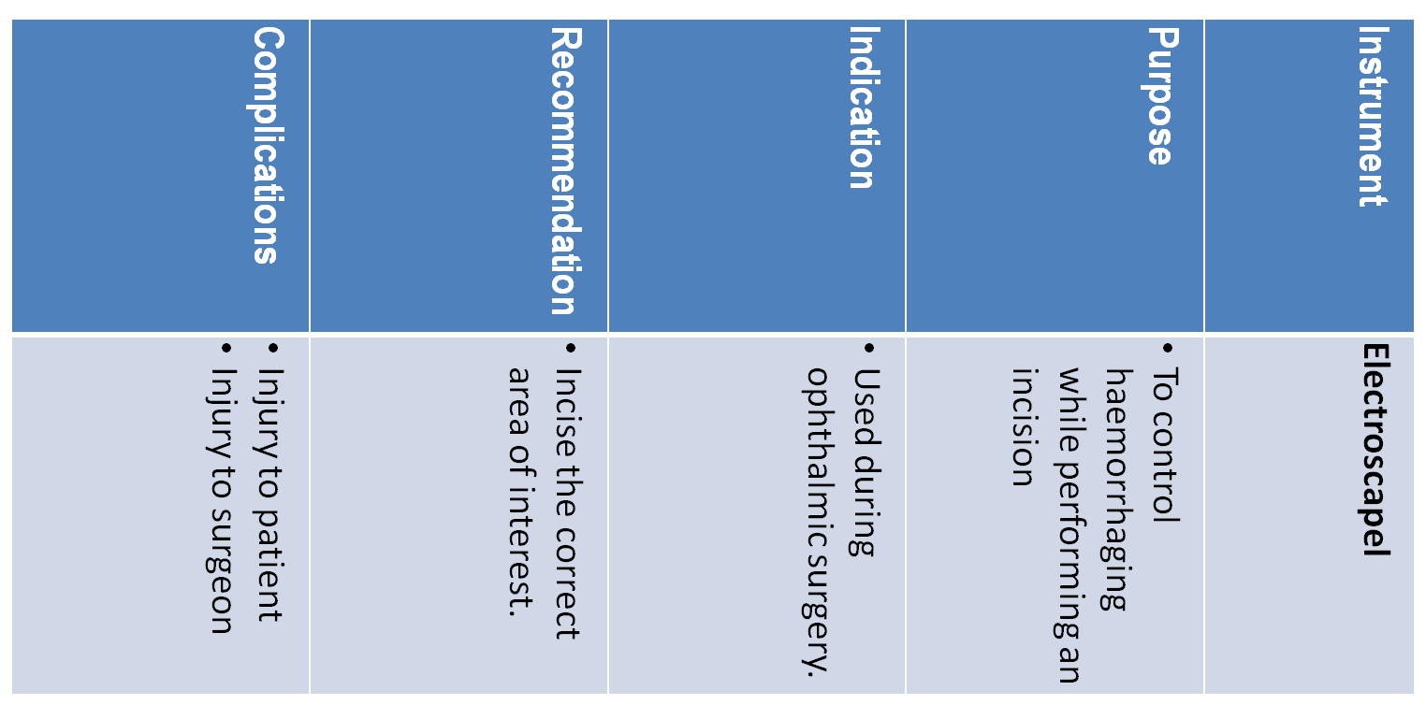
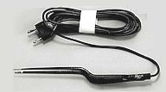

Slide 9
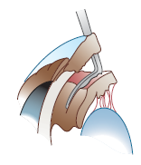
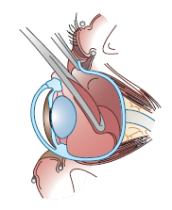
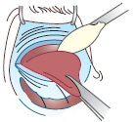
Step 3
The contents of the globe are removed with an evisceration spatula
or a lens loop, which includes the iris, ciliary body, lens, vitreous, and retina.

Slide 10
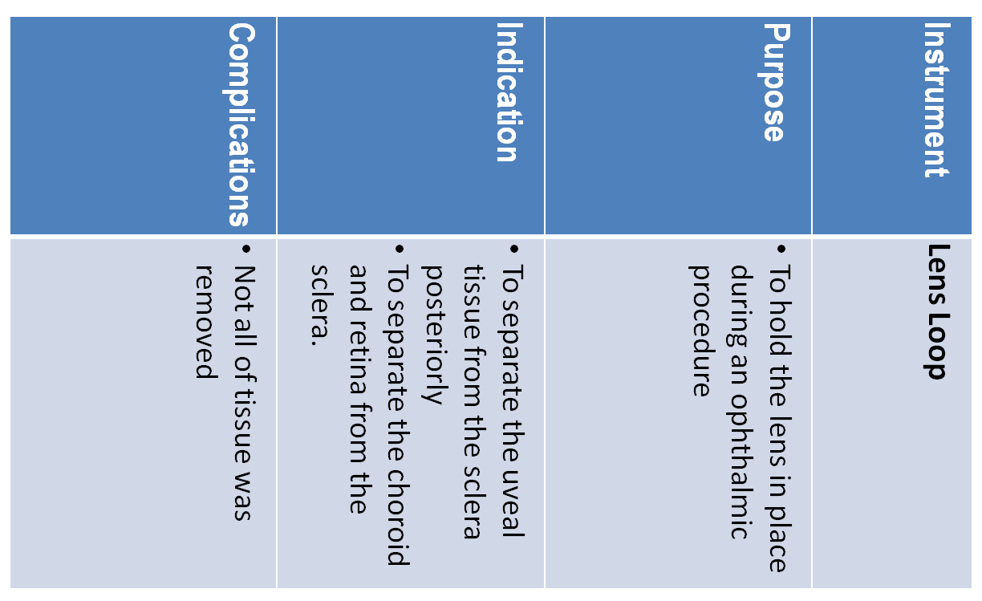
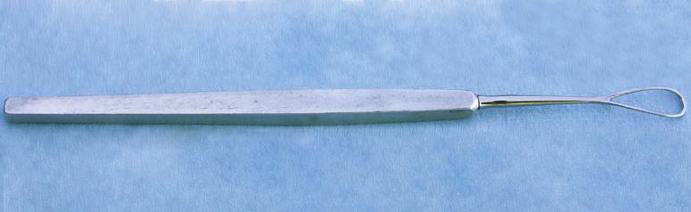

Slide 11

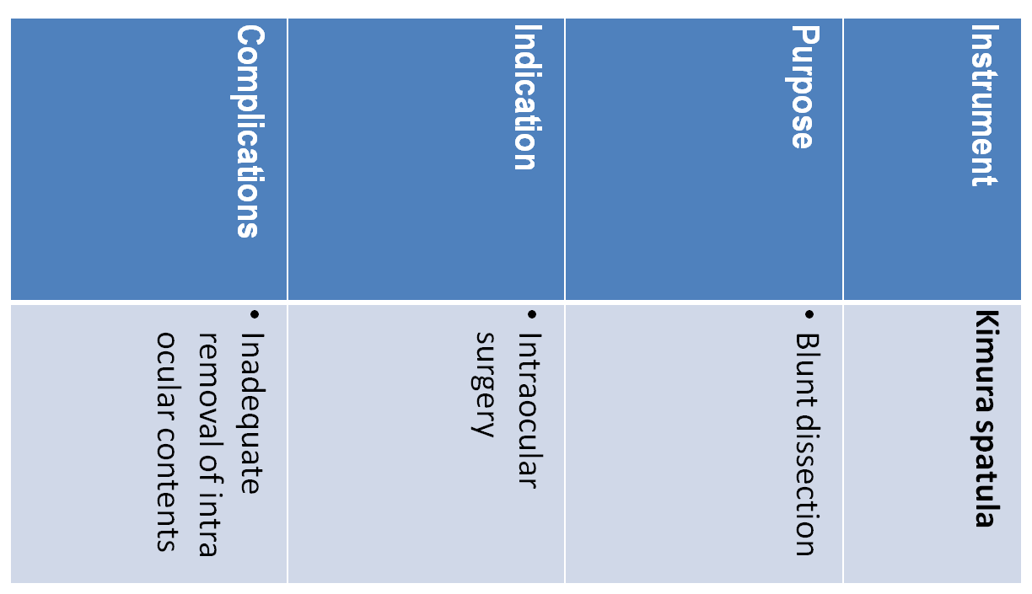

Slide 12
In most cases, implantation of Intraocular/Intrascleral prosthesis is performed after evisceration for a cosmetic effect of the eye

Slide 13
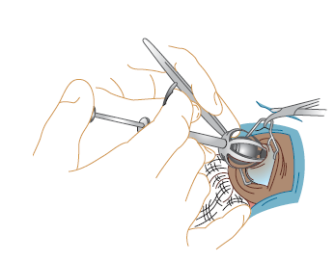
Step 4
The appropriate size silicone (prosthesis) sphere is introduced with a sphere inserter or by everting the scleral incision edges with forceps.

Slide 14
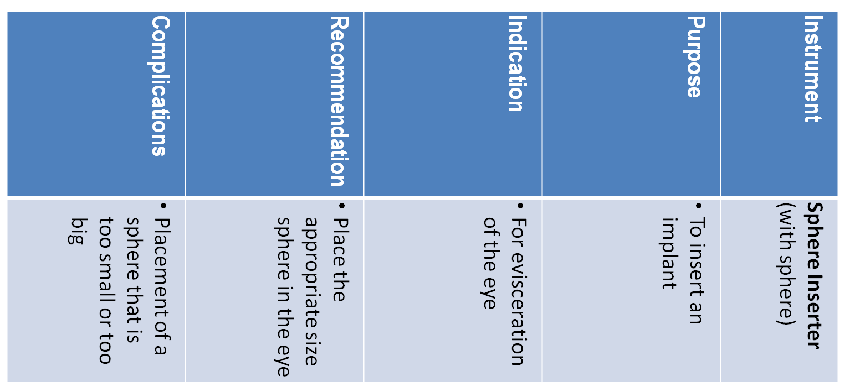
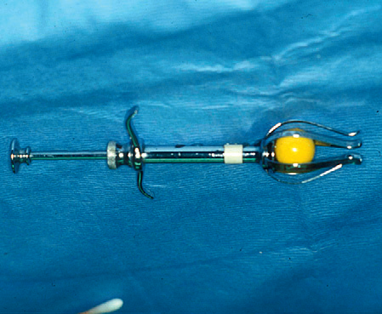

Slide 15
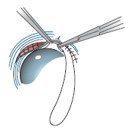
Step 5
The two layer closure consists of apposition of the scleral and the bulbar conjunctival wounds with simple interrupted absorbable
sutures.

Slide 16
References
Slatter’s Fundamental of Veterinary Ophthalmolgy, 4th Ed. – D. Maggs, P. Miller & R. Ofri
Veterinary Ophthalmic Surgery - Kirk N. Gelatt & Janice P. Gelatt
Essentials Of Veterinary Ophthalmology - Kirk N. Gelatt
Ophthalmic Disease in Veterinary Medicine – C. L. Martin
Ophthalmology for the Veterinary Practitioner – F. C. Stades, M. Wyman, M. H. Boeve, W. Neumann & B. Spiess
Veterinary Instruments and Equipment: A Pocket Guide, 3rd Ed. - Teresa F. Sonsthagen
Veterinary surgical instruments - College of Animal Welfare
Surgical Instruments (PDF) – Don’t have a title page or Author

