Slide 1
Stages of Vomiting
By: Kristan Griffith

Slide 2
1. Nausea
Signs may include

Slide 3
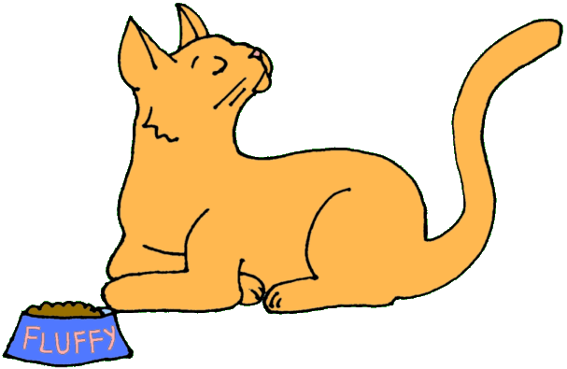
Turning away head from food

Slide 4
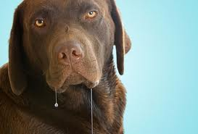
Excessive Salivation

Slide 5
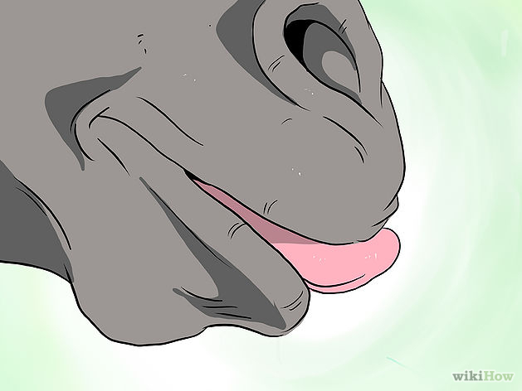
Licking lips excessively

Slide 6

Pacing

Slide 7
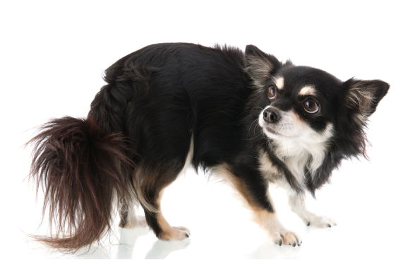
Anxious expression

Slide 8
2. Retching

Slide 9
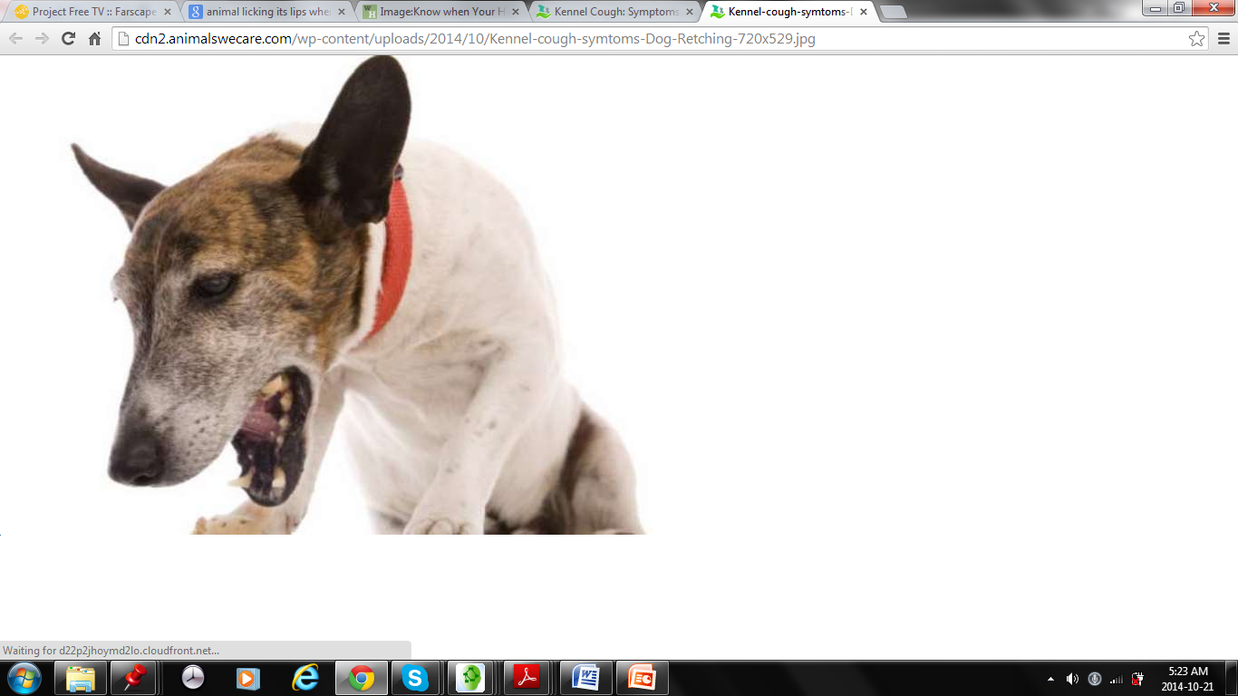

Slide 10
3. Vomiting

Slide 11
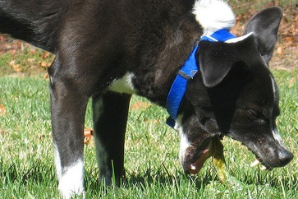

Slide 12
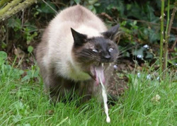

Slide 13
References
http://findavet.us/wp-content/uploads/2010/09/drooling_chocolate_lab1.jpg
http://www.marvistavet.com/html/anorexia.html
http://www.animalswecare.com/home_section/kennel-cough-symptoms-prevention-treatment/#jp-carousel-6427
http://www.wikihow.com/Image:Know-when-Your-Horse-Is-Sick-and-when-to-Call-the-Vet-Step-1Bullet28-Version-2.jpg
http://www.all-creatures.org/anan/
http://www.dogarmor.net/wp-content/uploads/2014/08/Anxiety-disorders-Slide-pics-980-x-400a.jpg
http://www.emetophobiaresource.org/misc-ii--animals.html

