Slide 1
Faculty highlights
May 2014
Scott Van Bramer – Faculty chair

Slide 2
Strategic Planning Process
Notes:
The greatest impact of Faculty Governance this year has been on the strategic plan. Although there have been plenty of issues and the process has felt rushed at times. I want to thank President Harris, Provost Wilhite, Vice-President Baker, and the Board of Trustees for their flexibility adjusting the timeline to coordinate with faculty meetings so that we could use the faculty governance structure to get thoughtful feedback and suggestions that came out of a dialogue between faculty.

Slide 3
High Impact Practices
Notes:
One of the most exciting parts of the strategic plan for me, is the focus on students. In particular the importance of high impact practices on student learning. Since many of these practices are things that we do at Widener, the increased emphasis and the opportunity to share our best practices is a great opportunity for Widener.

Slide 4
AAC&U
High-Impact Educational Practices
First-Year Seminars and Experiences
Common Intellectual Experiences
Learning Communities
Writing-Intensive Courses
Collaborative Assignments and Projects
Undergraduate Research
Diversity/Global Learning
Service Learning, Community-Based Learning
Internships
Capstone Courses and Projects

Slide 5
First-Year Seminars:
Freshman Seminar
Started 1990’s
Improved Retention
Expanding Program
  20 sections
  35+ sections
Notes:
Betsey Barefoot
Required by NURS - added 120 - 140 a year
ENGR embedded it into the ENGR 111 - added 110-120.
More programs are adding this year.
35 sections scheduled for the fall and hoping to add at least 5 more.

Slide 6
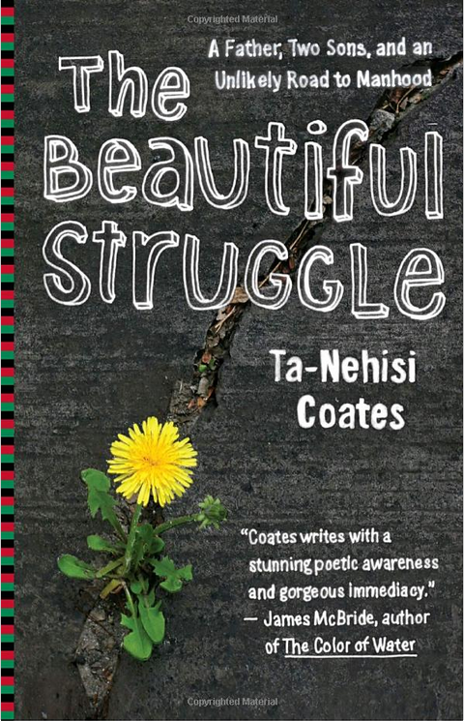


Common Intellectual Experience: English 101
Notes:
Visit by author
Film screenings
Panel discussion
The Common Freshman Experience debuted this academic year with all freshmen and a good number of faculty and staff reading The Beautiful Struggle by Ta-Nehisi Coates. In addition to discussing the book in class and writing about it, the Common Freshman Experience included film screenings and panel discussions as well as a visit to campus by the author.
In the fall of 2014, freshmen will read Public Figures by Public Figures, by Jena Osman. Osman, a faculty member at Temple University, uses photographs and text to engage with questions of public space, history, and civic engagement in her work. Public Figures looks at statues and monuments of historically significant figures in the city of Philadelphia -- often from the perspective of the statue itself -- in order to ask how we construct history and public space, what constitutes a “public figure,” and what contributes to the civic life of a city.
Public Figures will be taught in all sections of ENGL 101 and will be accompanied by a range of exciting and academically challenging interdisciplinary programming throughout the year. Our faculty will be asking students to think about what makes a public figure, what figures are left invisible or silent, and how does Widener’s special role as a metropolitan university in Chester shape our own ideas about public space, public figures, and civic engagement.
We envision a year of asking questions, and more, from an interdisciplinary perspective, centered around reading, writing, discussion, and high-impact assignments that give students the opportunity to explore Philadelphia and Chester, and their own role as civically engaged scholars, thinkers, and leaders in these dynamic and historically and culturally rich urban areas. Among the events planned is a visit to Widener’s campus by the writer, as well as collaboration across the faculty, administration, and student life and academic support units.

Slide 7
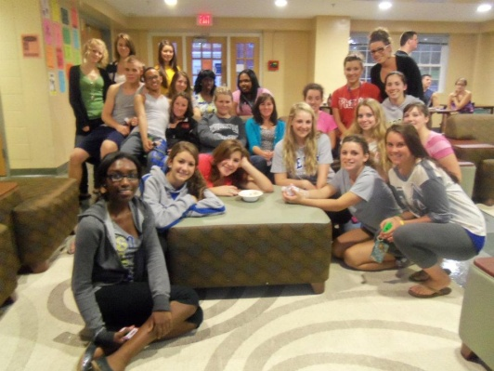
Learning Community:
Nursing
Engineering
Honors
Science
Criminal Justice
90% retention rate
Notes:
Nursing and Engineering 2010
Honors, A&S Summer Research 2011
A pilot Nursing Living Learning Community opened in 2010, and by 2013, it proved so popular that within three years, it had reached its maximum capacity of 46 students. In fact, it was so popular, the Nursing School had to turn away 100 additional students who wanted to join it. Students live in the same residence hall and take courses together as a cohort. In addition, they participate in at least two events per semester, such as movie nights around a health care or nursing theme, CPR training, etc. The program has been expanded to include students in other programs and the retention rate is about 90% for students in learning communities.

Slide 8
Writing Intensive Courses:
History
Requirements
Assessment
Criteria
Notes:
Started 1999
Four WE courses
The Writing-Enriched Program at Widener has been in place since 1999 and is an integral component of the teaching of undergraduate writing. Students are required to take four WE courses, within the major, within an allied field, or as part of general education. The program relies on a writing-in-the-disciplines pedagogy, with a heavy emphasis on using writing to master content, best practices related to process -- brainstorming, drafting, revising, peer review -- and ongoing actionable feedback. A study done in 2008, as well as subsequent NSSE data, reveal that students do a great deal of writing while at Widener, but assessment performed in 2010 and 2012 revealed that the focus on writing needed to be shifted away from quantity of writing to quality of writing. To do this, clearly articulated standards and criteria, as well as intense discussions amongst the faculty about expectations and goals for teaching writing, were required. As a result of assessment, and those conversations, we have articulated common criteria and have begun revising the process for creating and assessing WE courses.

Slide 9
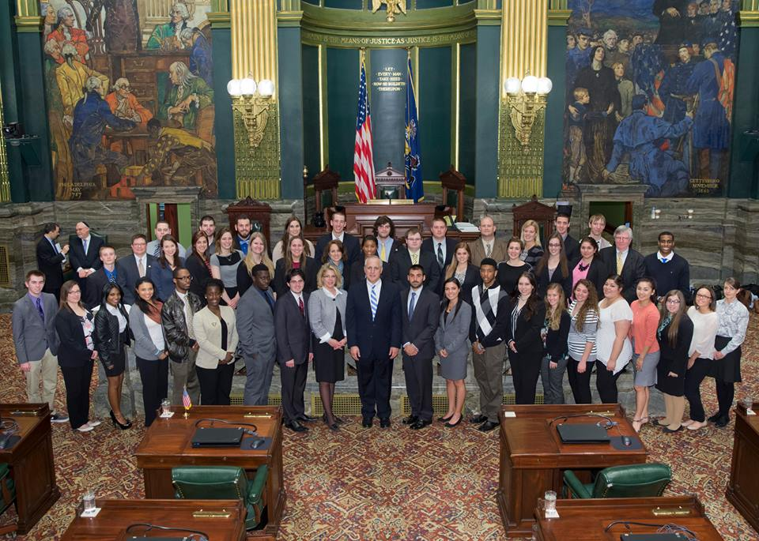
Collaborative Projects:
Cost of Higher Education/Lobby Day
Education:
Tim Sullivan
Business:
Rick Goeke
Political Science:
Wes Leckrone
COMS:
Angie Corbo
Notes:
2012 NAC&U Undergraduate Research Topic
Communications Studies and Political Science faculty collaborated on Widener’s participation in AACUP Lobby Day, April 1.
Cost of Higher education NAC&U undergraduate research topic.
The Communication Studies students created an integrated PR campaign for Lobby Day based on political research conducted by Dr. Leckrone’s students.
The classes acted collaboratively throughout the semester as the previously established Super PAC College Students Concerned about College Costs (CSC3). They hosted events on campus to discuss student debt and created postcards arguing for middle income student debt relief, which they encouraged their peers to sign. personally delivered them to state legislators while in Harrisburg.
In Harrisburg, the nearly 40 Widener participants divided into smaller groups attending previously scheduled meetings with state legislators and dropping in on others.
For each encounter, they had their postcards and talking points in hand.

Slide 10
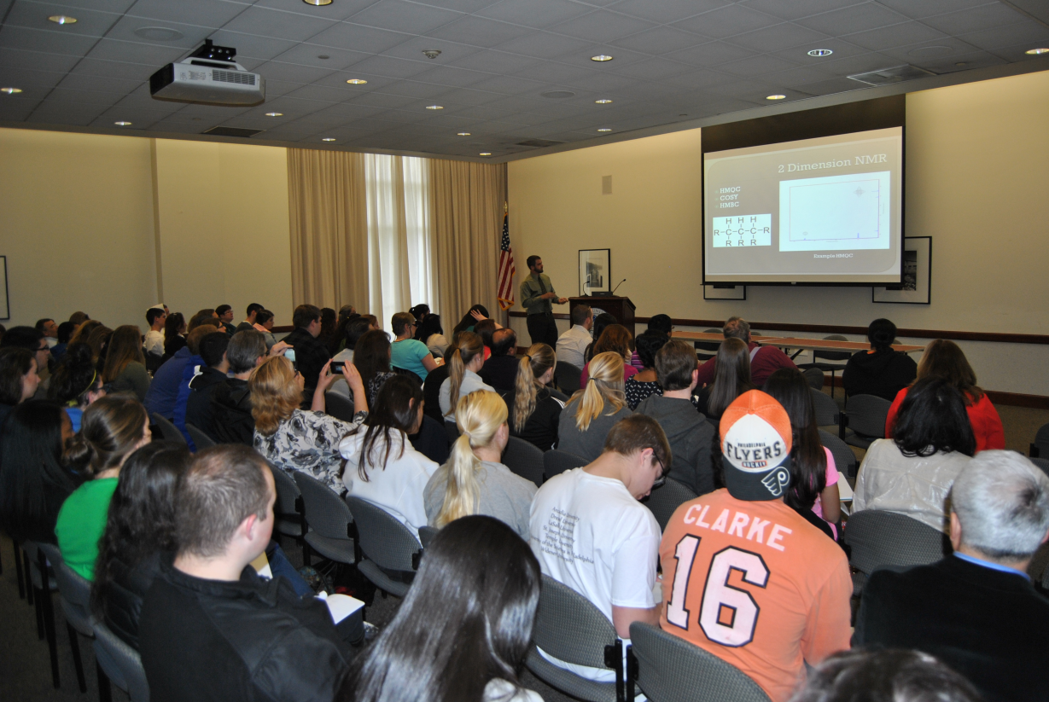
Undergraduate Research:
Student Projects Day
Science
Engineering
Social Science
Humanities
Business
Social Work
Education
Nursing
Notes:
Started in 2000

Slide 11
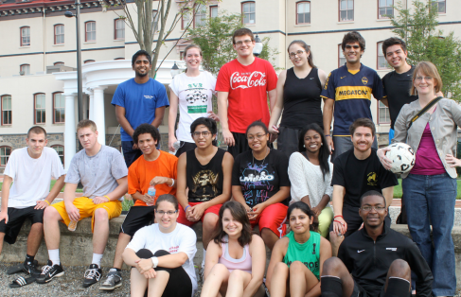
Diversity
Programming
  Pride Mentors
  Cultural Immersion Trips
Majors
  Anthropology
  Sociology
  Modern Languages
  Gender and Womens Studies
  Social Work
  International Relations
  Nursing
Diversity Assessment Pilot
Notes:
Nursing has worked to integrate throughout their curriculum
Ie:
French conversation and composition looks at controversial issues like islamic headscarf in French schools.
Service learning where students work in Chester and engage with local students.
Has a profound effect on Widener students involved in these experiences.
LGBT, French Club, Latinos Unitos, BSU, Black Men United, and international students have annual fall soccer match that has fosters collaborations and group events and carries over to class experiences.

Slide 12
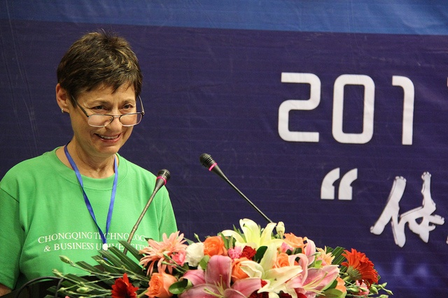
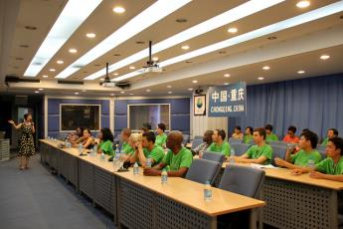
Global Learning
Faculty/Student Trips
Spain (6)
Trinidad (9)
Netherlands (6)
China (9)
Honduras (10)
Costa Rica (10)
Germany (2)

Slide 13
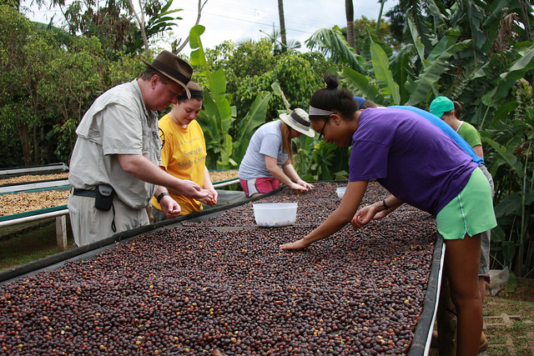
Service Learning:
Sustainability Science in Costa Rica
ENVR:
Stephen Madigosky
Chad Freed
Itzick Vatnick
COMS:
Tim Scepansky
Notes:
78 Faculty trained
over 100 service learning courses,
60 community partners,
3000 students
Ten students joined Dr. Stephen Madigosky's Special Topics in Sustainability Science course on an 11-day service-learning trip to Costa Rica over winter break. The trip was designed to introduce students to unique sustainable development projects that have a significant economic and social impact on villagers and farmers who harness biological resources for a living.
At the Las Lajas coffee farm, students focused on characterizing the physical aspects of a coffee farm that produces organic, shade-grown coffee compared to one that produces sun-grown coffee to learn how consumer decisions impact the environment. Las Lajas produces the beans for WU Brew, Widener's own brand of coffee, which is for sale in the bookstore. Sales of the WU Brew helped fund the trip.
Then, students visited one of the world's most important nesting sites for Olive Ridley sea turtles. They examined the dynamics of how harvesting a fraction of the turtle eggs helps support the local economy. Students had the opportunity to speak directly with community members about all aspects of the operation.
The course is the brainchild of Dr. Stephen Madigosky, a professor of environmental science. He, along with several of his colleagues including Tim Scepansky and Drs. Chad Freed and Itzick Vatnick, use this opportunity to develop within students a sense of inquiry that hones their research skills while addressing real world problems and applications.

Slide 14
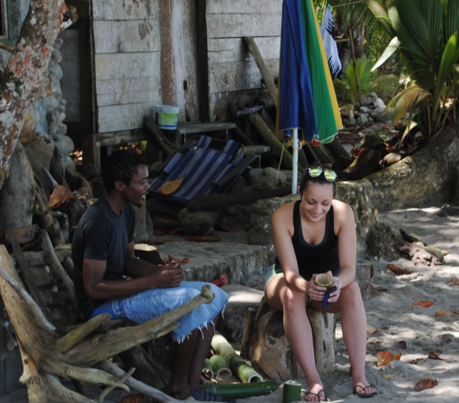
Community Based Learning:
Trinidad and Tobago
Anthropology:
Brett Alvaré
Education:
Nadine McHenry
Notes:
Five undergraduates from Dr. Bretton Alvaré's Rum, Rasta and Revolution anthropology course and three undergraduates from Dr. Nadine McHenry's Cross-Cultural Research in Trinidad education course visited the Republic of Trinidad and Tobago over Spring Break for a week-long exploration of Trinidadian culture and ecology.
They first stopped in Toco to see primary nesting ground for massive leatherback turtles. Here they saw a behemoth female leatherback measuring more than six feet in length lay her eggs in the sand.
Then they visited the Asa Wright Nature Center before heading to the southern city of San Fernando to witness the spectacular Carnival celebration held annually to mark the beginning of Lent. The last two days of the trip were spent touring some of the most impoverished regions of the island and "grounding" (talking and spending time) with the local residents there.
McHenry and her students, in partnership with faculty and students from the University of the West Indies, St. Augustine, focused their attention on the state of the island's schools, touring various facilities and offering advice on how to improve conditions for special needs students.
This was the Department of Anthropology's second Spring Break trip to Trinidad and Tobago, and the department looks to continue this trip on a bi-annual basis.
Alvaré and his students visited local residents living in and around the oilfields in the island's depressed South region. They spoke with and visited the homes of local elders of both African and East Indian descent to understand the cultural similarities and differences between the island's two main ethnic groups and the difficulties they both face.

Slide 15
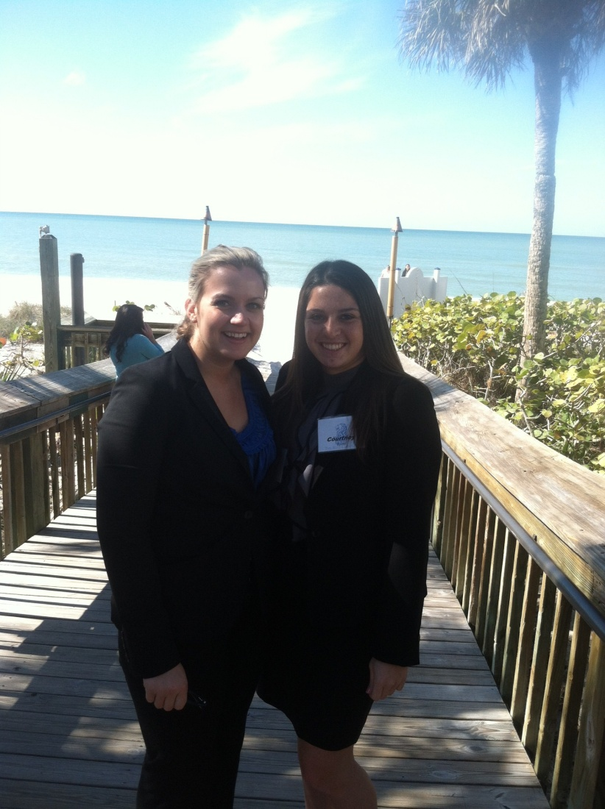
Internships:
Hospitality Management Co-op
Hospitality Management:
Joy Dickerson
Courtney Baron
Claire Maddocks
Notes:
A new era in co-op began in the School of Hospitality Management when Courtney Baron and Claire Maddocks were able to a work full-time co-op at the Ritz Carlton Resort in Naples, Florida while participating in Professor Joy Dickerson’s weekly management seminars held at Widener University's Main Campus via Adobe Connect.
Both Claire and Courtney took rotational positions as rooms interns. They also spent time in the Guest Relations Department and learned about the “Mystique” program. In addition, they got familiar with the Concierge and the Beach Concierge positions. Courtney and Claire also spent time as Recreation Attendants and helped organize and coordinate special amenities and celebration packages for VIP guests. And both students gained experience in the Ritz-Carlton Club Level, housekeeping, and front office.

Slide 16
Capstone Courses and Projects
Capstone Experiences
  A&S – Values Seminar, Senior thesis, senior seminars
  SBA – MGT 452
  Education - INTASC portfolio
  Engineering – Senior Projects
  Social Work – Senior Capstone
  Nursing – clinical intensive
Capstone Assessment Project

Slide 17
Bridgeweek
High-Impact Practices: Sharing What Works
Sharing Undergraduate Research Models
Nursing Freshman Seminars
Internships: Lessons Learned
Clinical/Field Work Experience
Student Writing x2
Scholarship of Diversity
Service-Learning at Widener x2
Challenges of Teaching Diversity

Slide 18
Graduate Programs

Slide 19
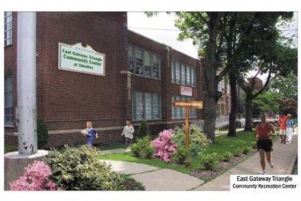
Center for Social Work Education:
East Gateway Triangle Neighborhood
Dr. Marina Barnett, social work
East Gateway Triangle Neighborhood Association
Chester Community Improvement Project
Chester Police Department
Widener Social Work Graduate Students
Notes:
Dr. Marina Barnett, her graduate students from the Center for Social Work Education, in collaboration with the East Gateway Triangle Neighborhood Association, the Chester Community Improvement Project and the Chester Police Department are conducting an assessment of the East Gateway Triangle community.
Widener will use the data collected to apply for a Choice Neighborhoods Planning Grant that supports the development of comprehensive neighborhood revitalization plans.

Slide 20

Graduate Student Collaboration:
Clinical Psychology & Adoption
Co-edited by:
Dr. Virginia Brabender
Chapters by Widener faculty members:
Dr. Hal Shorey
Dr. Sanjay Nath
Dr. Bret Boyer
Dr. Phil Rutter
Dr. Barbara Goldsmith
Research by Widener students:
Dr. Alicia Padovano ’12
Dr. Amanda Swartz ’11
Meridith Carter ’14
Notes:
A new book offering practical tips for parents and mental health professionals in navigating adoption prominently features research by Widener faculty, young alumni, and a current graduate student. Working with Adoptive Parents: Research, Theory, and Therapeutic Interventions was released in June 2013 and is co-edited by Virginia Brabender.

Slide 21
School of Law

Slide 22
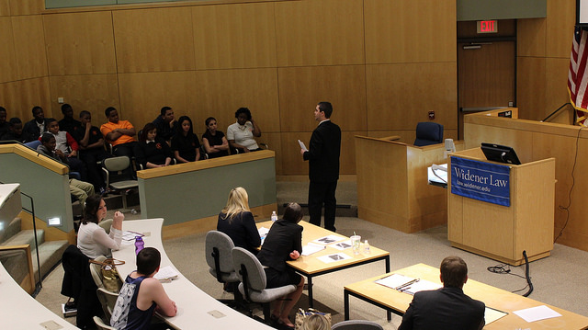
Youth Courts
Faculty:
Francis Catania
Jim May
Sydney Howe-Barksdale
Kathleen Turezyn
10+ law students
Notes:
Youth Courts are student directed alternative discipline systems in schools that focus on restorative justice. Youth Court offers a way to keep students in school and out of the disciplinary system.
The goal of Youth Court is to use positive peer pressure to ensure that young people who have committed minor offenses to pay back the community.
Widener Law students are training middle school students with the idea that they will take the youth court model into high school with them. They train middle school students to act as attorneys, judges, and jurors for their peers with the goal of helping classmates who have committed minor offenses avoid further disciplinary problems. The real benefit of youth court is that it is an educational tool because the students involved learn what a judge, bailiff, and jury do.

Slide 23
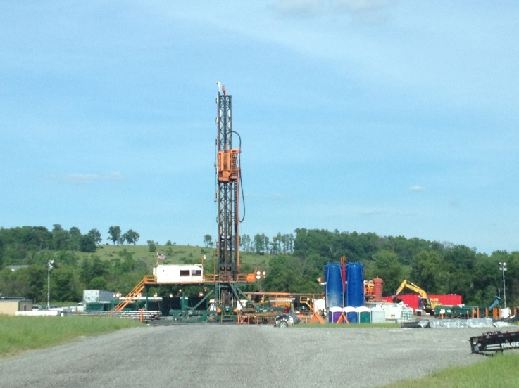
Environmental Law Center:
Marcellus Shale
Faculty:
John Dernbach
Jim May
Ken Kristl
David Hodas
Jill Family
Jean Eggen
Student:
Timothy Bishop, author of the 2012-2013 Widener Law Journal Best Student Article
Notes:
This past fall, the Environmental Law Center hosted a symposium on Marcellus Shale Development and Pennsylvania. Organized by John Dernbach, the symposium brought together environmental law experts from Widener Law and elsewhere to examine natural gas extraction from Pennsylvania’s Marcellus Shale through hydraulic fracturing or “fracking,” and what it means for sustainable development.
Distinguished Professor John C. Dernbach framed the discussion for the day with an overview of just how important and far-reaching the developments in Pennsylvania are for energy, security, and the economy. He observed that the rest of the world can learn from Pennsylvania’s experiences with “fostering sustainability of shale gas production.”
Law student Timothy Bishop delivered the lunchtime address about Modeling Pennsylvania’s Development of Natural Gas After Alaska’s Permanent Fund Dividend.

Slide 24
More Stories

Slide 25
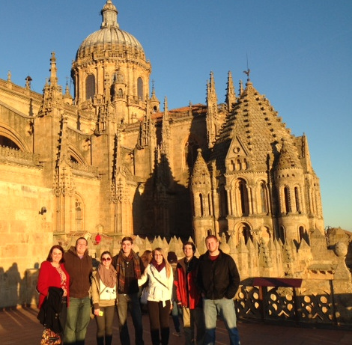
Global Learning:
Marketing in Spain
Business:
Mary Shoemaker
Principles of Marketing Honors Course
Notes:
Six business students spent part of the winter break studying abroad in Spain as part of the Principles of Marketing honors course taught by Dr. Mary Shoemaker, associate professor in the School of Business Administration.
The students traveled to Avila, Madrid, Salamanca, Segovia, and Valladolid during the eight-day trip. Their travels included tours of a ham factory, a technology park, and a food testing and inspection facility. They met and discussed Spain’s business and economic climate with local business leaders.
The course presents marketing from the perspective of an individual manager or firm in the design of a marketing mix, target market selection, environmental assessment, information procurement, and analysis of consumer behavior. It also examines marketing’s interface with society and the ethical responsibilities of managers in a global context, which was the focus of the study abroad excursion.

Slide 26
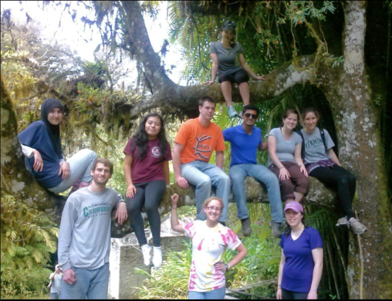
Global Learning:
Honduras
Pat Dyer
Bruce Grant
10 students
Notes:
This is the study abroad group that went to Zamorano University in Tegucigalpa, Honduras, for spring break. The students are 'hanging around' on a mahogany tree where we rested as we traveled back down the mountain in Uyuca Preserve.

Slide 27
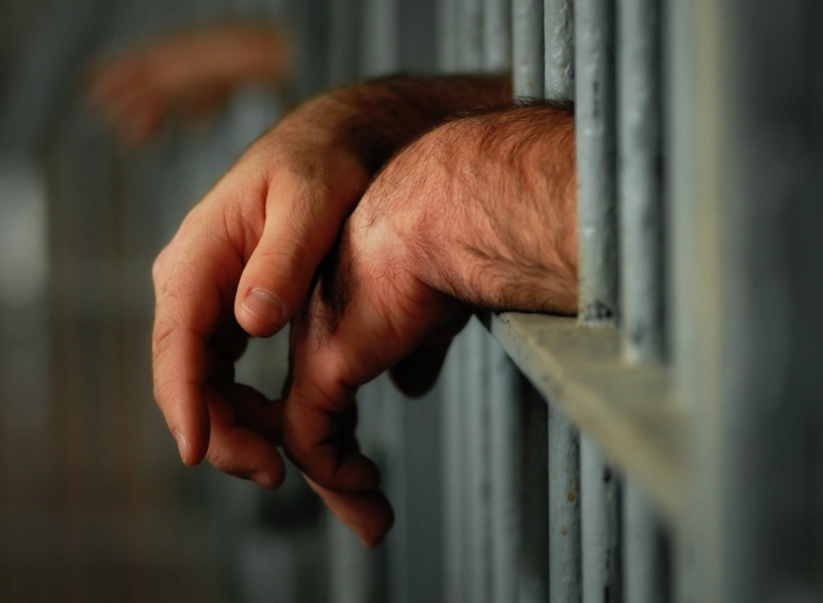
Community Learning:
Prison Writing Anthology
Faculty:
Jayne Thompson
Student:
Emily DeFreitas
Co-edited Letters to My Younger Self
anthology of letters by incarcerated men at Graterford Prison.
Distribution to juvenile offenders as a deterrent to crime
Notes:
This book due out in May consists of letters written by incarcerated men to their younger selves at pivotal moment, for example, when the person made a critical decision to commit a crime and how that affected his life. The aim of the book is to influence juvenile offenders to listen to "the better angels" of their nature and to avoid imprisonment. Any profits from the book will go to its distribution in schools and juvenile detention centers.
Emily, the creating writing major, helped type, edit, and select pieces for inclusion as well as create writing prompts. She wrote a short piece in the forward as well.

Slide 28
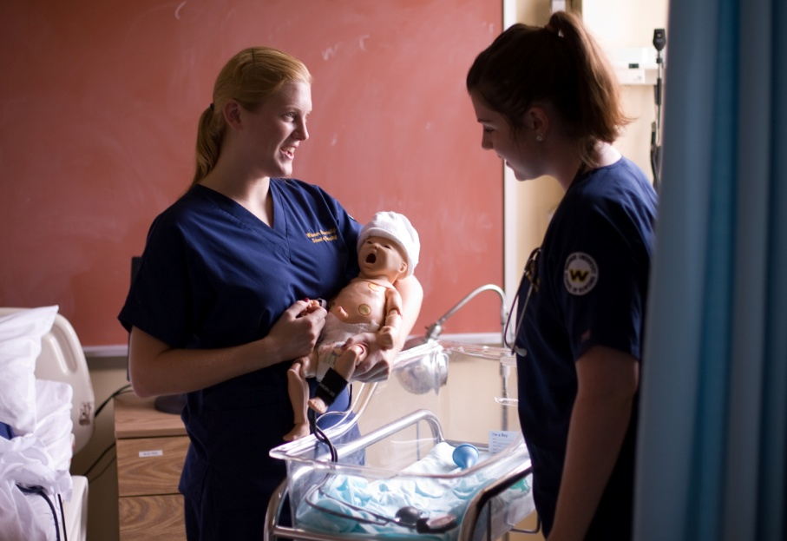
Community Learning:
Nursing: Family Center
Dr. Pamela Williams,
Students in maternity nursing class
Notes:
Dr. Pamela Williams serves as a member of the advisory board for the Family Center that is part of the Delaware County Intermediate Unit. She is working with pregnant teens in Chester to help them stay in school. She took the teens into the Simulation Lab that has the Noelle manikin that delivers a baby. We talked for a long time about pregnancy, labor, and delivery and then they watched as the manikin delivered. Two students in her maternity nursing class helped out and met with the students from the Family Center.
Professor Williams is teaching a nursing elective course on women's health in the fall, and the Family Center will be the site for the students’ service learning. I'm excited for the students to have an opportunity to work with women of all ages within the Family Center and create projects that involve many members of a family.

Slide 29
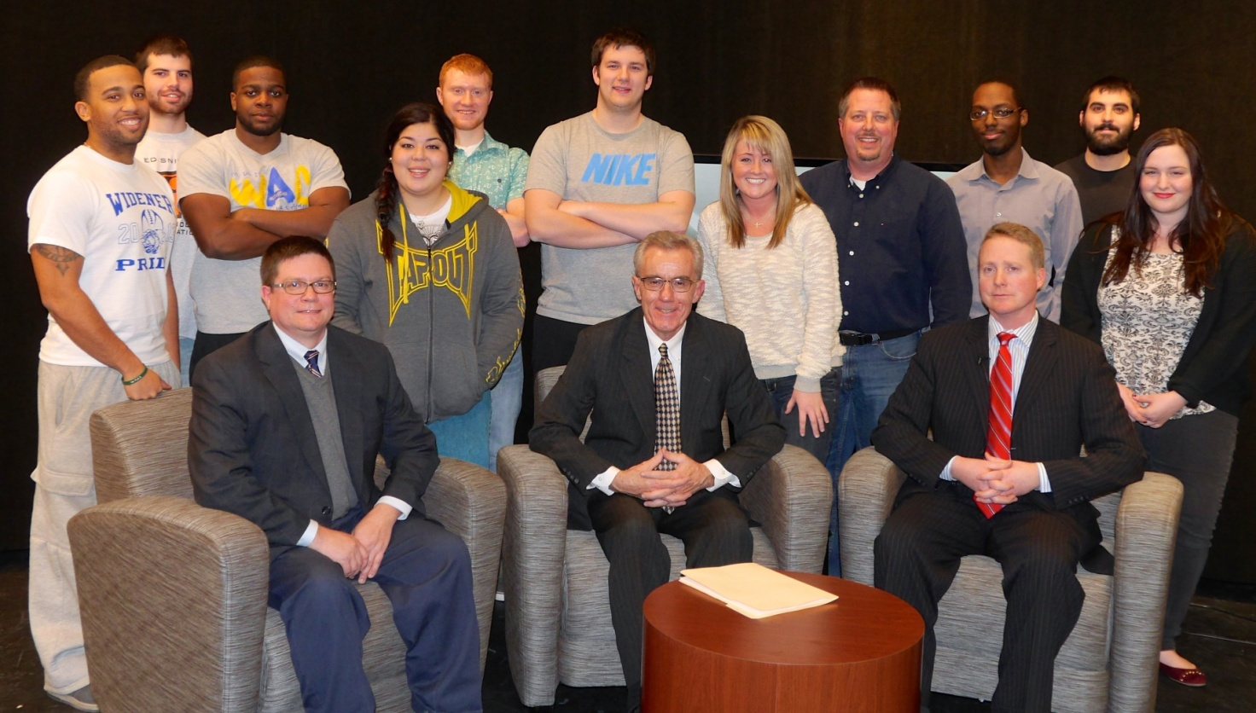
Collaborative Assignments:
Live from the Newsroom
Communications Studies: Tim Scepansky
Political Science: Wesley Leckrone
Notes:
The Communication Studies Program is partnering with the Delaware County Daily Times to broadcast "Live from the Newsroom" from Widener’s new television studio in Freedom Hall once a month.
"Live from the Newsroom" is a weekly 30-minute interview program on issues of interest to Delaware County residents hosted by Daily Times Editor Phil Heron. The program is streamed live through the Daily Times website and also recorded for later viewing.
Widener students are involved in some of the technical aspects of our show, and Widener professors talk about some of the issues of the day. Students also participate in the televised round-table discussions.
Communication students operate the cameras and served as technical engineers for the program.
Communication Studies Senior Lecturer Tim Scepansky is the supervising producer/director for the production of "Live from the Newsroom" at Widener. Scepansky coordinates and directs the students working as the production crew for the show.
In the initial broadcast, Dr. J. Wesley Leckrone, associate professor of political science at Widener and four Widener political science students offered their opinions on the State of the Union address and the political climate in Washington, D.C.

Slide 30
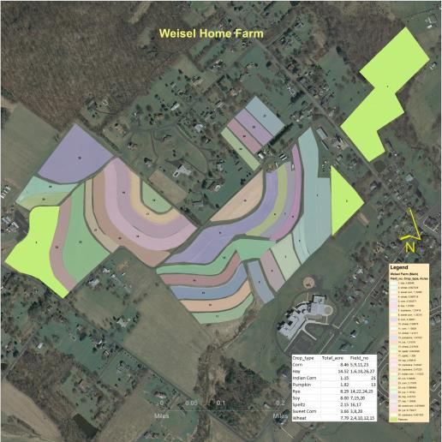
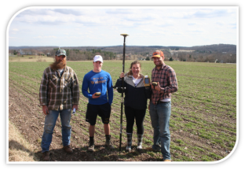
Service Learning:
Geographical Information Systems
ENVR:
Chad Freed
Notes:
Develop an Agricultural Management System using GIS Technology to support a Local Farm
Environmental Benefits
Decrease pesticide application, Decrease herbicide application, Decrease fertilizer application, Increase water quality, Maximize crop production, Facilitate crop rotation

Slide 31

Environmental Science:
Chester Shade Tree Inventory
Dr. Chad Freed ENVR
Students in Advanced
GIS course
Faculty
Notes:
is developing and initiating a model for the design, construction and maintenance of a shade-tree inventory for the city of Chester.
Dr. Chad Freed and his students in Advanced GIS are updating an existing shade-tree database developed by previous environmental science students. The update will include field verification of the location, species and condition of previously mapped shade trees. The creation of a city-wide database of shade tree locations and environmental attributes will assist the Shade Tree Commission in targeting urban forestry planting areas, assist in planning future tree maintenance and provide a base for future grant proposals.

Slide 32
Undergraduate Research:

Slide 33
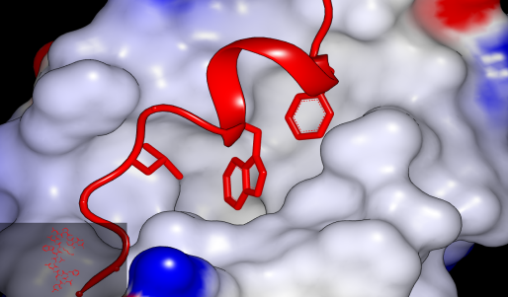
Undergraduate Research:
Cancer Research
Chemical Engineering:
Sachin Patil
Computer Science
Jeff Rufinus
Biomedical engineering student:
Cassidy Kerezsi
Notes:
collaborated with a researcher from the University of Cambridge
on a paper on cancer: “Prospective virtual screening for novel
p53-MDM2 inhibitors using Ultrafast Shape Recognition,”
which was accepted for publication in the peer-reviewed
Journal of Computer-Aided Molecular Design.
took part in this project and is listed as a co-author on this paper.

Slide 34

Clinton Global Initiative
Dr. Itzick Vatnick, biology, and Nicole Gilette, '16, the effects of herbicides on aquatic ecosystems.
Dr. Krishna Bhat, chemistry, and Margaret Karmeris, '15, green, inexpensive synthesis of derivatives of Resveratrol.
Dr. Steve Madigosky, environmental science, and Ben MacLuckie, '16, effects between global warming and the cultivation of coffee.
Dr. Chad Freed , environmental science, and Elisabeth Powell, '14, spatial and temporal landscape changes from Marcellus Shale gas mining.
Megan Pifer, education, and Karley Riffe, doctoral student in Higher Education Leadership, analysis of scholarly literature on the experiences of female faculty in higher education.
Notes:
Widener recently became the first university in the region to join the Clinton Global Initiative University (CGI University) Network. This consortium, founded by former President Bill Clinton, provides support and funding to students who are committed to developing solutions for some of the world’s most pressing challenges.
Widener students were invited to develop a plan that addresses an issue at Widener, the community, or around the world and relates to one of five focus areas: education, environment and climate change, peace and human rights, poverty alleviation, or public health.
Five student projects are currently underway. Widener is providing a minimum of $10,000 from an endowment fund to be divided among the students selected to pursue their "Commitments to Action.“
One of the projects is led by a graduate student. Dr. Megan Pifer, assistant professor of higher education, is working with Karley Riffe, a graduate student in the doctoral program in Higher Education Leadership, to conduct an extensive content analysis of the scholarly literature about the professional and personal experiences of female faculty members in higher education.
The university also mentors the student "commitment-makers" as they implement their plans. Each project has a faculty sponsor.
As a member of the Clinton Global Initiative, Widener is committed to an evaluation each year to ensure it is constantly moving in a direction to pursue global engagement. The university is also committed to annually nominating students to attend CGI University, which is a way for students to showcase their research.

Slide 35
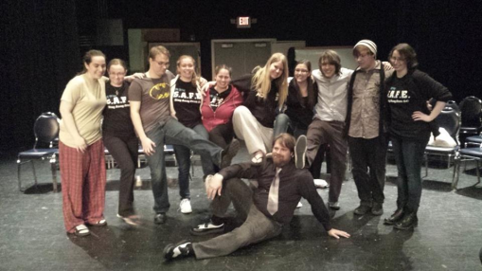
Lone Brick Theater Company
Renaissance Festival
Distracted
The Legend of Sleepy Hollow
Robin Hood

Slide 36
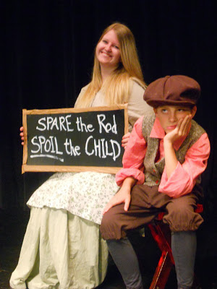
FreshBaked Theater
Started in 2001
Lisa Cocchiarale
$1000 for food pantry

Slide 37
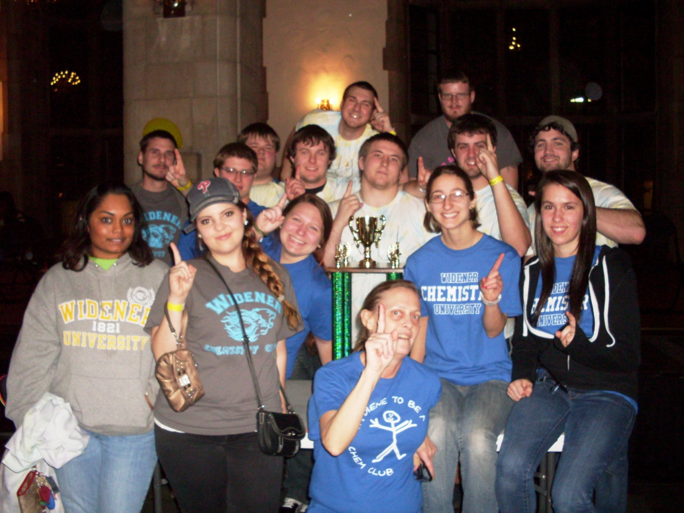
Chem Wars

Slide 38
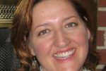
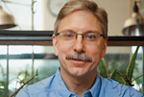
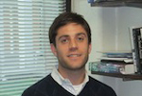
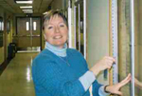
Faculty Awards for Commitment to Students
Dr. Alexis Nagengast, chemistry and biochemistry
Braude Award from the Maryland chapter of the American
Chemical Society for undergraduate research.
Dr. Stephen R. Madigosky, environmental science
Lindback Foundation Award for Distinguished Teaching
Dr. Ross B. Steinman, psychology
College of Arts and Sciences Faculty Award for Excellence in Teaching
Dr. Andrea Martin, chemistry
Ronald T. Pflaum Outstanding Chapter Advisor Award
for work with Widener chapter of the Alpha Chi Sigma National Chemistry Fraternity.
Notes:
Dr. Steinman mentors students in their research projects and involves students in his research about consumer behavior and choice.

Slide 39
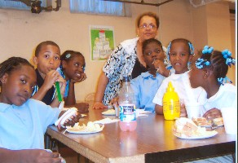
Undergraduate Research:
Assessment of Camp Programs for Chester Eastside Ministries
Psychology:
Lori Simon
Sociology:
Stuart Eimer
Notes:
Drs. Simon and Eimer are partnering with Chester Eastside Ministries to conduct an assessment of the organization's after-school and summer camp programs.
The data from the assessment will be used for program development and to help acquire grants. Widener student are acting as research assistants in the project.

Slide 40
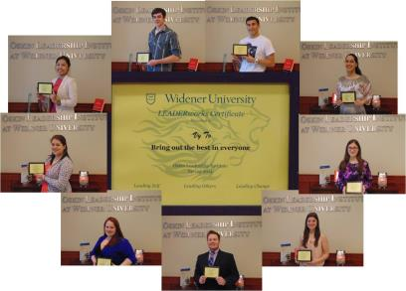
Leadership Certificates
· We offered 158 leadership workshops in 2013- 2014
· 69 workshops were reserved; 89 open
· 595 students participated in at least one workshop
· 1,340 Post-Workshop Reflections were written
· 20 different workshop themes were offered
· 11 different facilitators
· 9 students received their Leadership Certificate
Notes:
· We offered 158 leadership workshops in 2013- 2014
· 69 workshops were reserved; 89 open
· 595 students participated in at least one workshop
· 1,340 Post-Workshop Reflections were written
· 20 different workshop themes were offered
· 11 different facilitators
· 9 students received their Leadership Certificate

